Slide 1
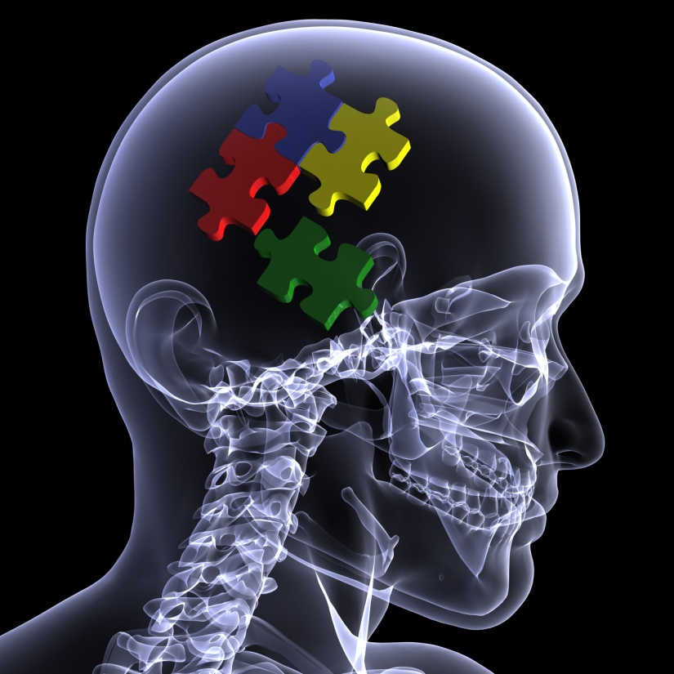
MTI²
Jim Meadows

Slide 2
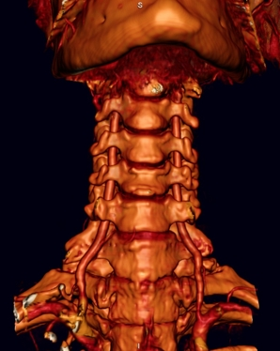
Vertebral Artery
Anatomy

Slide 3
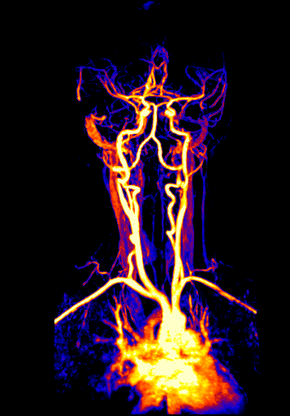
Two systems: carotid and vertebrobasilar
Internal carotid forms the middle cerebral artery that supplies the fore brain
Vertebral and basilar arteries that supply the hind brain
Both systems typically arise from the subclavian arteries as the common carotid and vertebral arteries

Slide 4
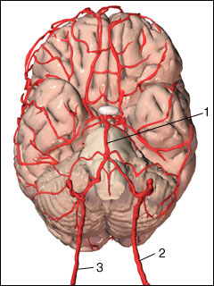
# 2 and 3 are the right and left vertebral arteries
# 1 is the basilar
# 4 is the middle cerebral
# 5 is the anterior cerebral
They anastomose at the circle of Willis
5
4

Slide 5
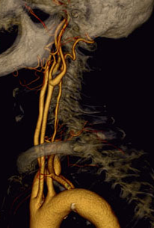
The vertebral artery is in 4 parts
V1 or the Osteal
V2 or the transverse
V3 or the Sub-occipital
V4 or the intracranial
V4: foramen magnum -> basilar
V3: C2 -> foramen magnum
V2: C6 -> C2
V1: Subclavian -> C6

Slide 6
L. Common Carotid
V1 or Osteal Portion
L. Vertebral
From the subclavian artery (96%) to C6 foramen (89%)
A lot of slack in the artery to allow for large range of motion
Branches: none
L. Subclavian
L. Aortic Arch

Slide 7
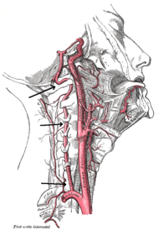
V2 or Transverse Portion
C6 (90%) to C2 transverse foraminae
Periosteal sheath
Average diameter 4mm and the canal 6mm
Boundaries of the canal are: anterior longus collis; lateral the scalenes; posterior the joints and capsules medial the vertebral body
Branches: radicular

Slide 8
V3 or Suboccipital Portion
C2 transverse foramen magnum
Goes through many directional changes in this portion
Branches: osseomuscular

Slide 9
V4 or Intracranial Portion
Foramen magnum to basilar a.
Branches: anterior spinal, posterior inferior cerebellar , medullary and osseomeningeal
Posterior infereior cerebellar a
Anterior spinal a
Vertebral a

Slide 10
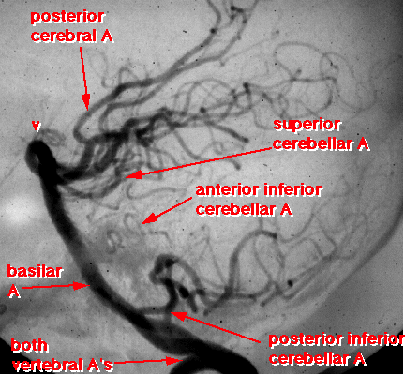
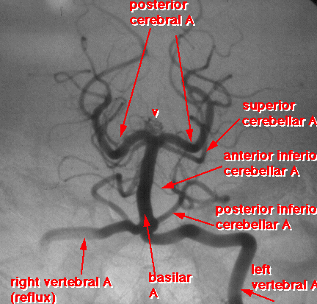
Basilar Artery
Formed by the union of both vertebral arteries at the lower border of the pons it terminates forming both posterior cerebral arteries
Branches: pontine, labyrinthine, anterior inferior cerebellar, superior cerebellar, posterior cerebellar

Slide 11
Circle of Willis
The posterior cerebral a. generates the posterior communicating a which communicates with the middle cerebral, whicher generates the anterior cerebral a. to form the circle of Willis.
It is a system designed to shunt blood back and forth between the fore and hind brain circulatory systems.

Slide 12
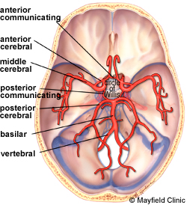
Circle of Willis
While the previous diagram depicts the system as vertical this image shows it as horizontal with the base of the brain lying on top.
The four arteries at the bottom of the picture are the larger carotids and the smaller vertebrals just before they unite to form the basilar
The two arteries at the top are the anterior cerebral arteries

Slide 13
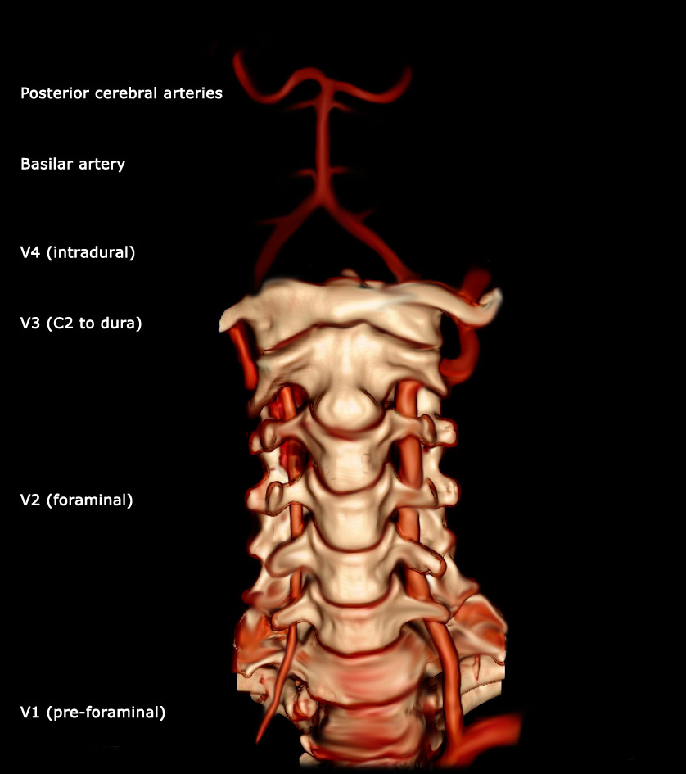
Vertebrobasilar System

Slide 14
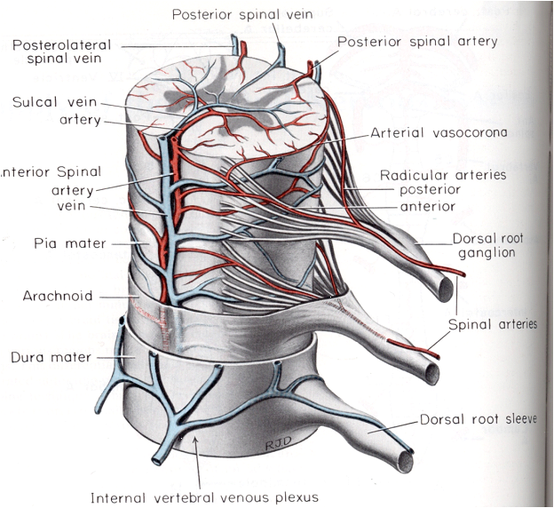
Spinal Cord Vascularization
The cervical cord is supplied by the anterior, posterior and radicular arteries
The radicular is from the vertebral , it splits into two and runs with and supplies the roots to anastomose with the anterior and posterior spinals

Slide 15
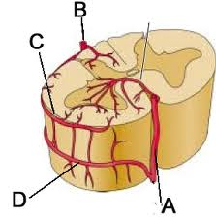
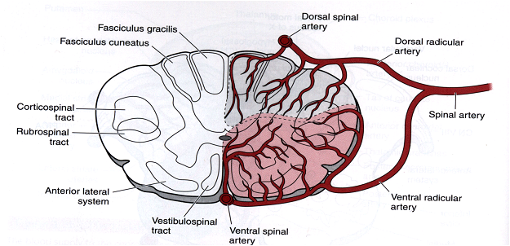
Spinal Cord Vascularization
The anterior or sulcal artery is generated from the two vertebrals (V4) and runs down the anterior spinal sulcus
The posterior spinal(s) arteries comes from the PICA (highly variable) and runs down medial to the posterior root
There is a watershed area between the anterior and posterior spinal arteries

Slide 16
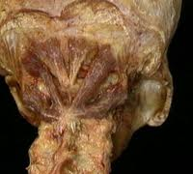
Branches & Vascularized Areas
V1: none
V2: radicular
Spinal nerve
Spinal roots
Dural sheaths
Spinal meninges
Anterior and lateral spinal cord
V3: osseomuscular
Atlas and axis
Posterior suboccipital mm

Slide 17
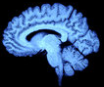
V4:
Anterior spinal sulcal)
PICA
Medula
Cerebellum
Posterior spinal
Posterior roots
Posterior cord

Slide 18
Basilar
AICA
Cerebellum
Superior cerebellar
Cerebellum
Labyrinthine
8th nerve
Membranous labyrinth
Pontine
Pons and midbrain
Posterior cerebral
Posterior communicating
Calcerine radiation (calcerine a)
Visual cortex (calcerine a)
Wernike’s area (temporal)
Thalamus (thalamic or central)

Slide 19
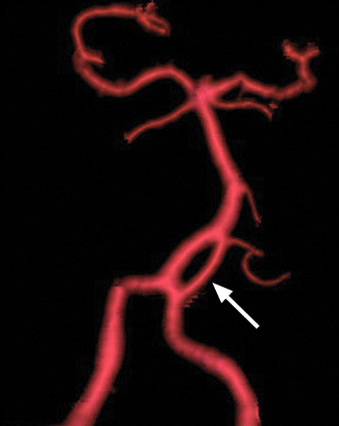
Anomalies

Slide 20
Portion Anomalies
V1:
Left origin off aorta rather than subclavian
Origin off underside of subclavian
V2:
Entry into transverse foramen at other than C6 (10%)
# of radicular arteries (rarely one for each level)

Slide 21
Portion Anomalies
V3:
Looping of the artery around the posterior arch of atlas (proatlanteal a.)
Ossification of the restraining ligament at the atlas with stenosis of the artery
V4:
Various branch anomalies
Atretic artery (L>R)

Slide 22
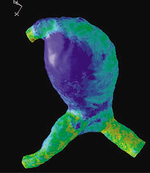
System Anomalies
Unequal in size
Unilateral Absence
Bilateral Absence
Hypoplastic
Fibromuscular Dysplasia
Aneurysm

Slide 23
Unequal Size
Only 40% of the population have equal sized arteries. In cases of a symmetry the larger is call dominant and smaller minor.
The slide shows a left minor artery

Slide 24
Hypoplastic
An artery less than 1mm in diameter is insignificant and termed hypoplastic

Slide 25
Absence
Absence of the artery can be unilateral or bilateral
Bilateral absence is really persistence of segmental fetal arteries and blood flow is maintained
Unilateral absence as seen in this slide is a potentially dangerous condition

Slide 26
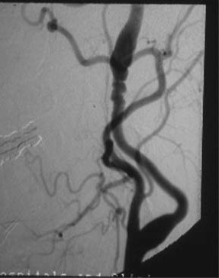
Fibromuscular Dysplasia
Areas of vessel wall weakness alternating with normal
Produces what are essentially serial aneurysms

Slide 27
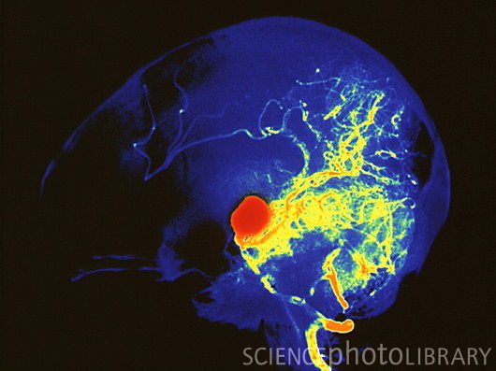
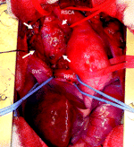
Aneurysm
Effects depend on size and location and are usually associated with hypertension

Slide 28
