Slide 1
A Clinician’s Appreciation of Evidence Based Practice
Jim Meadows

Slide 2
Science and Physical Therapy

Slide 3
All science is either physics or stamp collecting.
Ernest Rutherford (1871-1937)

Slide 4
"IT HAS LONG BEEN KNOWN"...I didn't look up the original reference.
"WHILE IT HAS NOT BEEN POSSIBLE TO PROVIDE DEFINITE ANSWERS TO THESE QUESTIONS"...An unsuccessful experiment, but I still hope to get it published.
"THREE OF THE SAMPLES WERE CHOSEN FOR DETAILED STUDY"... The results of the others did not make any sense.
"TYPICAL RESULTS ARE SHOWN"...This is the prettiest graph.

Slide 6
If a man is offered a fact which goes against his instincts, he will scrutinize it closely, and unless the evidence is overwhelming, he will refuse to believe it. If on the other hand he is offered something which affords a reason for acting in accordance to his instincts, he will accept it even on the slightest evidence.. Bertrand Russell

Slide 7
Definitions
If we are claiming to be a scientific profession then we should be as precise as possible in everything including language so some definitions.
More or less.

Slide 8
Evidence
information or signs indicating whether a belief or proposition is true or valid.
Latin: evidentia meaning obvious to the mind or eye
OED

Slide 9
Fact
An observation.
.

Slide 10
Proof
Supporting evidence for a theory or hypothesis
.

Slide 11
Scientific Principle
A self-evident universally accepted truth, an axiom.
It does not require proof and is often an assumption.

Slide 12
Scientific Principle
Examples
Nothing travels faster than light.
The fittest survive to transmit their genes
Heisenberg Uncertainty Principle

Slide 13
Scientific Principle
??Examples in PT
Stretching before an event reduces injuries
If a muscle is weak it must be strengthened if tight it must be stretched
Evidence Based Practice is better than the previous method of practice

Slide 14
Scientific Law
“This is a statement of fact meant to explain, in concise terms, an action or set of actions. It is generally accepted to be true and universal, and can sometimes be expressed in terms of a single mathematical equation. They are accepted at face value based upon the fact that they have always been observed to be true.

Slide 15
Scientific Law
Laws tend to be very limited and do not explain how a phenomenon occurs or exists just how it behaves.

Slide 16
Scientific Law Example
Newton’s 1st. Law of Motion
For every action there is an equal and opposite reaction.
The Law of Approximation
When a muscle contracts it tends to bring its attachments closer together.

Slide 17
Theory
The term theory in the scientific sense is the complete opposite of how the word is used in every day conversation.

Slide 18
Theory
“A scientific theory is an established and experimentally verified fact or collection of facts about the world.”

Slide 19
Theory
“a model or idea that has undergone testing or validation from careful observations and can be used to make a variety of predictions of what will happen under different circumstances.”
“An explanation for some phenomenon that is based on observation, experimentation, and reasoning.

Slide 20
Theory
“A comprehensive explanation of a given set of data that has been repeatedly confirmed by observation and experimentation and has gained general acceptance within the scientific community but has not yet been decisively proven.”

Slide 21
Theory Operational Definition
Is compatible with the evidence
Is internally consistent
Is based upon evidence
Has been successfully tested against a wide range of observations
Is predictive
It is potentially falsifiable

Slide 22
Scientific Law and Theory
“The biggest difference between a law and a theory is that a theory is much more complex and dynamic. A law governs a single action, whereas a theory explains a whole series of related phenomena.”

Slide 23
Hypothesis
“This is an educated guess based upon observation. It is a rational explanation of a single event or phenomenon based upon what is observed, but which has not been proved. Most hypotheses can be supported or refuted by experimentation or continued observation.”

Slide 24
Hypothesis
“a statement of a possible explanation for some natural phenomenon. A hypothesis is tested by drawing conclusions from it; if observation and experimentation show a conclusion to be false, the hypothesis must be false.”

Slide 25
Model
“A scientific model is simply an idea that allows us to create
explanations of how we think some part of the world works.”
“A simplified view of reality that allows the user to focus on fundamental processes.”

Slide 26
Model
It is not the truth and in fact the truth may never be known but it provides a working framework for the development of hypotheses, experiments, theories and techniques and expectations.

Slide 27
Model
A good model has the following characteristics:
explain facts (observations)
predicts new data
Is consistent with other knowledge

Slide 28
Examples of a Model
The chemist’s concept of the atom.
The physicist’s concept of the electron being particle-like and wave-like
My mother-in-law’s concept of how a son-in-law should behave

Slide 29
The Requirements for a Model of Mechanical Low Back Pain
The model must explain the following average clinical presentation that includes:
Short term episodes
Minor triggers
ROM limitation during episode
Full but abnormal ROM between episodes
Minor restriction of function

Slide 30
Mechanical Low Back Pain Models
Segmental Instability
Subluxation
Neurophysiological
Phase Transition

Slide 31
"IN MY EXPERIENCE"...Once.
"IN CASE AFTER CASE"...Twice.
"IN A SERIES OF CASES"...Thrice.

Slide 33
What is Evidence Based Practice
“….include precisely defining a patient problem, and what information is required to resolve the problem; conducting an efficient search of the literature; selecting the best of the relevant studies, and applying rules of evidence to determine their validity [3]; being able to present to colleagues in a succinct fashion the content of the article, and its strengths and weaknesses; extracting the clinical message, and applying it to the patient problem. We will refer to this process as the "critical appraisal exercise."

Slide 34
Types of Evidence
Criterion
Construct
Face
Content
Metanalysis
Opinion
Experiential

Slide 35
Criterion Used to demonstrate the accuracy of a measuring procedure or device by comparing it with another procedure which has been demonstrated to be valid
The most useful afford sensitivity and specificity values

Slide 36
Construct
The ability to measure an abstract concept or
The agreement between a theoretical concept and a specific measuring device, such as observation.
e.g. It is observed that a single manipulation based on the examination relieves a patient’s pain and improves motion, confirms the thinking behind the examination of the patient

Slide 37
Face
Does it make sense

Slide 38
Content
Does it measure all aspects

Slide 39
Reporting Information

Slide 40
Single Study Report
Reports the results of one investigation
Basis for systemic reviews and metanalysis
May suffer from power issues
Investigator’s bias may be an issue
Investigators methodology and/or statistics may be flawed
Conclusions may be inappropriate for the results

Slide 41
Systematic Review
High-quality systematic reviews take great care to find all
relevant studies published and unpublished, assess each
study, synthesise the findings from individual studies
in an unbiased way and present a balanced and
impartial summary of the findings with due
consideration of any flaws in the evidence.

Slide 42
Systematic Review
“Not all published systematic reviews have been produced
with meticulous care – therefore the findings may
sometimes mislead. Interrogating published reports
by asking a series of questions can uncover
deficiencies.”
Davis, HTO. Crombie, IK.
www.evidence-based-medicine.co.uk

Slide 43
Metanalysis
Statistically combines individual studies’ effect sizes are combined to give a common estimate of the overall size of the effect of the intervention (effect size).
Group means differences/average standard deviation
High effect size 0.8 or higher
Moderate effect size 0.5
Small effect size 0.2

Slide 44
Advantages/Disadvantages
Improves power and effectively utilizes studies with Type 2 error
Resolves conflicting results
Demonstrates small but important effects
Is time efficient for the consumer
Reviewer’s bias may be an issue

Slide 45
Experiential
Case Studies
Case Reports

Slide 46
Statistics
"ACCORDING TO STATISTICAL ANALYSIS“ ...Rumor has it.
"A STATISTICALLY ORIENTED PROJECTION OF THE SIGNIFICANCE OF THESE FINDINGS“
...A wild guess.

Slide 47
Statistics
A descriptive statistic (in the count noun sense) is a summary that quantitatively describes or summarizes features of a collection of information, while descriptive statistics (in the non-count sense) is the process of using and analyzing those statistics..

Slide 49
If you like, descriptive statistics summarizes the sample:
Size of n
Central tendency (mean, mode, average)
Variation (standard deviation)

Slide 50
Statistics
Because of the complexity of modern statistics and the fact that new developments are constantly underway, unless you are expertly trained in inferential statistics, that is a specialist, you really are at the mercy of the authors and of the peer review process. Neither gets really good ratings from many systemic reviews.

Slide 51
Statistically the average American has one testicle, half a penis, half a uterus and less than two legs!
Yes I changed the quote, live with it.

Slide 52
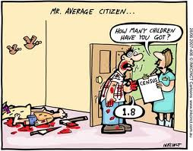
Remember that you are not treating a statistic and that those patients (some 30%) who live outside 1 standard deviation or even the 1% who are outside 3 standard deviations should not be dismissed because they are not almost average.

Slide 53
Averages suck in clinical physical therapy. The chances of you meeting an average patient is just about nil, but you are led to believe that he/she is out there and will certainly enter your care more commonly than the non-average.

Slide 54
In short treat the patient not the statistics. They are individuals and deserve to be considered as such.

Slide 55
Authority
“It is believed that”...I think.
“It is generally believed that”...A couple of other guys think so too.
Anyone who conducts an argument by appealing to authority is not using his intelligence; he is just using his memory.
Leonardo da Vinci

Slide 56
Authority
As soon as we abandon our own reason, and are content to rely upon authority, there is no end to our troubles.
Bertrand Russell
An expert is one who knows more and more about less and less.
Nicholas Murray Butler

Slide 57
Authority
Authority should equal expertise and expertise can be difficult to evaluate.
Beware of self-proclaimed experts and those that have never uttered the words “I don’t know” or “that’s weird”.
Doubt is a defining characteristic of an expert and 100% confidence is a defining characteristic or an incompetent

Slide 58
Part 2 A Paradigm Shift?
Based on Users' Guides to Evidence-based Medicine and reproduced with permission from JAMA. (1992 Nov 4;268(17):2420-5)

Slide 59
The Old Paradigm
Unsystematic observations from clinical experience are a valid way of building and maintaining one's knowledge about patient prognosis, the value of diagnostic tests, and the efficacy of treatment.
The study and understanding of basic mechanisms of disease and pathophysiologic principles is a sufficient guide for clinical practice.

Slide 60
A combination of thorough traditional medical training and common sense is sufficient to allow one to evaluate new tests and treatment.
Content expertise and clinical experience are a sufficient base from which to generate valid guidelines for clinical practice.

Slide 61
The New Paradigm
Clinical experience, and the development of clinical instincts (particularly with respect to diagnosis), are crucial and necessary parts of becoming a competent physician.
At the same time, systematic attempts to record observations in a reproducible and unbiased fashion markedly increase the confidence one can have in knowledge about patient prognosis, the value of diagnostic tests, and the efficacy of treatment.

Slide 62
In the absence of systematic observation one must be cautious in the interpretation of information derived from clinical experience and intuition, for it may at times be misleading.

Slide 63
The study and understanding of basic mechanisms of disease are necessary but insufficient guides for clinical practice. The rationales for diagnosis and treatment which follow from basic pathophysiologic principles may in fact be incorrect, leading to inaccurate predictions about the performance of diagnostic tests and the efficacy of treatments.
Understanding certain rules of evidence is necessary to correctly interpret literature on causation, prognosis, diagnostic tests, and treatment strategy.

Slide 64
Assessing the Evidence

Slide 65
It is worth noting and poetically ironic that there is no hard scientific evidence for evidence based practice just a belief that it is better.
But based on another axiom that more information is better than less we shall assume that in principle, that is we believe that evidence based practice is more efficacious than non-evidence based practice and go from there.
We have to assess the evidence.

Slide 66
The Literature

Slide 67
Obtaining the Paper
Get acquainted with the internet and pick a favorite search engine
Pick a citation source such as PubMed for primary articles and Cochrane for secondary sources such as systemic reviews

Slide 68
Know your target question or topic going in and be as specific as possible
Understand Boolean or fuzzy logic and what works best for you
Do not get side tracked, if you find interesting information that is unconnected with your target question make a note but leave it until later

Slide 69
Unless you have access to full text documents you will have to initially assess the abstracts
Read the abstract for relevance and print it out if it is of interest
Obtain the full text article either from the source (expensive) or by a visit to the local medical library

Slide 70
Read it critically especially the methodology and the results
Assess the conclusion

Slide 71
Assessing the Literature
Larger-scale studies should be weighted more heavily than smaller-scale studies
Randomized trials more heavily than observation studies
Rigorously designed trials more heavily than studies that may be biased.

Slide 72
Assessing the Literature
It should be relevant and significant
It should make sense
The results should be understandable
The conclusions should reflect the results

Slide 73
Publication Problems
The sheer mass of published materials and limited time
The resistance to publish studies with negative results or low statistical significance
The resistance to publish case reports and similar information articles that are not experimental
The often poor quality of the peer reviewed published articles
Author bias

Slide 74
Publication Problems
Most problems with published scientific articles falls under the following categories:
Failure to document adequately the statistics used
Misleading, out of date or inappropriate statistics
Type 2 error (low sample size)
Conclusion inappropriate for the results

Slide 75
An analysis of 300 randomly drawn orthopaedic spine articles, published between 1970 and 1990, was performed to assess the quality of biostatistical testing and research design reported in the literature. Of the 300 articles, 269 dealt with topics of an experimental nature, while 31 documented descriptive studies. Statistical deficiencies were identified in 54.0% of the total articles. Conclusions drawn as the result of misleading significance values occurred in 124 experimental studies (46%) while 96 failed to document the form of analysis chosen (35.7%). Statistical testing was not documented in 34 studies (12.6%), while 20 (7.4%) employed analyses considered inappropriate for the specific design structure.
Vrbos, L. A.Spine 18(8):1021-29 1993

Slide 76
A literature search was conducted of MED-LINE, PubMed, and Cochrane databases, using the key words of "spine" and "surgery" between 1967 and 2002. Trials were included if they were of a 2-group randomized controlled trial design, which reported a nonsignificant difference in the primary outcome. The frequency of reporting the primary outcome and sample size calculation was determined. The sample size was assessed to determine whether the trial had sufficient patients to detect a 10%, 25%, and 35% relative difference in the primary outcome for a power of 80%.
Type II error in the spine surgical literature. Bailey, CS. Spine 20(10): 1146-9, 2004

Slide 77
A total of 37 studies satisfied the inclusion criteria. Six studies reported a sample size calculation (17%). Of the remaining 31 studies, 5 explicitly stated a primary outcome (14%). The mean type II error (beta error) was 82%. CONCLUSION: The spine surgical literature is plagued with a high potential for type II error. A trial's methodology should be scrutinized to prevent misinterpretation of the results.

Slide 78
All descriptive or explanatory original articles published in the five-year period of 1996 through 2000 were reviewed in three (South American) journals:
CONCLUSIONS: Our results indicate the lack of compliance by authors and editors with accepted standards for the use of tests of statistical significance. The findings also highlight that the stagnant use of these tests continues to be a common practice in the scientific literature.
Tests of statistical significance in three biomedical journals: a critical review Sarria Castro, M. Rev Panam Salud Publica 15(5):300-6, 2004

Slide 79
The study was confined to English language articles published from 1975 through 1993. Of more than 4,000 LBP citations, more than 500 were chosen for review. Of that number, 35 articles met the selection criteria of randomization, reasonable controls, and work return comparisons. This paper focuses on the 10 articles relating to interventions for acute (less than 4 weeks) LBP, and considers bed rest, exercise, spinal manipulation, back school, and case management. A 26-point quality system was used to compare the methodologic rigor of each article.
Randomized controlled trials in industrial low back pain relating to return to work. Part 1. Acute interventions. Sheer, SJ. Arch Phys Med Rehabil. 76(10):966-73, 1995

Slide 80
This literature survey demonstrated the meager scientific foundations on which our industrial rehabilitation programs are based.

Slide 81
The WHO Collaborating Centre for Neurotrauma Task Force on Mild Traumatic Brain Injury performed a comprehensive search and critical review of the literature published between 1980 and 2002 to assemble the best evidence on the epidemiology, diagnosis, prognosis and treatment of mild traumatic brain injury.
Systematic search and review procedures: results of the WHO Collaborating Centre Task Force on Mild Traumatic Brain Injury. Carroll, L. J. J Rehabil Med 43 Suppl 11-14, 2004

Slide 82
We identified 38,806 citations, of which 671 studies were judged relevant to the mandate of the task force. These, plus 70 studies found by hand-searching reference lists and 2 original research reports performed as part of the task force mandate were subjected to critical reviews. After review, 313 (42%) were accepted on scientific merit and comprise our best-evidence synthesis.
That means that 58% were below par!

Slide 83
Metanalysis
We searched MEDLINE (from January1,1997,to September 1, 2002) and reference lists and solicited general surgery specialists to identify relevant meta-analyses. Inclusion criteria were use of meta-analytic methods to pool the results of primary studies in general surgery on issues of diagnosis, causation, prognosis, or treatment. 51 meta-analyses fulfilled eligibility criteria.
Evaluating meta-analyses in the general surgical literature: a critical appraisal. Dixon, E. Ann Surg. 241(3):450-9, 2005

Slide 84
Metanalysis
This critical appraisal of meta-analyses published in the general surgery literature demonstrates frequent methodologic flaws. The quality of these reports limits the validity of the findings and the inferences that can be made about the primary studies reviewed. To improve the quality of future meta-analyses, we recommend following guidelines for the optimal conduct and reporting of meta-analyses in general surgery.
Ann. Surg. 2005 Mar;241(3):450-9. Evaluating meta-analyses in the general surgical literature: a critical appraisal. Dixon, E. et al.

Slide 85
Systematic Reviews
Of the 2331 articles published across the fifteen journals in the year 2000, 110 were review articles. Only seventeen (15%) of the 110 reviews met our criteria for systematic reviews with rigor. Rigorous systematic reviews received more than twice the mean number of citations compared with other systematic or narrative reviews (13.8 compared with 6.0, p = 0.008). The rigor of a review was a significant predictor of the number of citations in other orthopaedic journals (p = 0.01). In addition, rigor was significantly associated with the number of citations in nonorthopaedic journals (p = 0.03).
Doubling the impact: publication of systematic review articles in orthopaedic journals Bhandari, M. J Joint Bone Surg 86A(5): 210-16, 2004

Slide 86
Almost 2 decades ago, it was pointed out that physical therapists tended to overlook the tenuous nature of the scientific basis for the use of therapeutic ultrasound. The purpose of this review is to examine the literature regarding the biophysical effects of therapeutic ultrasound to determine whether these effects may be considered sufficient to provide a reason (biological rationale) for the use of insonation for the treatment of people with pain and soft tissue injury.
A review of therapeutic ultrasound: biophysical effects. Baker, KG. Phys Ther 81(7): 1351-8, 2001

Slide 87
The frequently described biophysical effects of ultrasound either do not occur in vivo under therapeutic conditions or have not been proven to have a clinical effect under these conditions. This review reveals that there is currently insufficient biophysical evidence to provide a scientific foundation for the clinical use of therapeutic ultrasound for the treatment of people with pain and soft tissue injury.

Slide 88
Two Results and Conclusions
The most frequently found flaws were inadequate study size, nonrepresentative study sample, nonrepresentative crash conditions (for crash tests), and inappropriate study design.
The most frequent concerns reside with sampling, experimental design and interpretation of data.

Slide 89
Two Results and Conclusions
As a result of the current literature review, it was determined that there is no epidemiologic or scientific basis in the literature for the following statements: whiplash injuries do not lead to chronic pain, rear impact collisions that do not result in vehicle damage are unlikely to cause injury, and whiplash trauma is biomechanically comparable with common movements of daily living.
These articles contradict scientific measures and efforts which show that for Quebec Task Force Grade 1 and 2 whiplash-associated disorders, the highly prevalent problem of chronic pain may be a culturally and psychosocially determined phenomenon, in which confounding psychosocial variables determine the behaviour and outcome following an otherwise benign acute injury.

Slide 90
Two Results and Conclusions
A review and methodologic critique of the literature supporting 'chronic whiplash injury': part I - research articles. Kwan, O. Med Sci Monit 9(8), 2003
A review and methodologic critique of the literature refuting whiplash syndrome Freeman, MD. Spine 24(1) 1999

Slide 91
Critically Reading Case Reports/Studies Case Introduction
Is there adequate explanation for reporting this case
Are there adequate citations to substantiate the report
From Guidebook to Better Medical Writing. Iles, R.L. http://www.medwriting.com/index.html

Slide 92
Case Description
Is there adequate description of the case
Is the case description clear
Are the examination results clearly described
Are other investigations clearly described with normal values

Slide 93
Discussion, Comment
Is the diagnosis supported by the evidence offered by the author
Is the treatment and prognosis supported by the evidence offered by the author
Are other differential diagnoses and treatments refuted by the evidence offered
Does the author suggest improvements in the examination and/or treatment procedures for similar cases

Slide 94
Experts
An expert is a man who has made all the mistakes which can be made, in a narrow field.
Niels Bohr
True intuitive expertise is learned from prolonged experience with good feedback on mistakes.
Daniel Kahneman
I have expertise in five different fields….
Philip Emeagwali
A claim such as this needs to critically evaluated. In this case it is to a large part true but as often as not it will be, to be kind, exaggerated. JM

Slide 95
The Expert

Slide 96
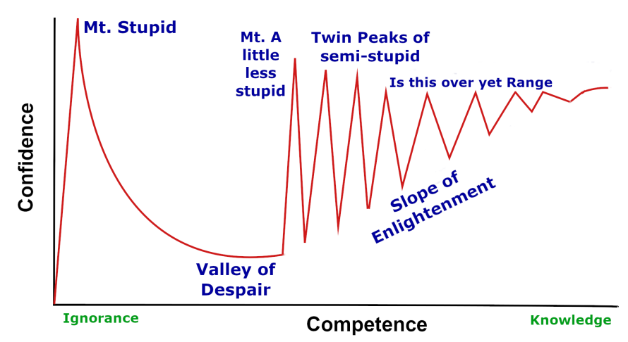
The Expert Another Perspective

Slide 97
Authority/Expert
Based on?
Experience
Peer acknowledgement
Knowledge and interpretation of the literature
Underpinning knowledge
Anecdote
??

Slide 98
Valuable Experience:
Is not the number of years worked but the extent that the clinician has reflected on that experience, particularly the failures.
Is not how confident the clinician is but how diffident they are. Absolute confidence is a sign of incompetence.

Slide 99
Authority/Expert
The experienced clinician
The experienced researcher
The experienced teacher
The more experienced colleague
Your mother

Slide 100
Authority/Expert
Pick the Authority/Expert that is most appropriate
for your question. Because you are an expert in one field it doesn’t make you an expert in all.

Slide 101
Assessing Authority/Expert
“I think we ought always to entertain our opinions with some measure of doubt. I shouldn’t wish people dogmatically to believe any philosophy, not even mine.”
Bertrand Russell

Slide 102
The Expert
This is a peer designation not an formal qualification
The expert in your area may be a big fish in a small pond or of international repute

Slide 103
The larger the field the expert is expert in the less chance that he/she is truly
an expert
“I don’t know” is a reassuring answer

Slide 104
Be clear with your question and give as much background information as possible
Ask questions about the field of expertise only, do not expect a clinician to be able to give expert opinion on statistics

Slide 105
Is the answer clear, if not ask it to be clarified (if it cannot be clarified it usually means that your expert does not know the answer)
Ask if he/she has had personal involvement with the particular topic

Slide 106
If appropriate ask for references or guidance on where to find further information
If the expert gives you the name of somebody else who may know more you either have an honest broker or a lazy expert

Slide 107
Remember, you asked for the opinion and you got it for free and you are entitled to value the opinion at the same amount you paid for it.
But if you do not agree with the opinion say thank you and move on

Slide 108
Teachers
The important point to remember is that you are paying for the class and it is not a favor.
It is the teacher’s job to provide the information and make sure you understand it

Slide 109
It is your job to make sure that the teacher does the job you are paying for
So ask questions and for clarifications whenever necessary

Slide 110
From Informed Speculation to Validity
The Sharp-Purser Test

Slide 111
Sharp and Purser used a construct based on:
the anatomy of the dens and atlas, the articular cartilage of their joints
the histology of the transverse ligaments
the pathological changes to these structures that could be caused by systemic arthritis
The clinical effects of these pathological changes

Slide 112
They then generated a mind experiment where they imagined what would happen during flexion at the atlanto-axial segment that was anteriorly unstable as a result of these changes and then what would happen if they pushed the atlas posteriorly on the stabilized axis
They then tried it out on patients, liked the results and came up with the Sharp-Purser test for atlanto-axial anterior instability

Slide 113
Uitvlugt and Indenbaum some quarter of century later liked the test and decided to validate it
They looked at the best available gold standard, the flexion/extension radiograph and compared the test to the radiograph
The result was a test that has sensitivity and specificity values
And we have a useful clinical tool

Slide 114
"IT IS CLEAR THAT MUCH ADDITIONAL WORK WILL BE REQUIRED BEFORE A COMPLETE UNDERSTANDING OF THIS PHENOMENA OCCURS"...
=
I don't understand it.

Slide 115
Scientific Practice
To practice scientifically is to practice using the Scientific Method not necessarily use research evidence.

Slide 116
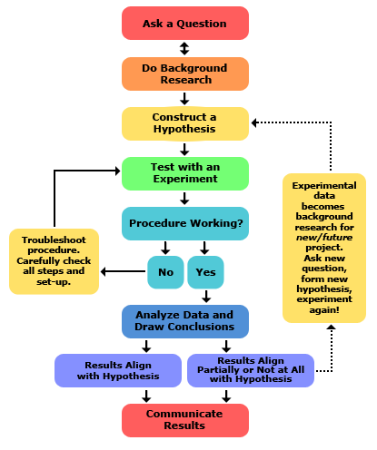
Scientific Method
This is the full version of the scientific method but we can modify it for clinical practice.
https://www.sciencebuddies.org/science-fair-projects/science-fair/steps-of-the-scientific-method

Slide 117
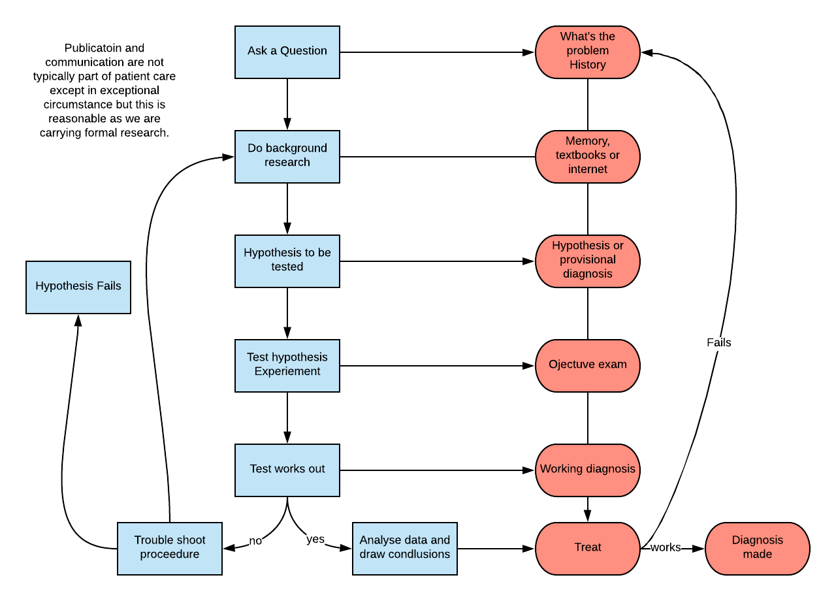
Scientific Method in Clinical Practice

Slide 118
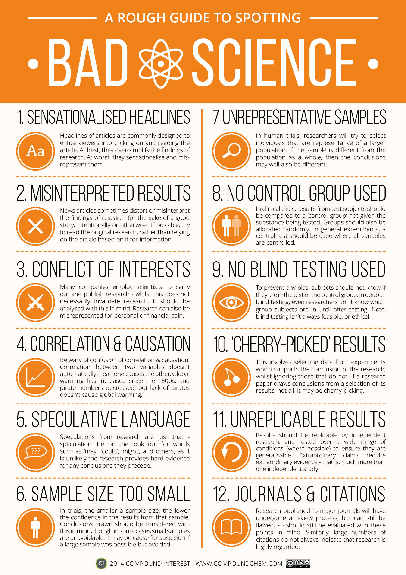
https://www.google.com/search?q=a+rough+guide+to+spotting+bad+science&rlz=1C1CHBD_enMX865MX865&sxsrf=ACYBGNT6GEF6q-xsJKER_EPJxjUaxLkh_g:1574980636404&source=lnms&tbm=isch&sa=X&ved=2ahUKEwiojPGK_I3mAhXPhOAKHSnMCPYQ_AUoAXoECAsQAw&biw=1366&bih=576#imgrc=CNIT22CG4Gea6M:

Slide 119
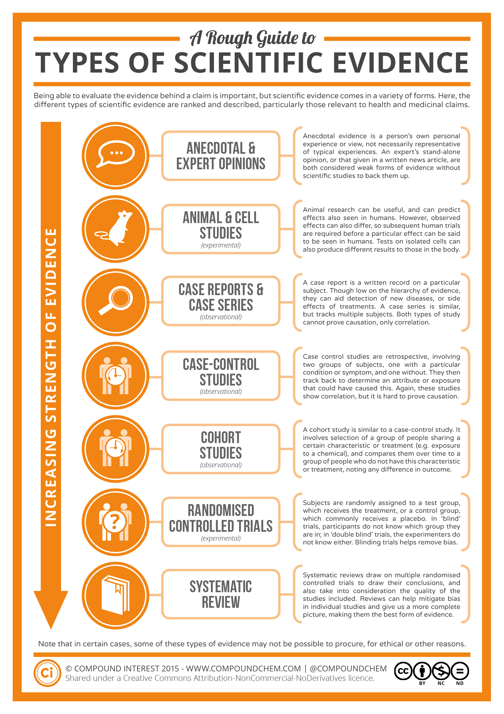
www.google.com/search?q=a+rough+guide+to+spotting+bad+science&rlz=1C1CHBD_enMX865MX865&sxsrf=ACYBGNT6GEF6q-xsJKER_EPJxjUaxLkh_g:1574980636404&source=lnms&tbm=isch&sa=X&ved=2ahUKEwiojPGK_I3mAhXPhOAKHSnMCPYQ_AUoAXoECAsQAw&biw=1366&bih=576#imgrc=CNIT22CG4Gea6M

Slide 120
Summary
Be a critical consumer of all information
Assess the source’s credentials for speaking to the question
Understand what you are reading and/or being told
Make sure it makes sense to you and fits with you experiences (it is more likely that the research is flawed than your experiences delusional)

Slide 121
Look and/or listen for relevance
Assess the written evidence for bias, methodology, power, results, generalizability, and conclusions
Assess the teacher’s knowledge base by asking peripheral questions and for references when appropriate
If you do not understand the teacher it is his/her job to get you to understand it, do not let him/her off the hook

Slide 122
Remember that a study saying that 56% of all whiplash neck pain will be completely recovered in six weeks and fails to address the remaining 44% is a piece of garbage
Remember that even if only 1% of a given population will have prolonged problems then that 1% deserves your best effort even though he or she has been written off by the statistician

Slide 123
The best guide to what works for you and an individual patient is a your judgment which should be influenced by the evidence but not be dominated by it.
If this could all be done from the evidence then there would be no need for clinicians, just researchers and technicians and there ain’t no sign of that happening anytime soon

Slide 124
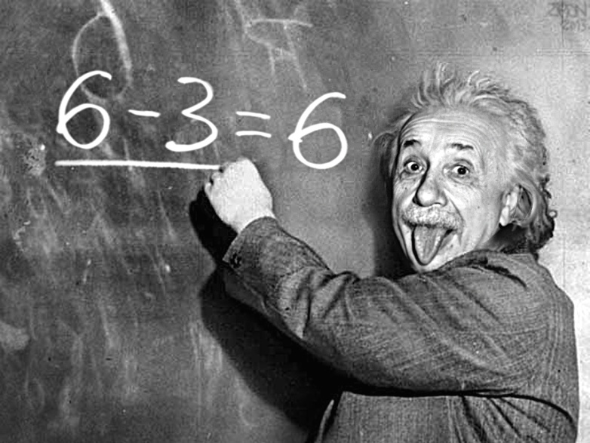
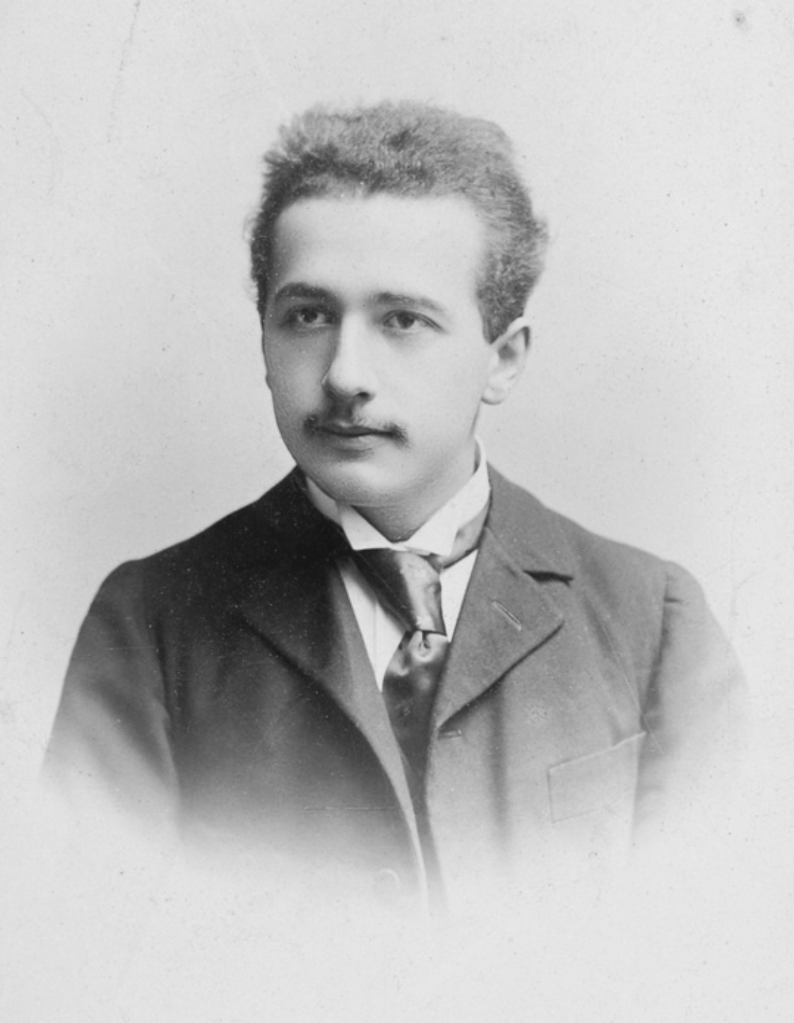
Imagination is more important than knowledge

Slide 125
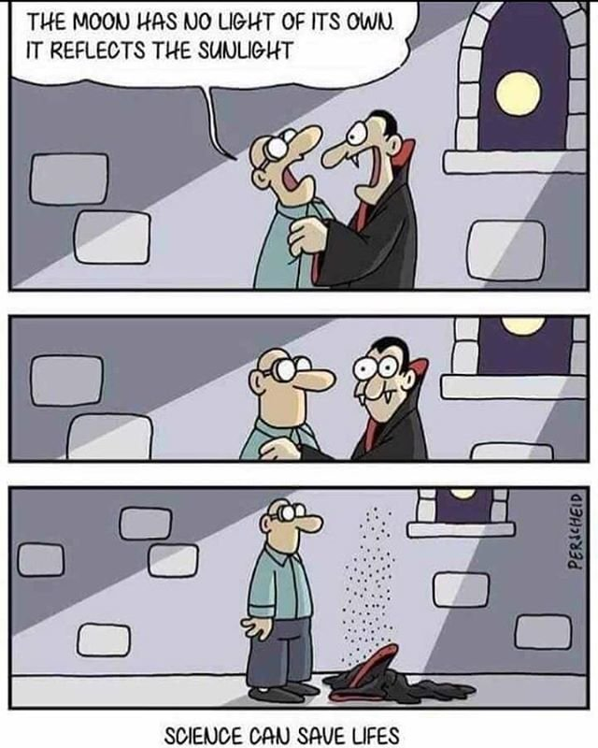
https://www.google.com/search?rlz=1C1CHBD_enMX865MX865&biw=1366&bih=576&tbm=isch&sxsrf=ACYBGNT-42Lnyb97siSg9x8v3e_Dr2hKwQ%3A1574980646103&sa=1&ei=JkzgXZfvBYfasQXfwqjIDw&q=bad+science+jokes&oq=bad+science&gs_l=img.1.1.0l10.694037.694037..697548...0.0..0.592.760.0j1j5-1......0....1..gws-wiz-img.......0i24.tDIzSLM28ag#imgrc=bbnQJdRpqRvB7M:

