Slide 1
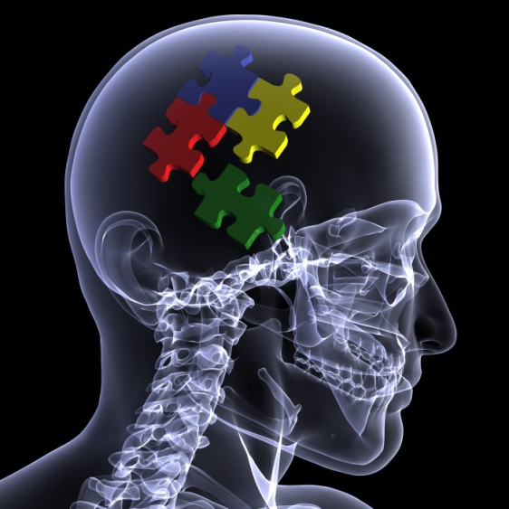
Clinical Reasoning III
The search for Why!
MTI²
Jim Meadows

Slide 2
Remote Etiologies and
Co-dependent Pathologies
This presentation will take clinical reasoning away from diagnosis and into the realm of why the problem is there in the first place.
For the most part these hidden and often remote non-environmental etiologies are asymptomatic so this presentation will concentrate on the links between the patient’s complaints and the causative agent and which tests will demonstrate it.

Slide 3
Links
For a remote pathology/dysfuntion to contribute or cause a local problem there must be some form of link between the two tissues. These links are:
  Neurological
  Neurophysiological
  Mechanical
  Systemic Disease
  Chemical (hormonal, allergenic etc.)

Slide 4
Neurological
Causes:
  Radiculopathy
  Brachial plexopathy
  Peripheral neuropathy
  Axoplasmic Flow Compromise

Slide 5
Effects
Weakness
  Tearing of muscle fibers
  Failure to limit range of motion and promoting hypermobility
  Failure to control translation and promoting instability

Slide 6
Effects
Sensory Loss
  Arthropathy
Trophic Malnutrion
  Muscle tear
  Tendonosis

Slide 7
Neurophysiological
Segmental Facilitation
Pain Inhibition
Reflex Inhibtion

Slide 9
Hypothetic-deduction Tennis Elbow

Slide 12
Script Focused Deduction

Slide 13
Script Focused Deduction – with H2

Slide 15
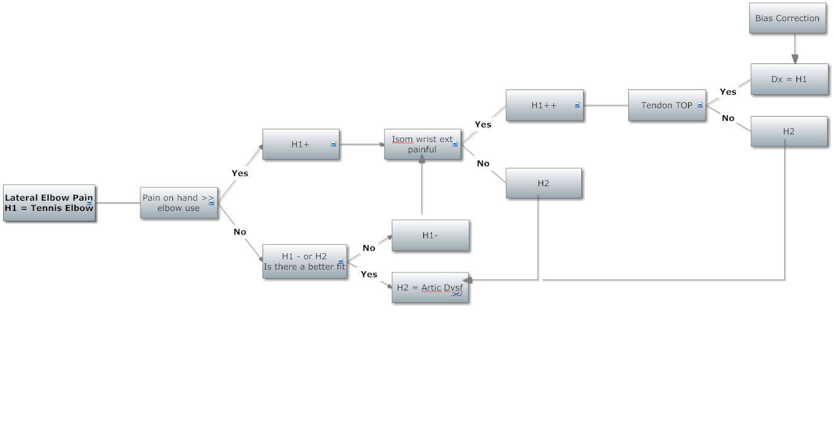

Slide 18
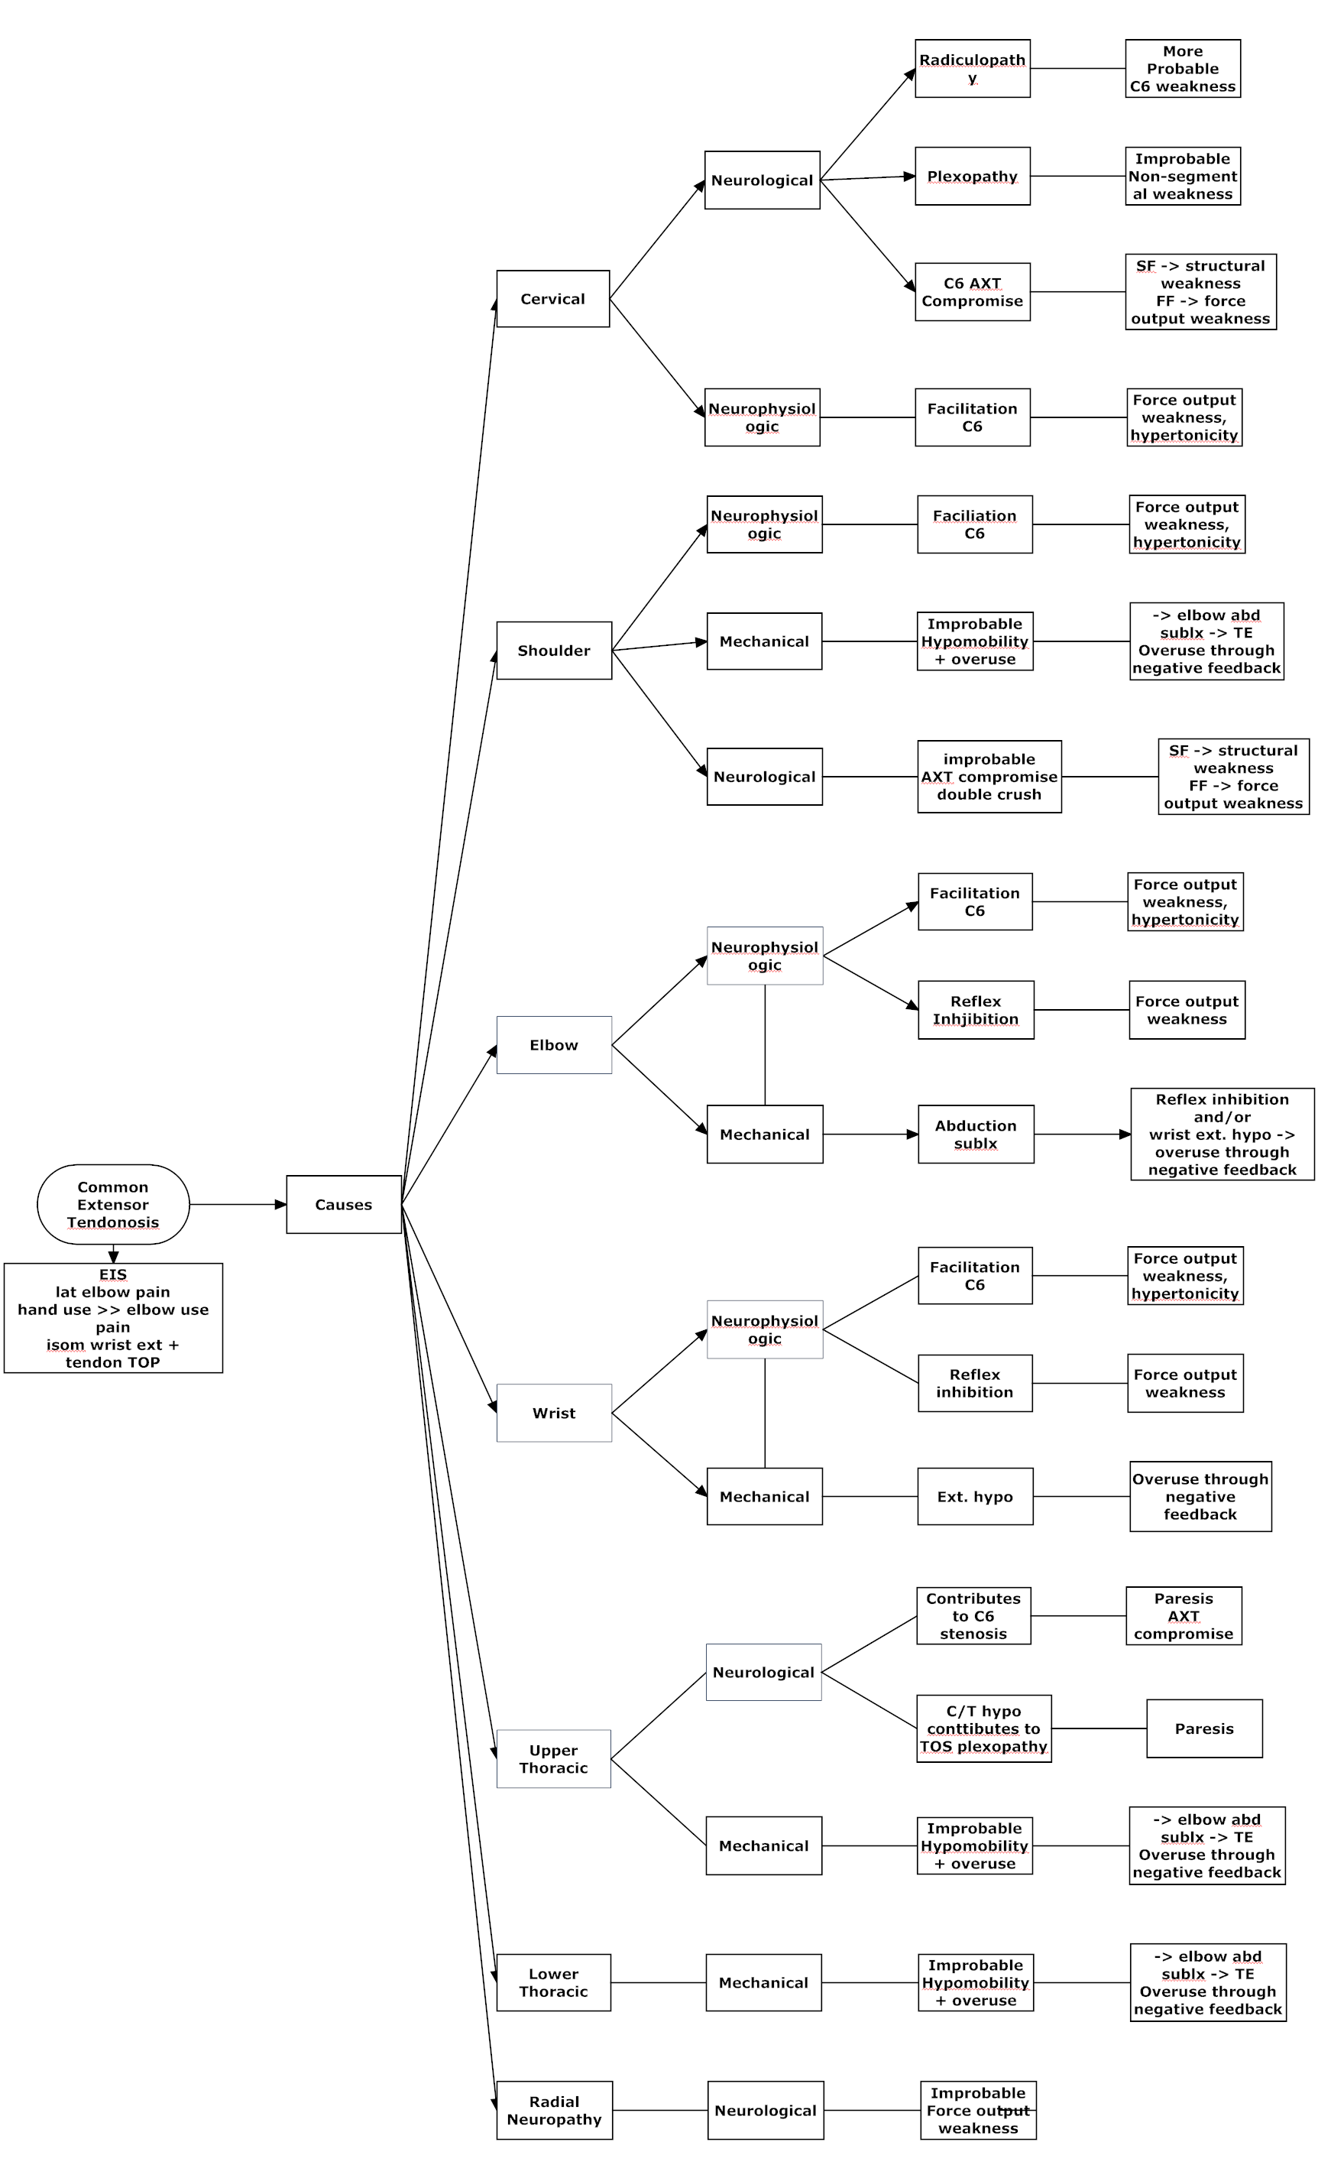

Slide 20
Abducted Ulna Effects

Slide 21
Abducted Ulna Causes

