Slide 1
Essential Illness Scripts
The Illness Script is a picture of the condition held by the practitioner. How deep and rich the picture is, is dependent on how experienced and well read the clinician is.
The Essential Illness Script (EIS) is a description of the average presentation of the condition complained of by the patient. Because it is average more complex outlying presentations will not be obvious using this method.
If diagnosing the patient fails with Script Focus Hypothetic Deduction then either another method of reasoning or a second opinion will be required.

Slide 2
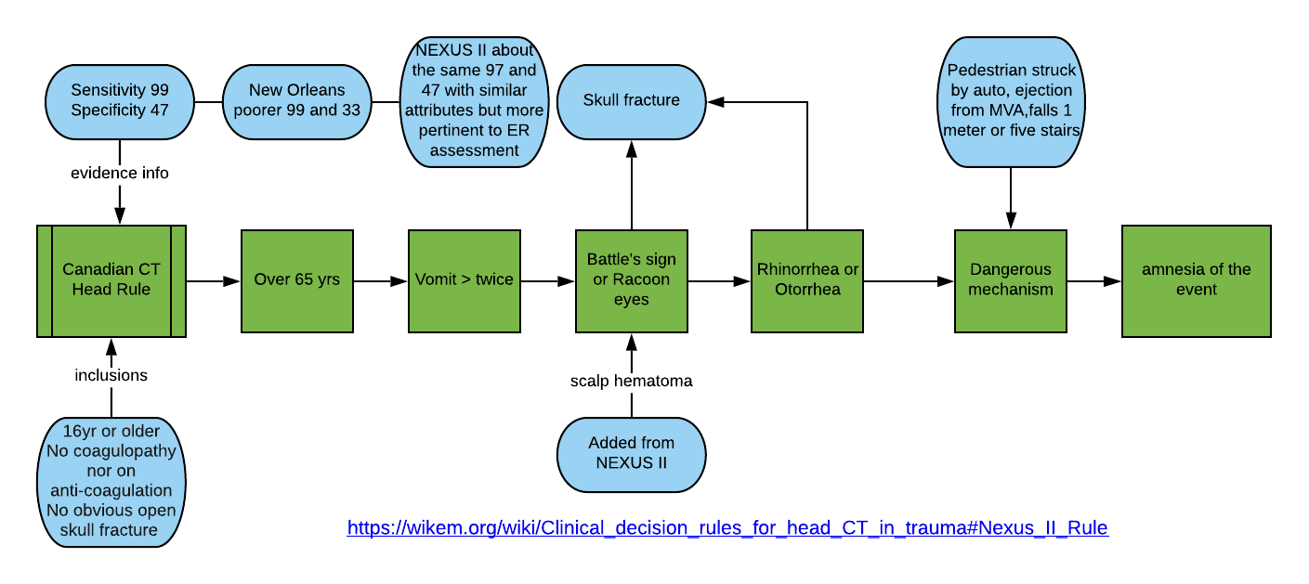
Need for Imaging Protocols
Notes:
The Canadian Head Rules is a protocol with high Sensitivity so that you can exclude serious injuries by excluding the need for CT scanning. If any of the green variables are present a CT is necessary. So if none are present the probability of a serious skeletal or neurological injury is small. The Canadian rules is better than the NEXUS and New Orleans in that it has a specificity than the NO and is more pertinent to us than the NEXUS which is more aimed at the ER with such things distracting injuries and intoxication.

Slide 3
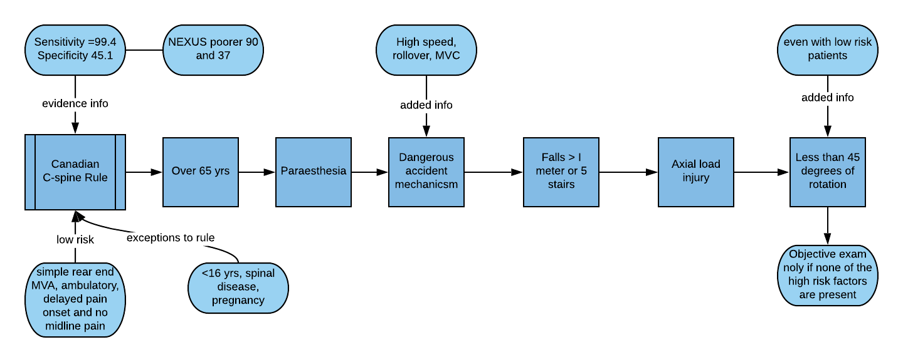
Notes:
Very similar to the head injury rules the Canadian Cspine protocol determines if imaging is necessary and by correleation if a serious injury is absent. High specificity ensures that serious conditions are excluded by the absence of any one of the variables in the center lane.

Slide 4
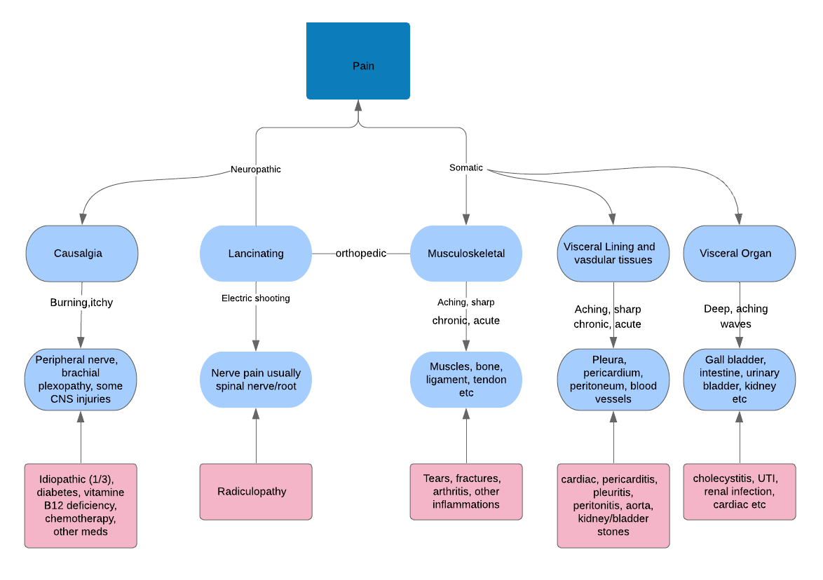

Slide 5
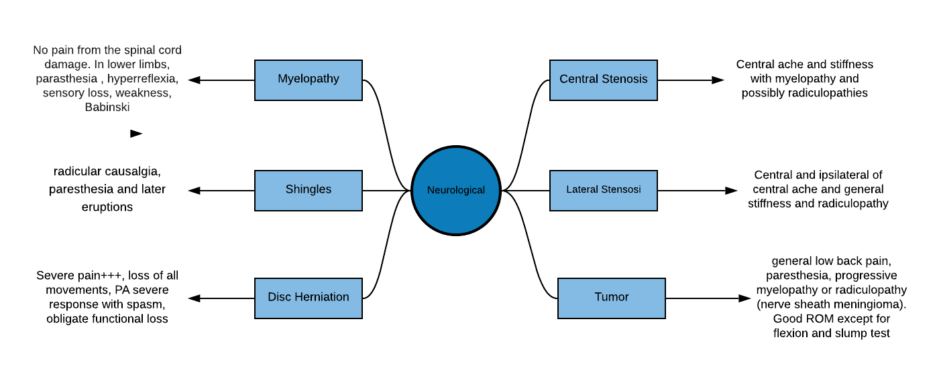

Slide 6
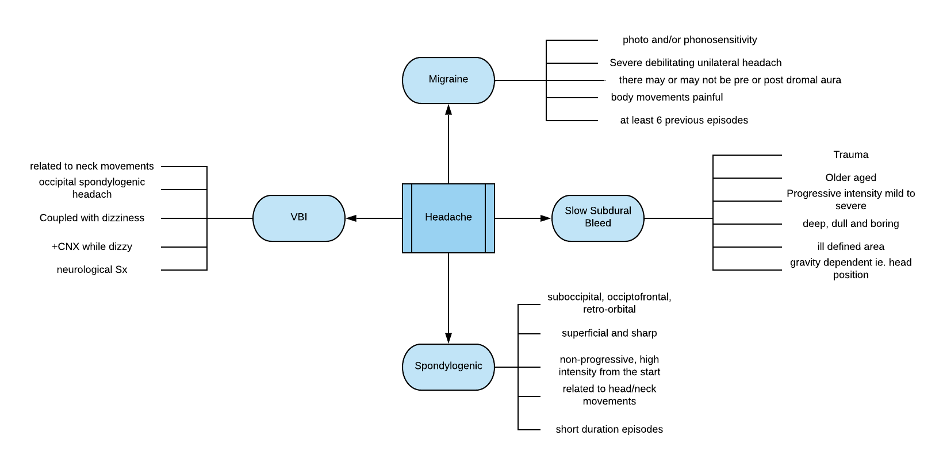

Slide 7
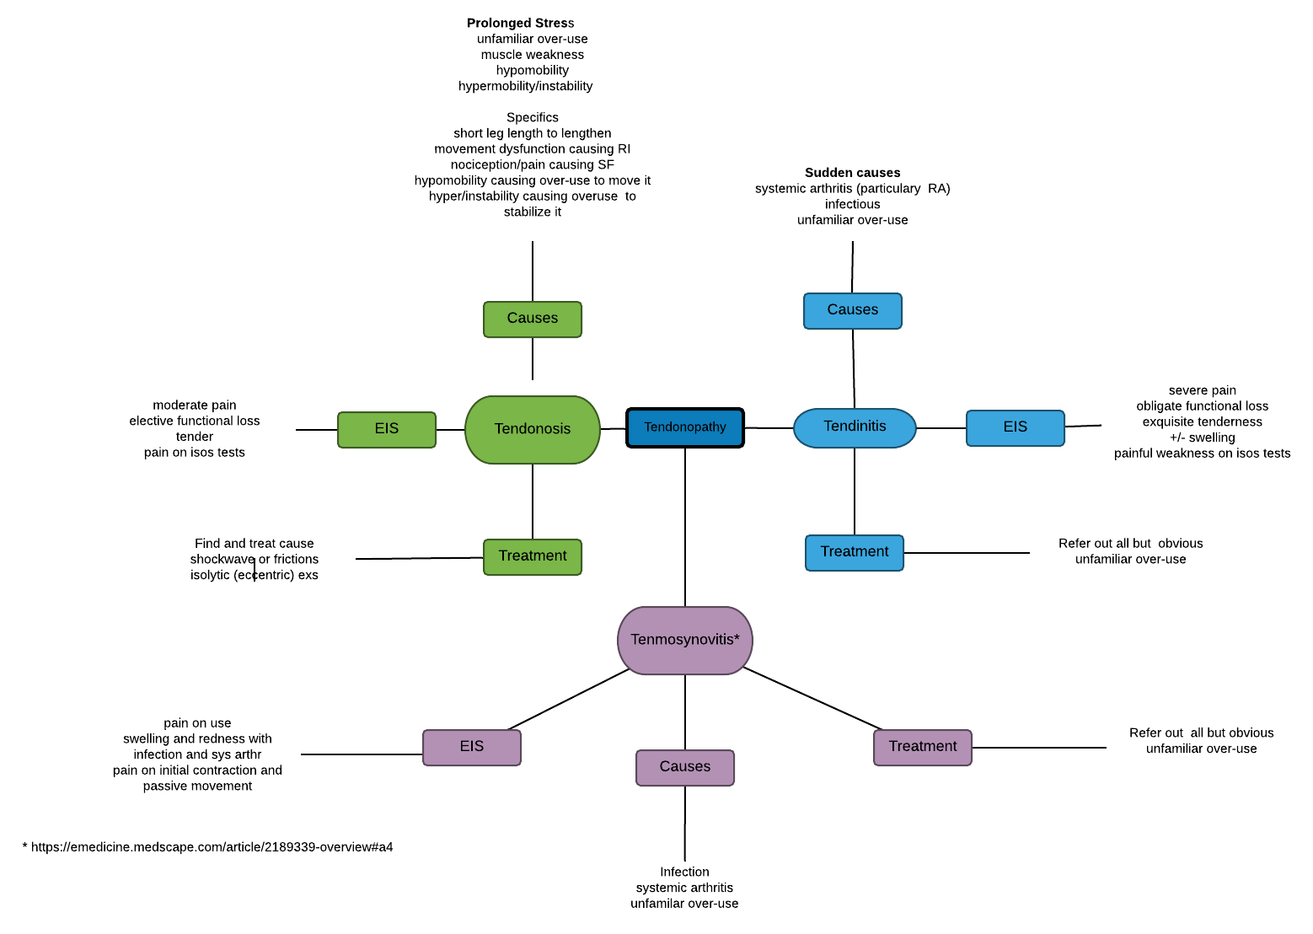

Slide 8
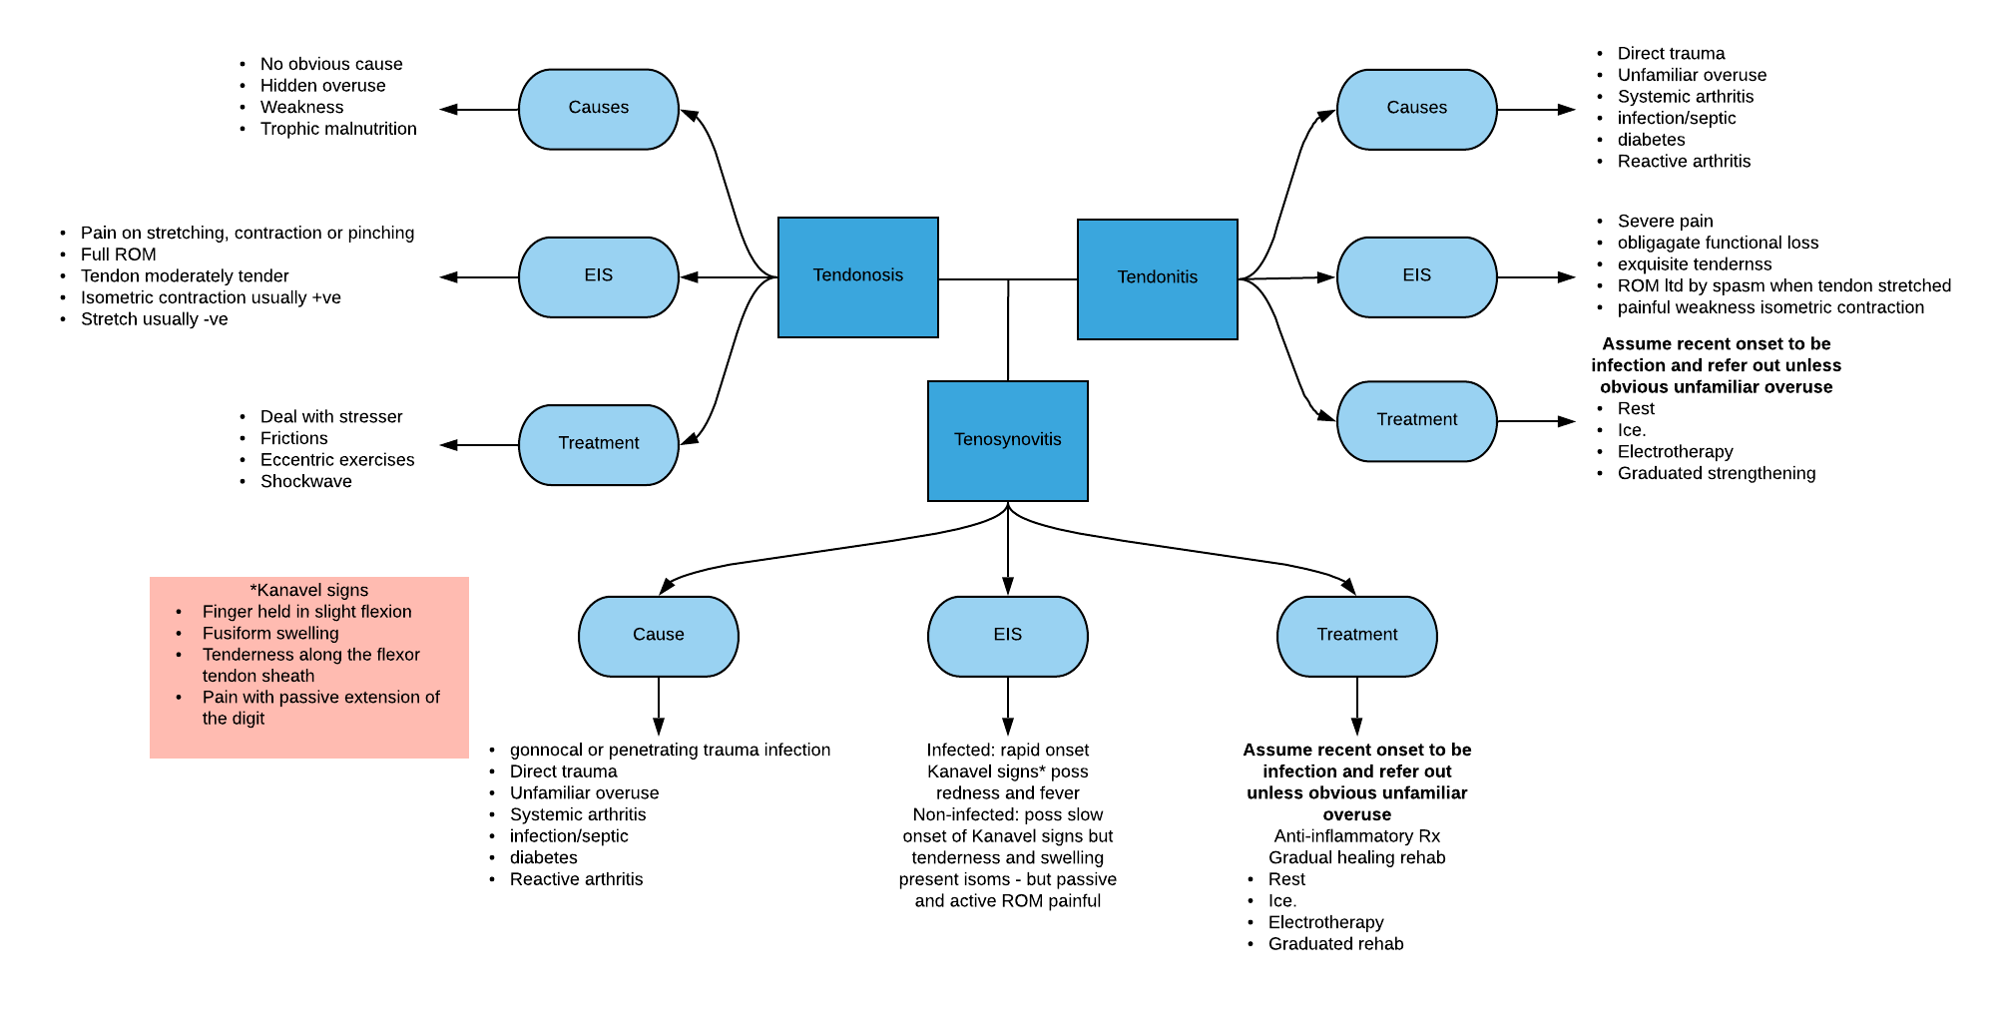

Slide 9
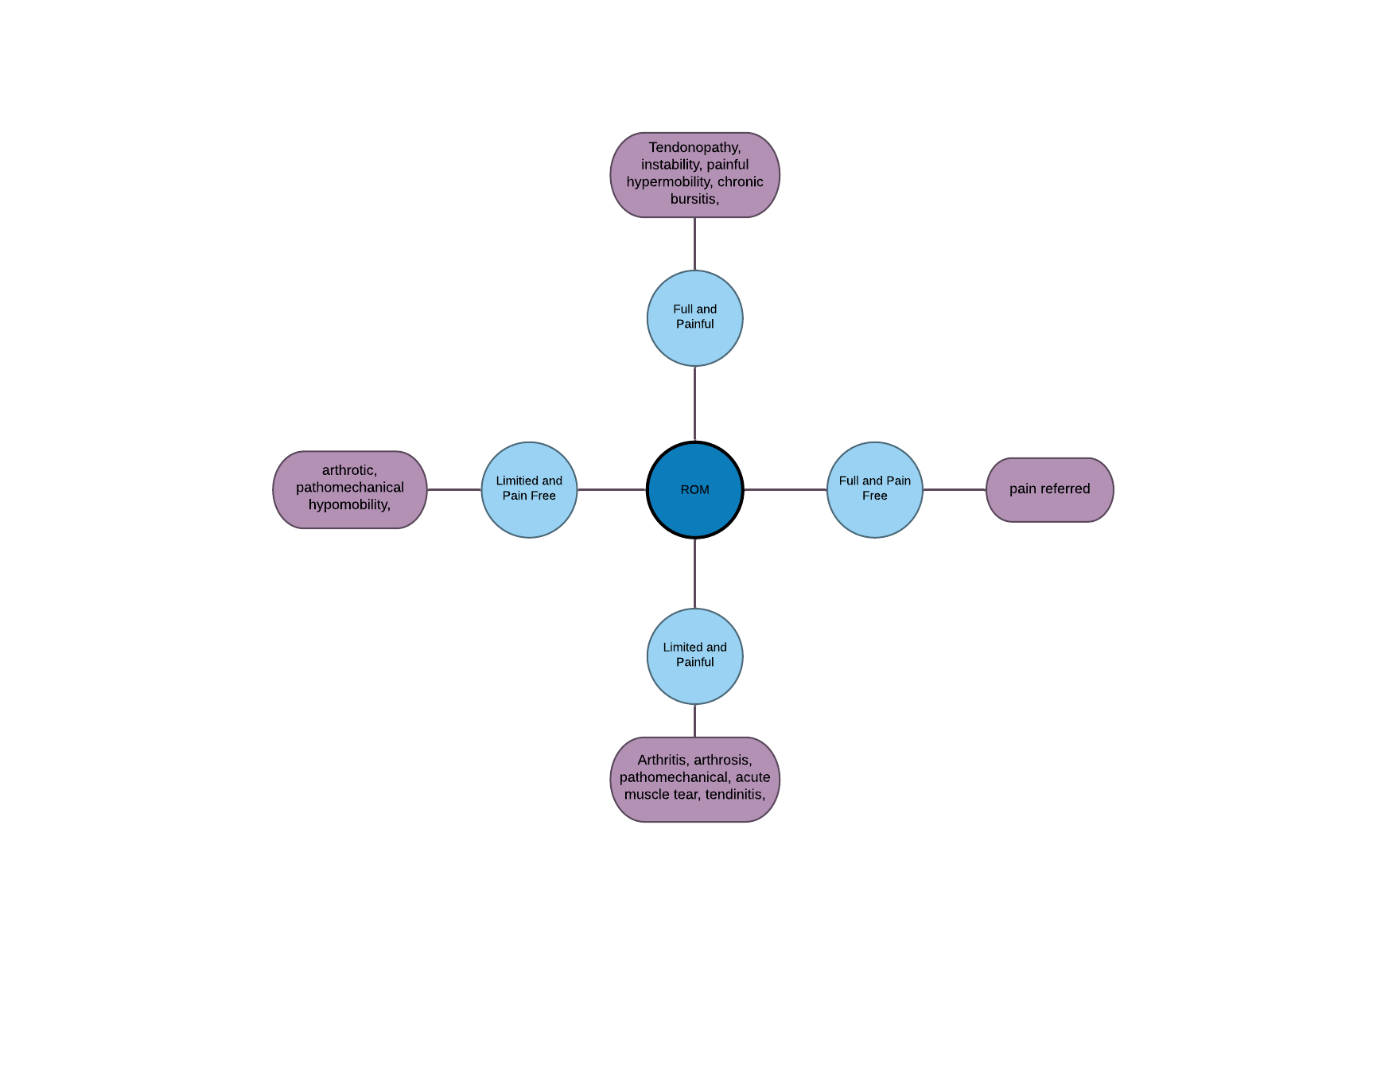

Slide 10
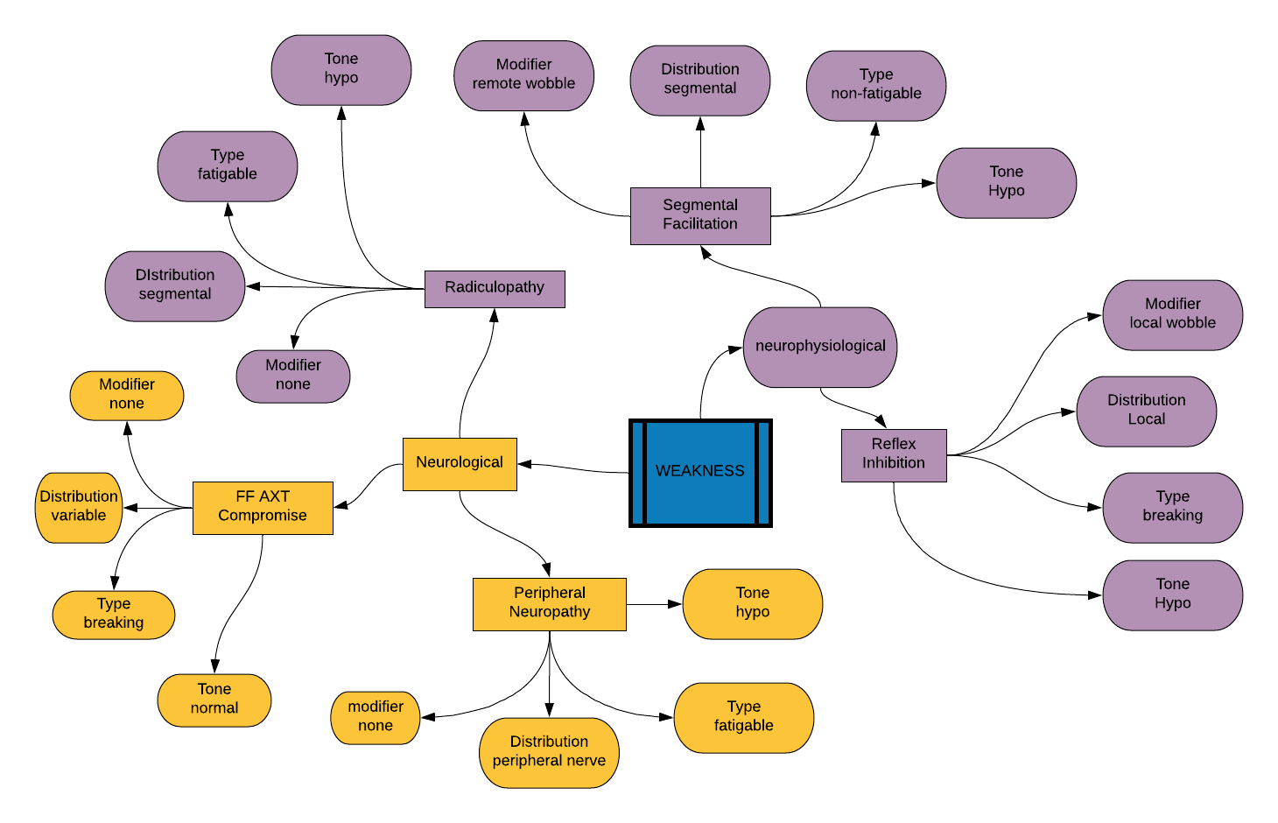

Slide 11
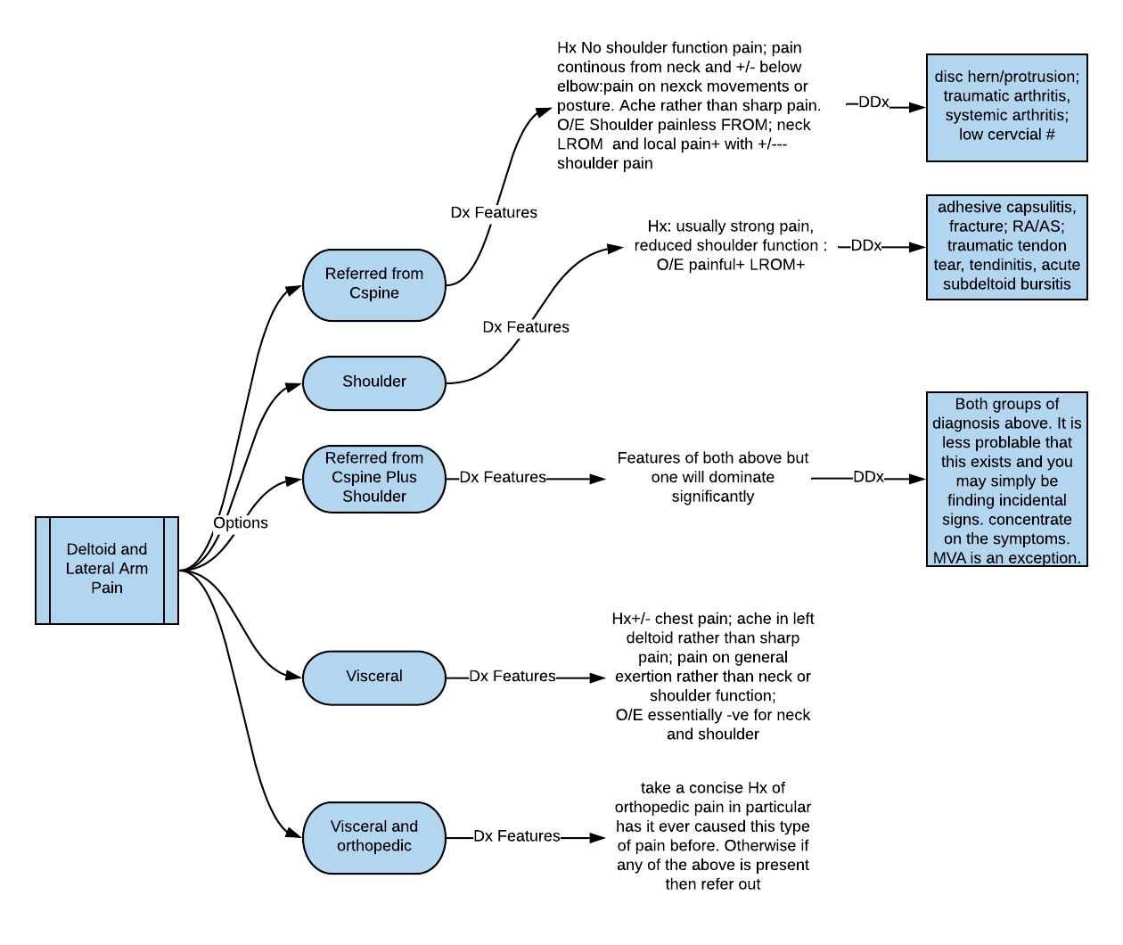

Slide 12
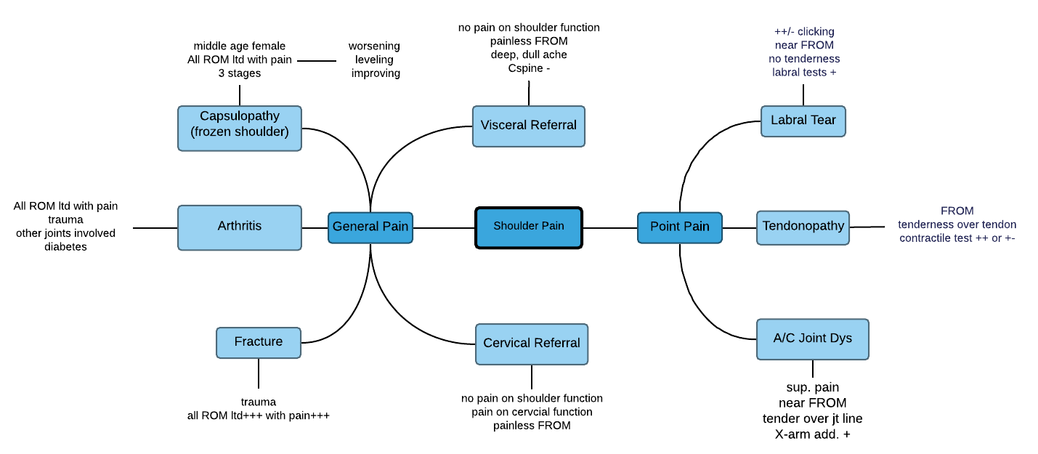

Slide 13
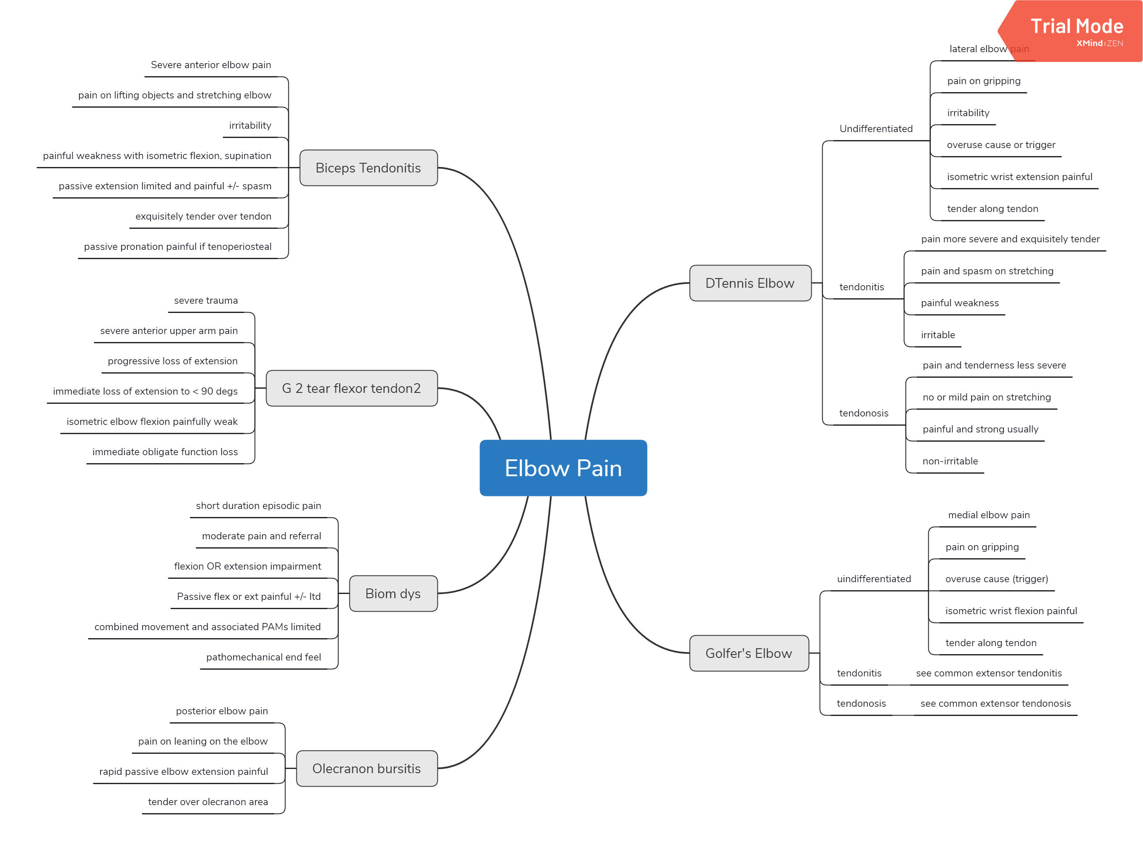

Slide 14
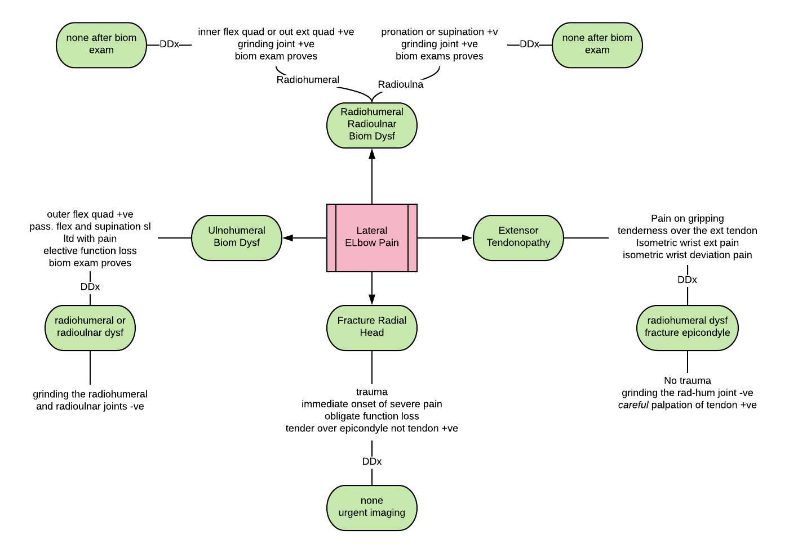

Slide 15
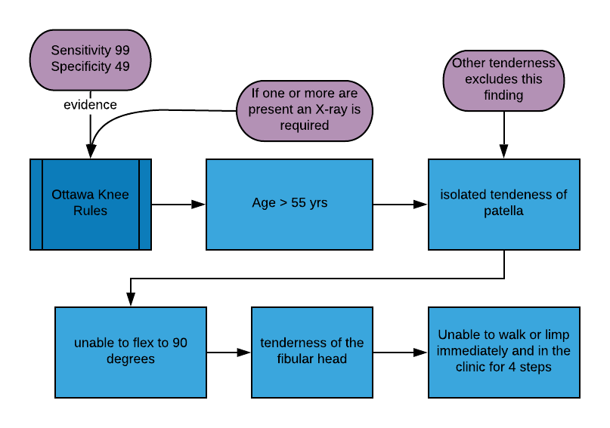
Notes:
If any of the five factors are present there is a real chance of serious damage and imaging is required. If not then you are good to go with physical therapy.

Slide 16
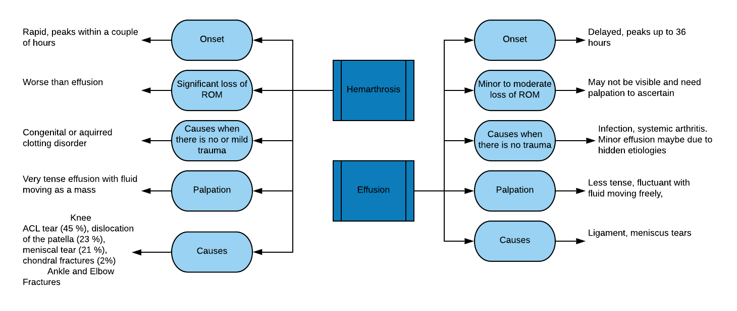

Slide 17
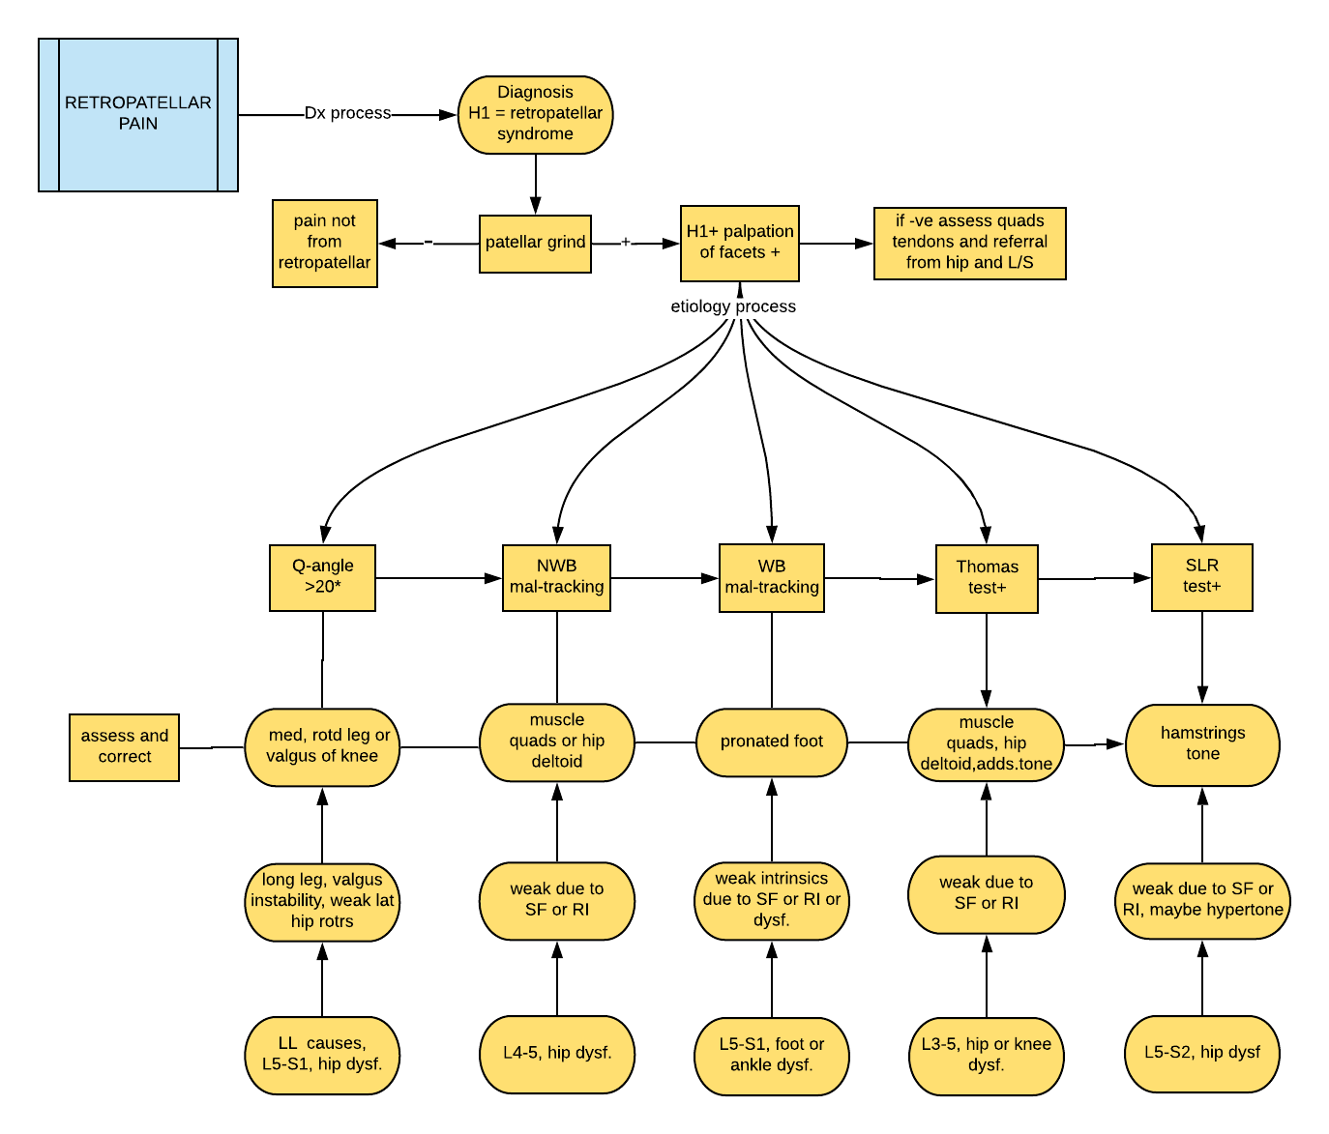

Slide 18
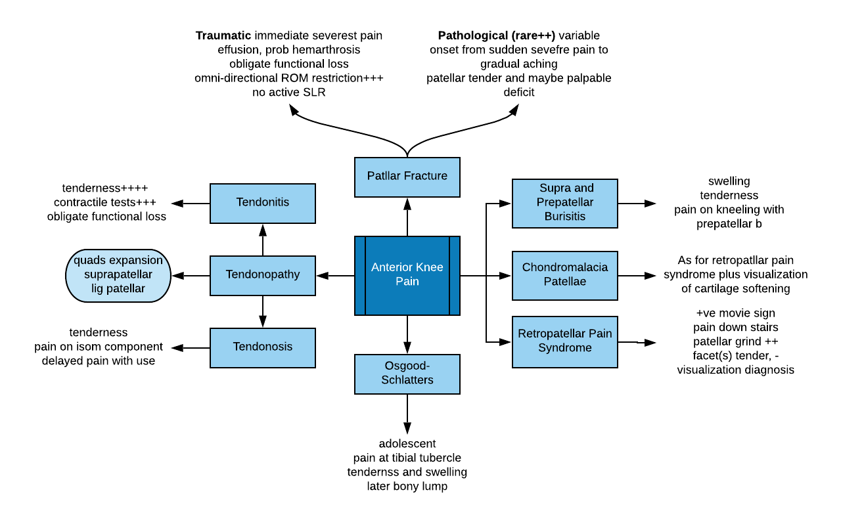

Slide 19
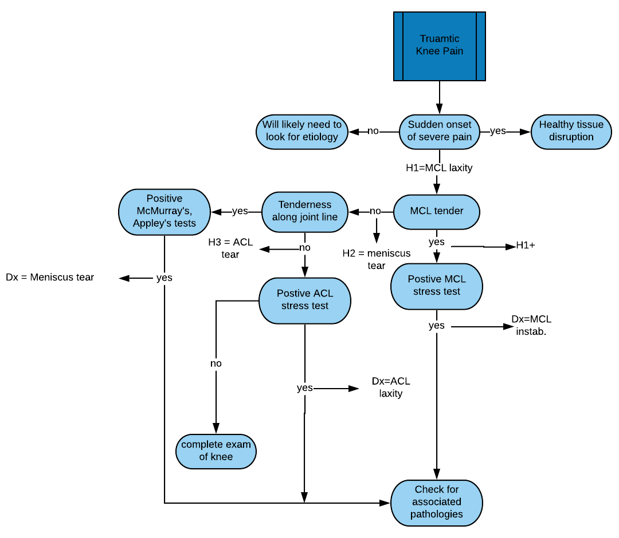

Slide 20
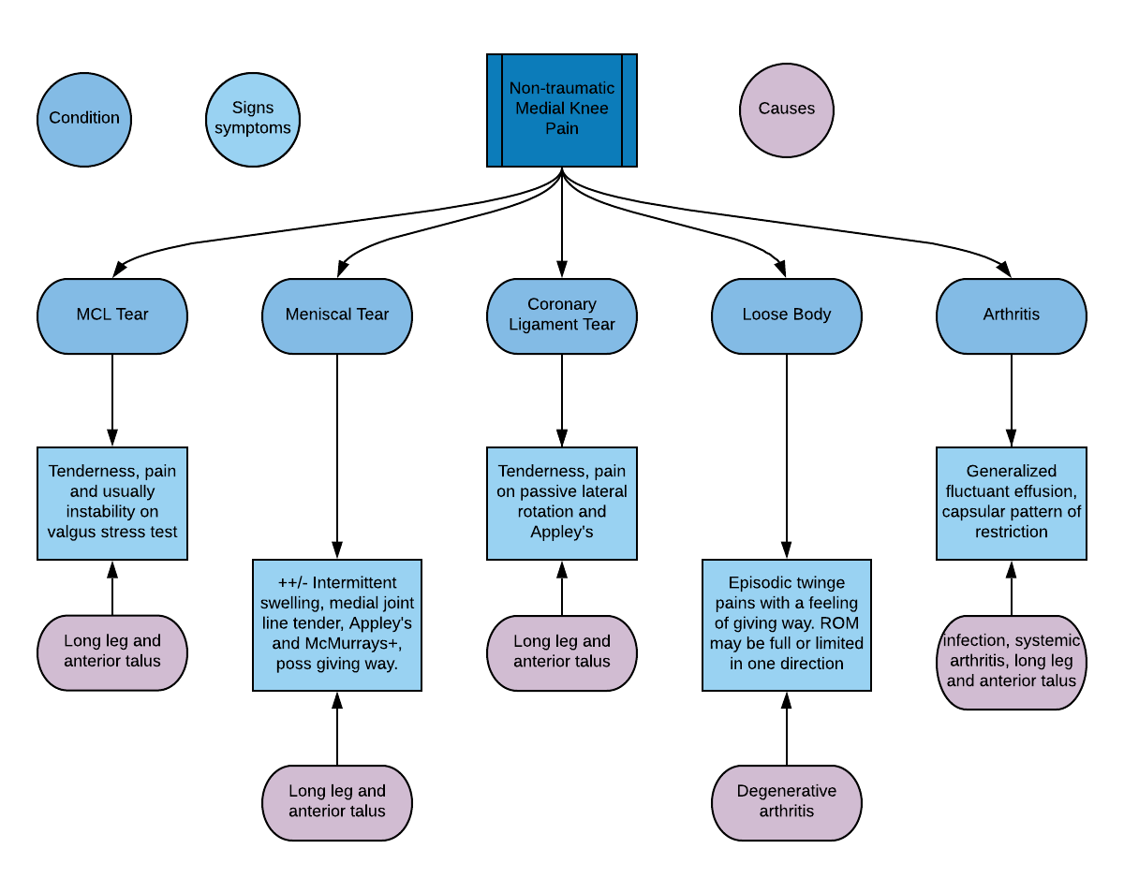

Slide 21
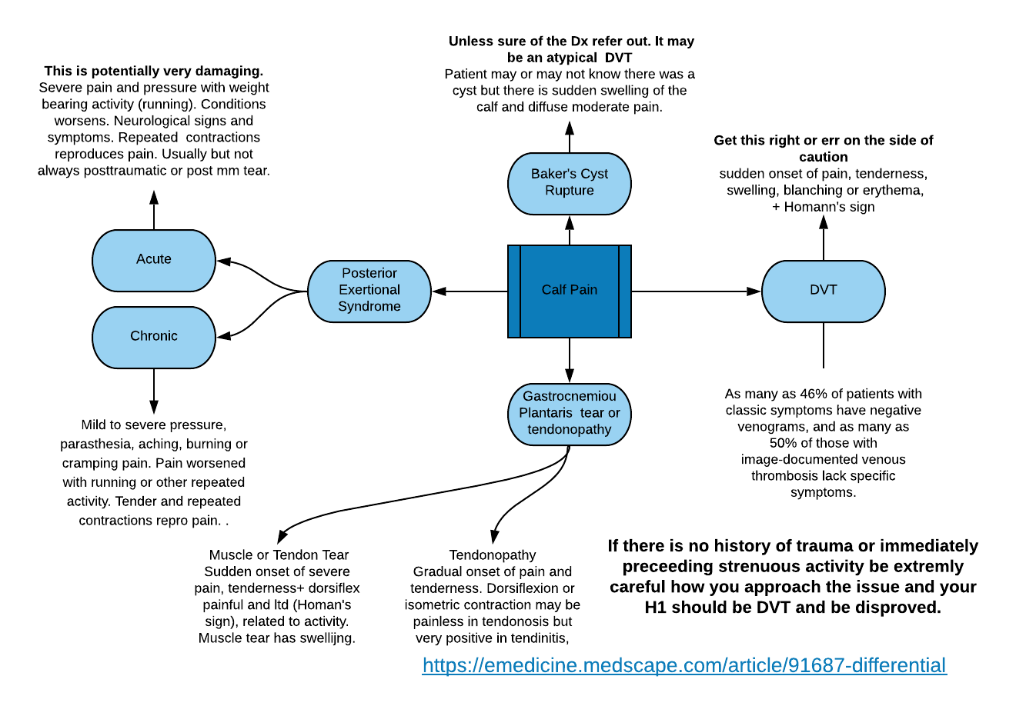

Slide 22
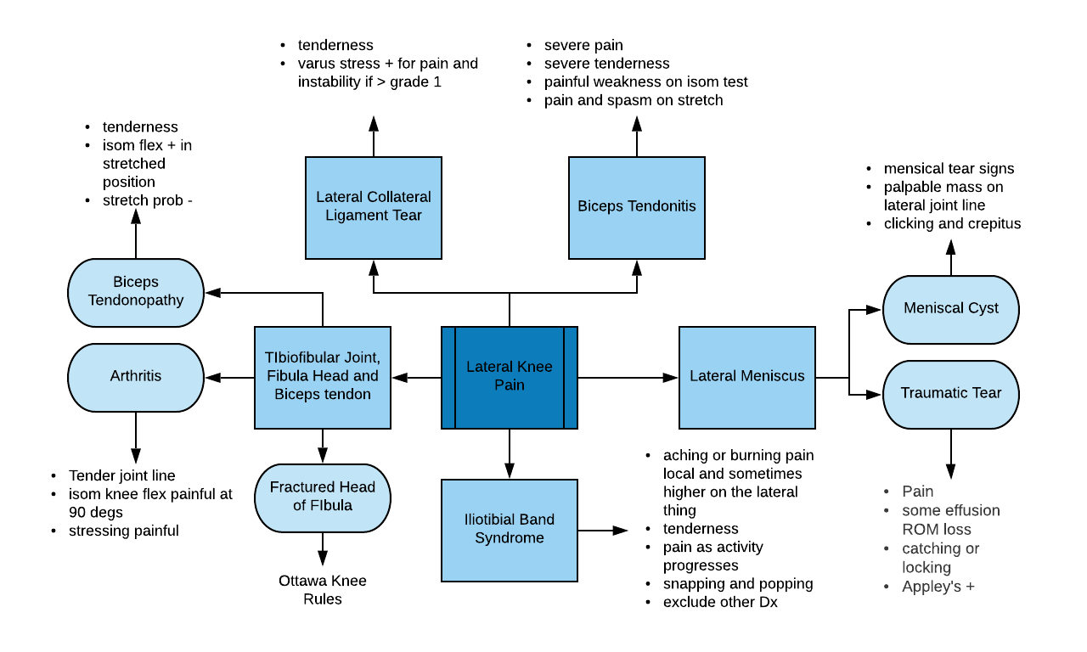

Slide 23
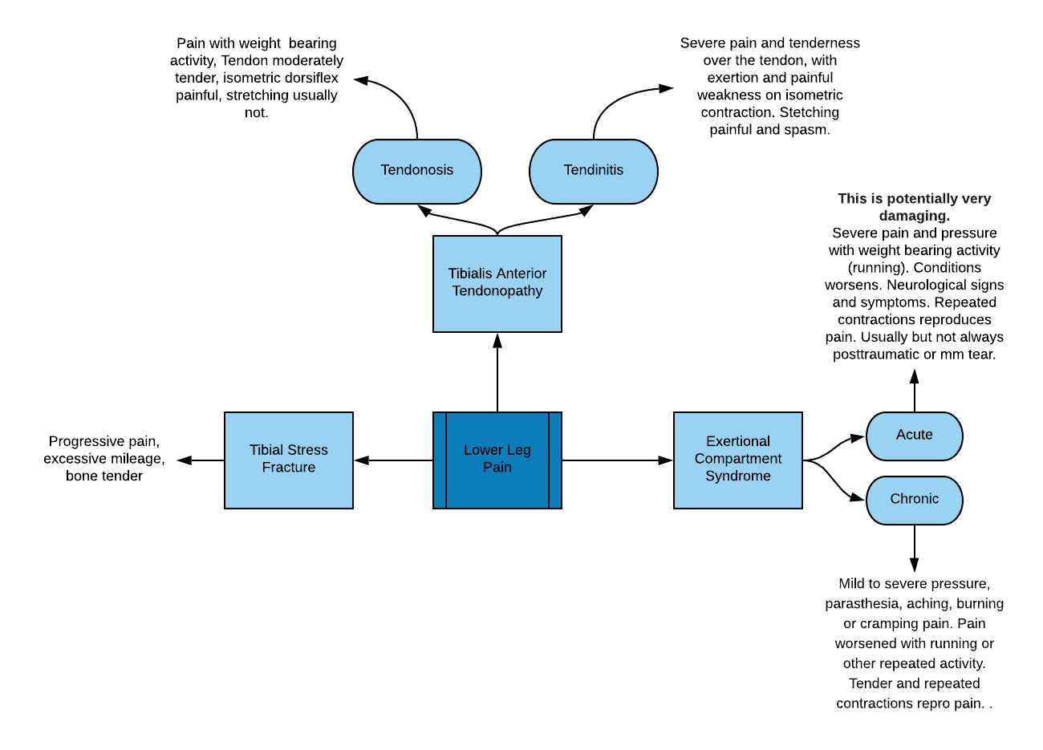

Slide 24
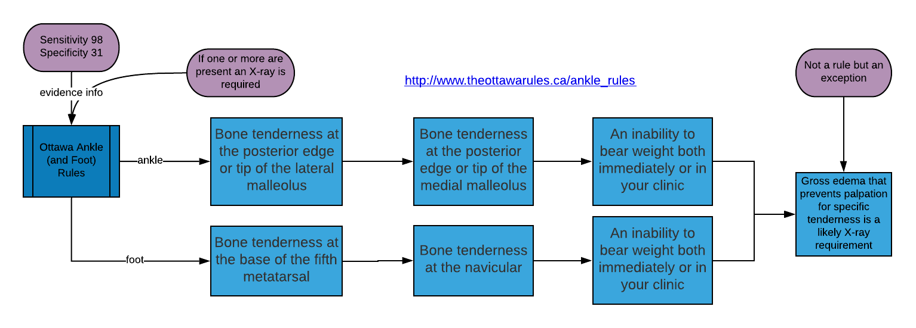
Notes:
Is imagaing necessary in an ankle foot injury. The Ottawa Ankle/foot Rule protocol says not if there are no risk factors listed above. If imaging is unnecessary then a serious injury is absent and physical therapy is OK.

Slide 25
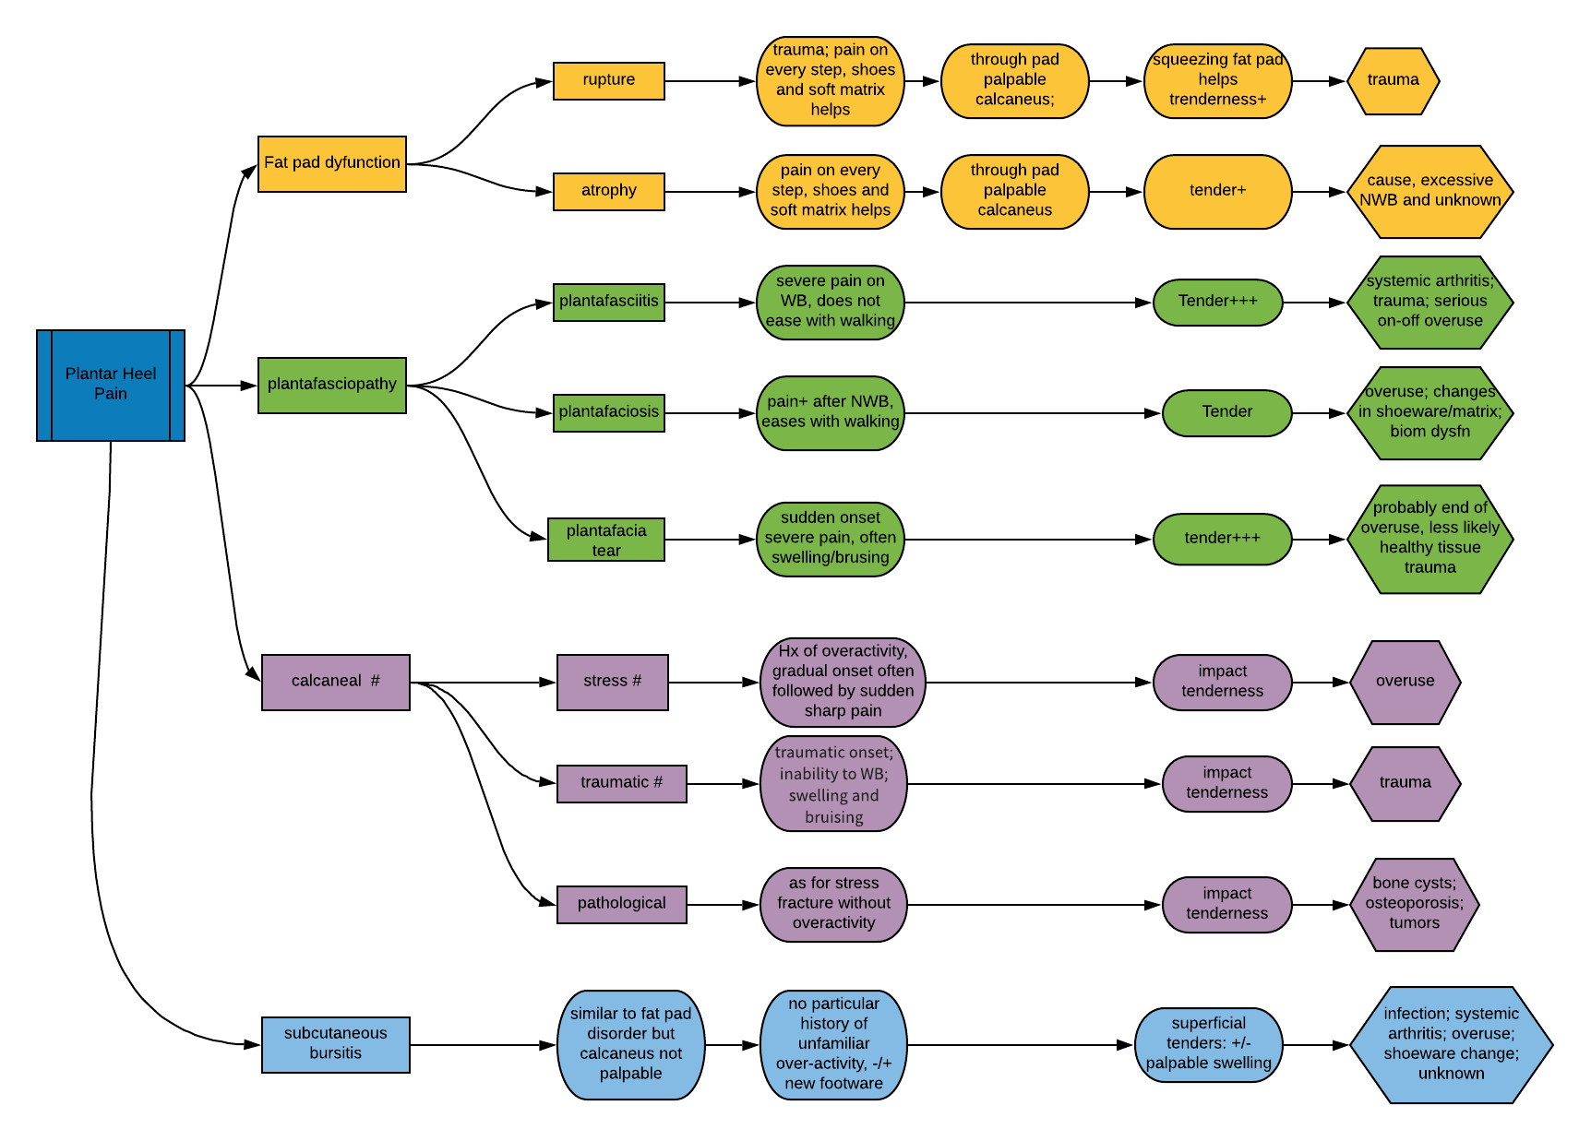

Slide 26
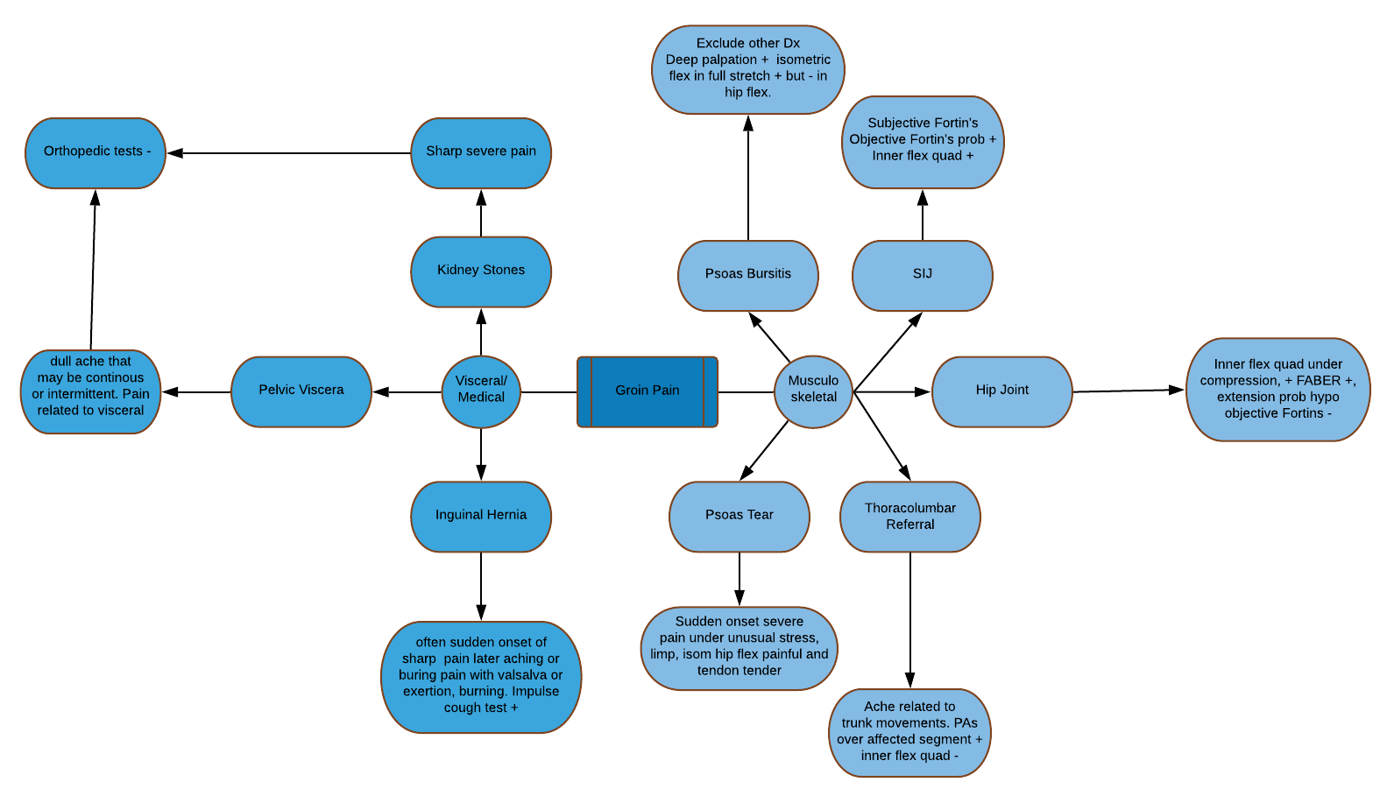

Slide 27
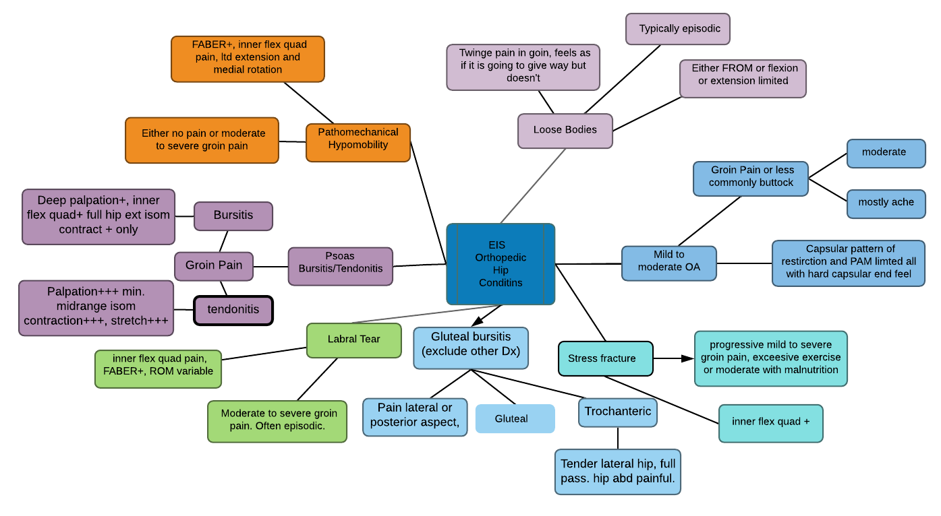

Slide 28
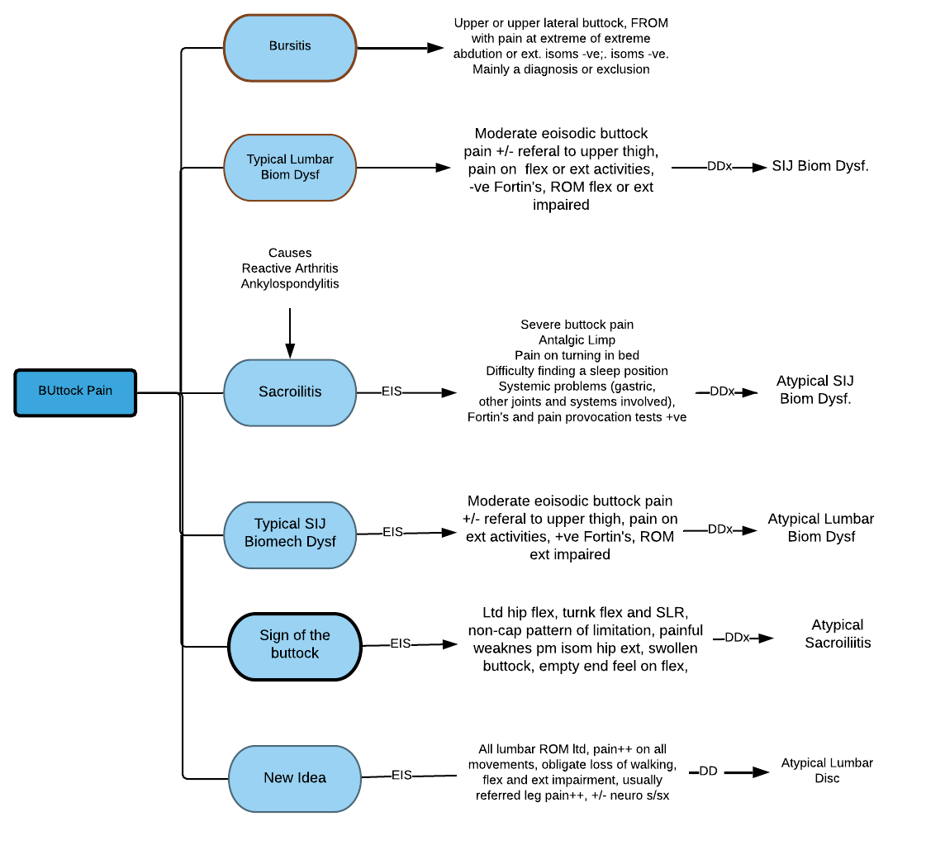

Slide 29
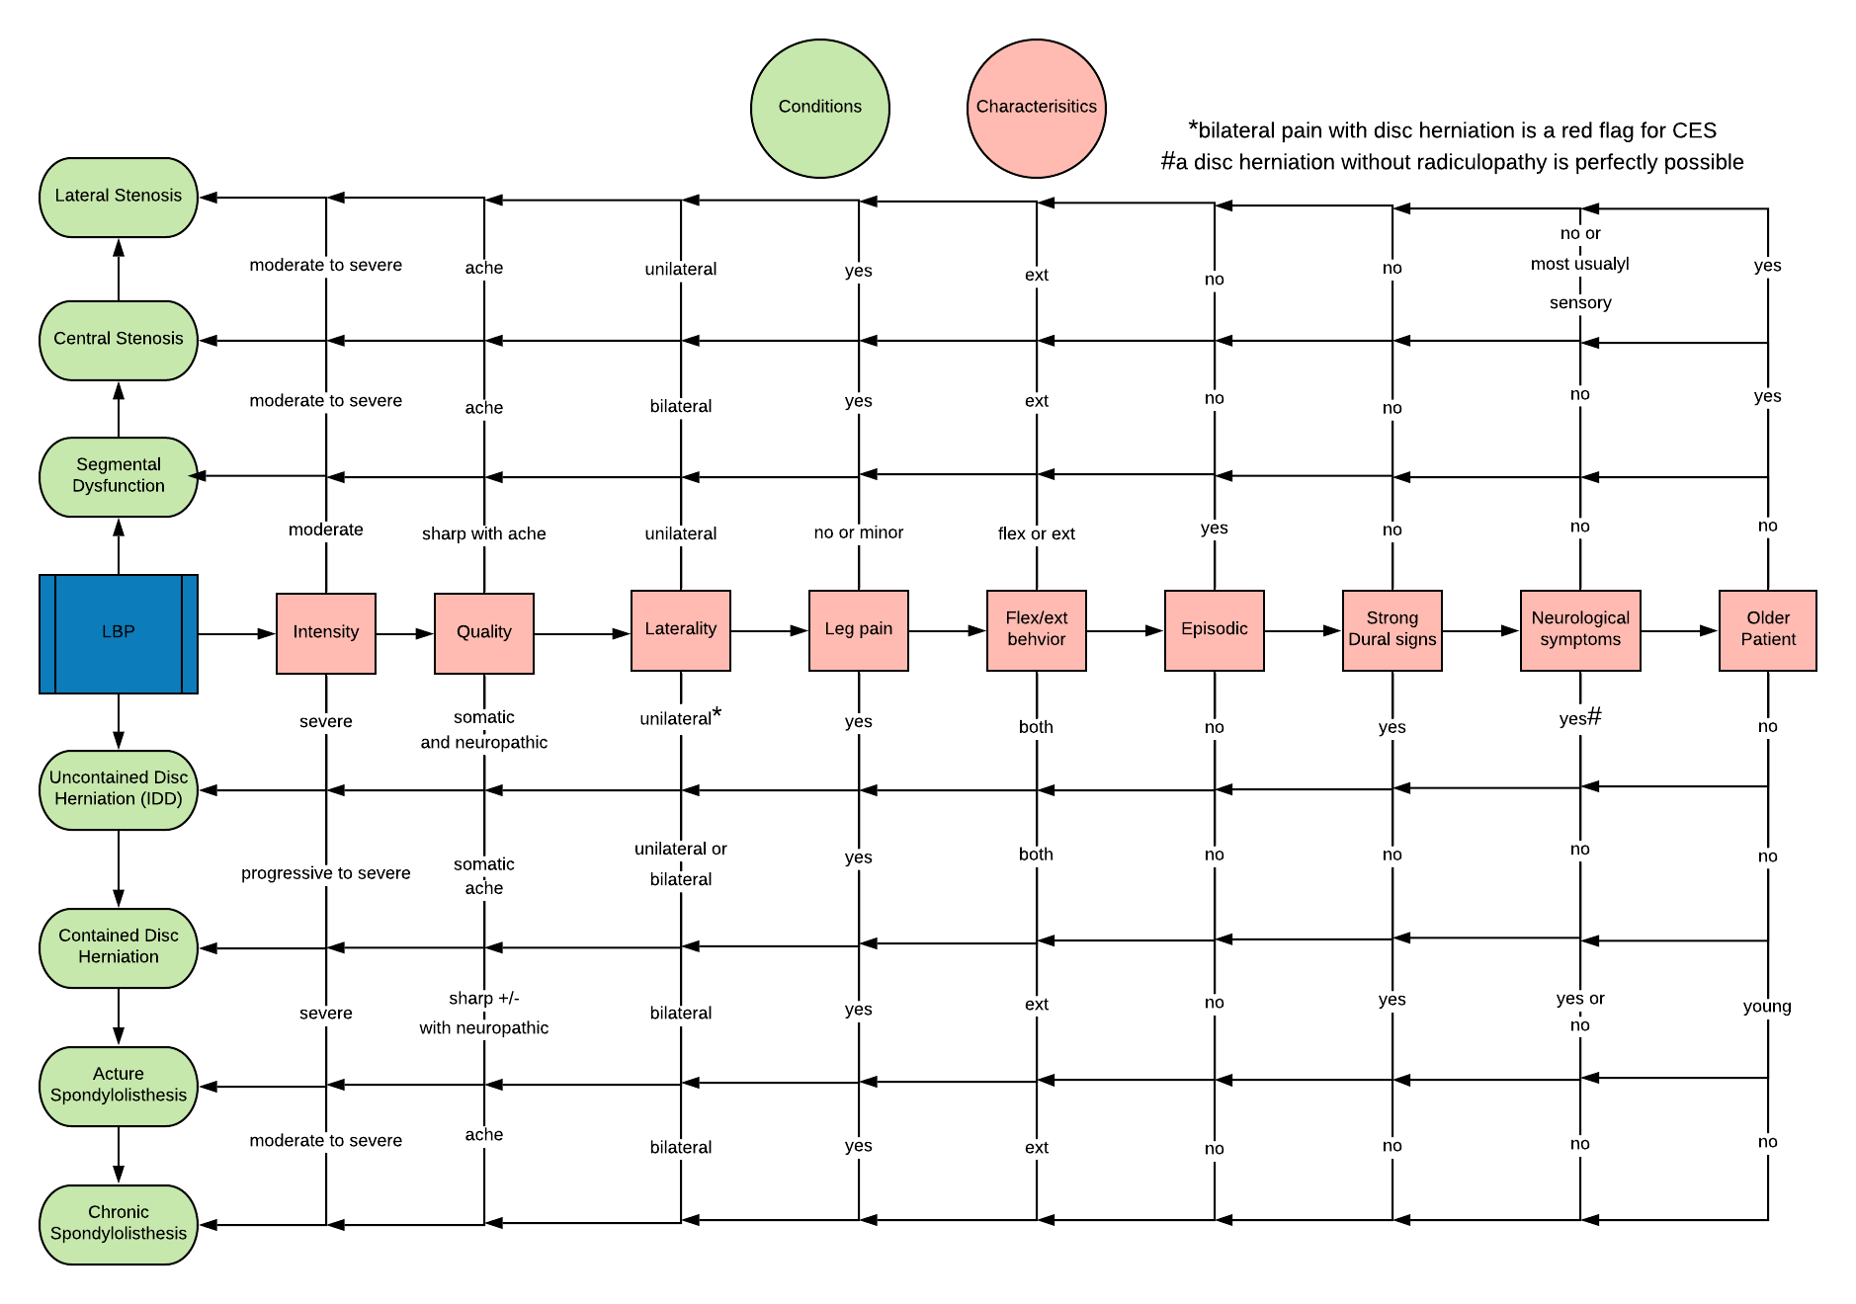

Slide 30
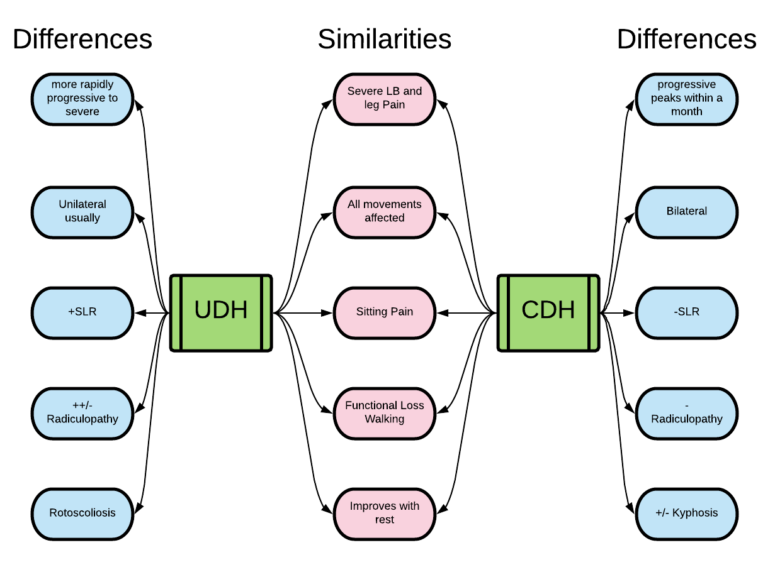

Slide 31
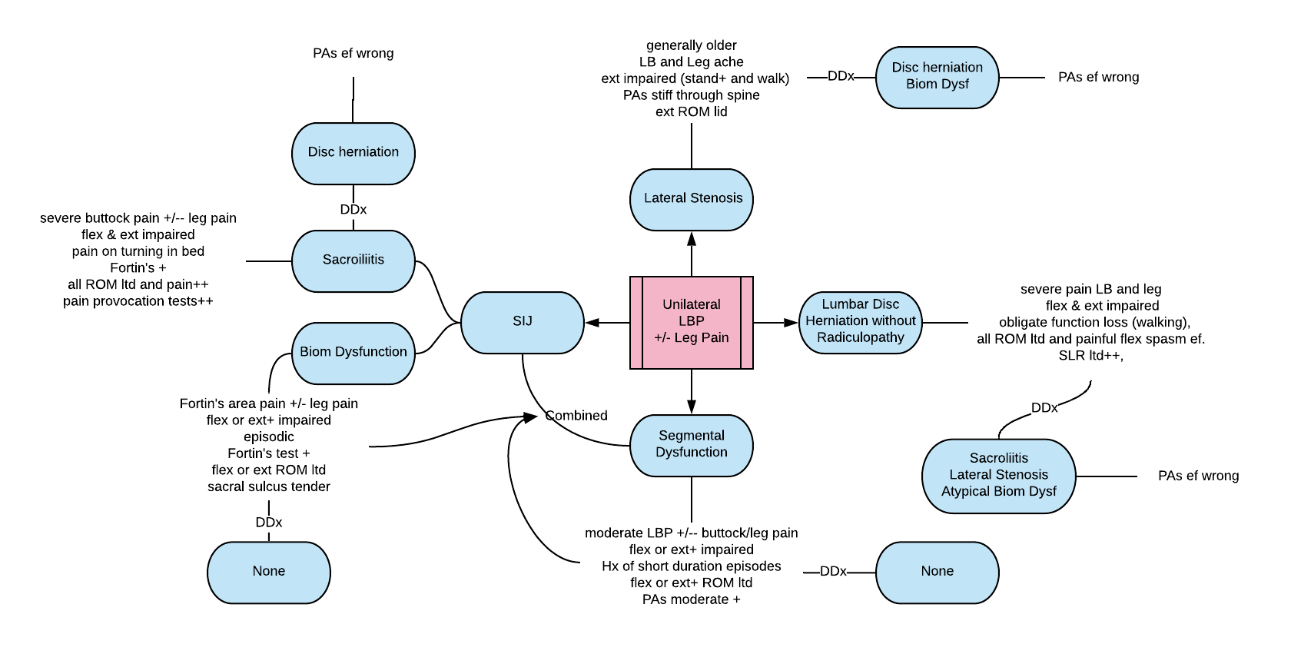

Slide 32
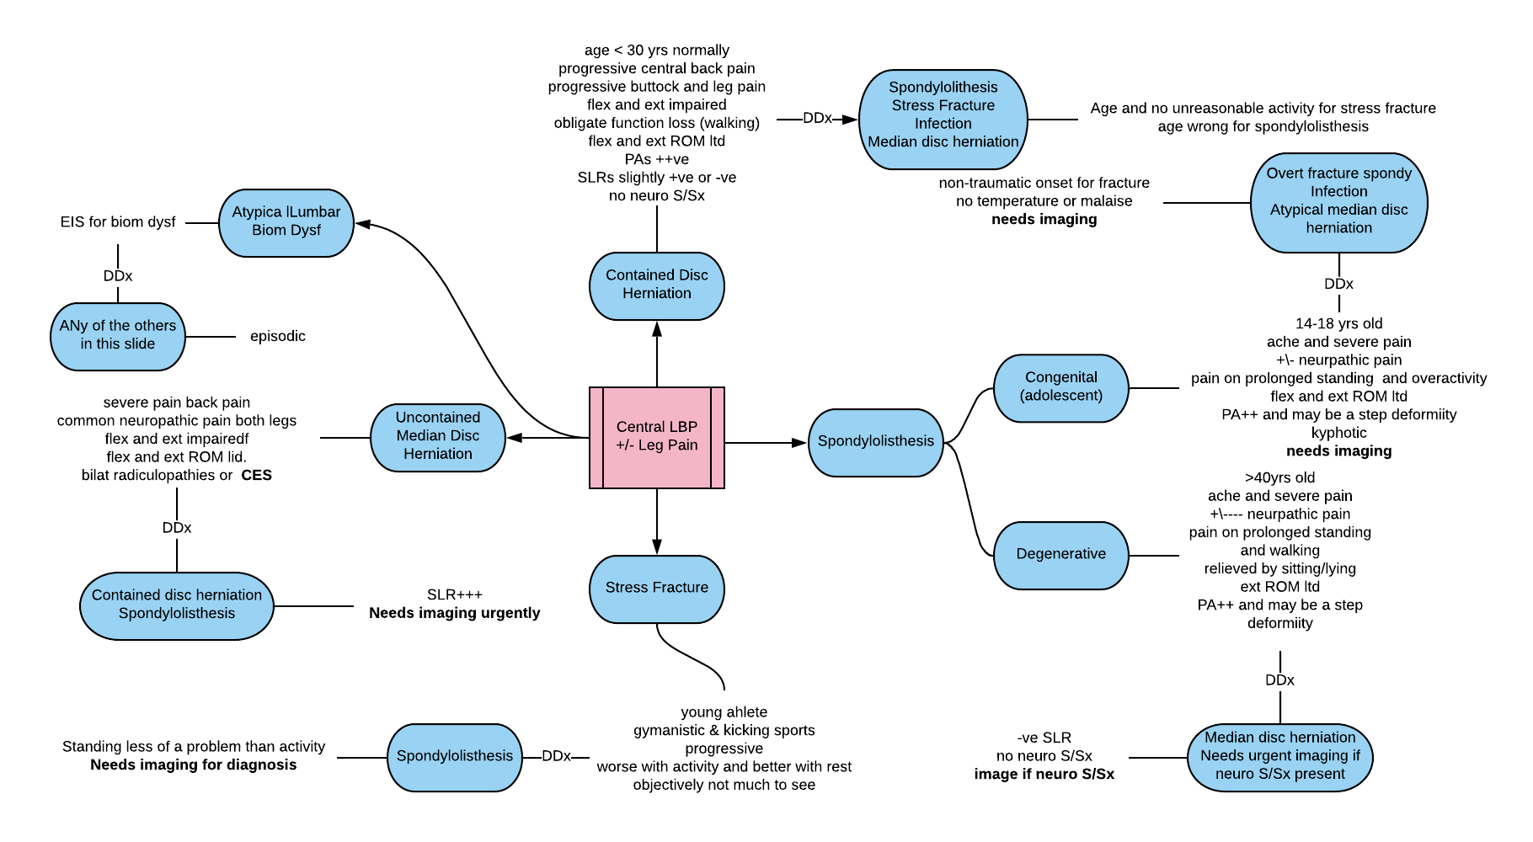

Slide 33
