Slide 1

Swodeam
Institute

Slide 2
Pathologies

Slide 3
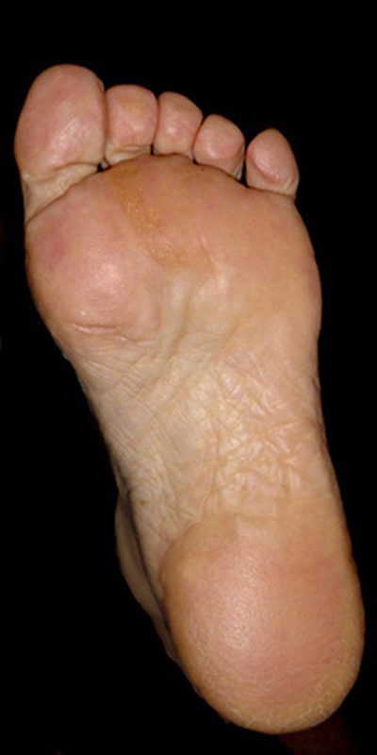
DDx
1
Notes:
What conditions can cause generalised heel pain.

Slide 4
Fat pad atropy
Fat pad spread
Subcutaneous plantar bursitis
Heel Bruise
Stress fracture
Calcaneal cyst
1
Notes:
Plantar fasciitis is not included because the pain is specific to another area.

Slide 5
2
Notes:
Conditions affecting this area?

Slide 6
DDx
Plantar fasciopathy
Spring ligament injury
2
Notes:
There’s your plantar faciopathy (the proper name for undifferentiated plantar fascia pathology). The entire extent of the fascia may also be painful but this goes toe-ward not heel-ward.

Slide 7
DDx
3
Notes:
And here?

Slide 8
Plantar fasciopathy
Muscle tear
3

Slide 9
DDx
4 4 4 4
Notes:
Across the metatarsals?

Slide 10
Stress fracture
Morton’s neuroma
Metatarsal bursitis
Fat pad atrophy
Fat pad dislocation
4 4 4 4
Notes:
More than you thought?

Slide 11
Metarsal and Tarsal Stress Fractures
Bursitis
Fat pad pathology

Slide 12
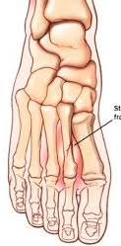
Stress Fractures
There is a difference between a stress fracture and a pathological fracture eg. Osteoporosis but the line between them is blurred eg. Female triad.
Notes:
A pathological fracture, say due to osteoporosis may be triggered by undue stress but that stress would not have been sufficient to cause a fracture unless the underlying pathology was present. This is true of all pathological fracture in that some stress must kick it off the problem lies in our perception of what stress is unde and what is not. Just because somebody runs 15 miles a day it does not necessary result in a fracture but when osteoporosis is present it may well do. The question is “what is undue”. In the end the only way to be sure that the fracture is not, at least in part, due to predisposing pathology is to search for the pathology, bone density studies and the like, otherwise the diagnoses of stress fracture or pathological fracture is presumptive.

Slide 13
Diagnostic Criteria
Non-sudden and either non-traumatic or trivial traumatic onset
Progressive pain
Progressive functional loss
  Hyperactive runners and ballistic exercisers
  Female triad (athletes, malnutrition, amenorrhea)
  Gradual onset and progression of pain relieved by avoiding triggering activity
  Tenderness over the bone and stressing the bone maybe painful
Stressing bone positive (compression, shear, tuning fork and US)
Notes:
Some stress fractures do not conform entirely to this and may come on with a sudden onset of severe pain, calcaneal fractures are an example.

Slide 14
Diagnostic Criteria
Imaging
  Plain-film radiography Radiographs may be negative early in the process and may not be +ve for three months if at all (50% never show up)
  Bone scan about 100% sensitive but low specificity
  MRI gold standard with high (according to some studies and regions) sensitivity and specificity
  Ultrasound cheaper than MRI and in Canada faster but less predictive
Notes:
As you can see from this review, the values of the various imaging for stress/pathological fractures varies widely across studies and from region to region. X-rays are not terribly sensitive for either stress or pathological fractures. Bone scanning may be extremely sensitive but also includes other “hot” conditions such as infections and so is not very specific. MRI is the gold standard and when associated with the clinical picture US works well also.

Slide 15
Diagnostic Criteria
Imaging
Conventional radiography - Sensitivity, 12% (0-29%) to 56% (39-72%); specificity, 88% (55-100%) to 96% (87-100%)
Nuclear scintigraphy - Sensitivity, 50% (23-77%) to 97% (90-100%); specificity, 33% (12-53%) to 98% (93-100%)
MRI - Sensitivity, 68% (45-90%) to 99% (95-100%); specificity, 4% (0-11%) to 97% (88-100%)
CT - Sensitivity, 32% (8-57%) to 38% (16-59%); specificity, 88% (55-100%) to 98% (91-100%)
Ultrasonography - Sensitivity, 43% (26-61%) to 99% (95-100%); specificity, 13% (0-45%) to 79% (61-96%)
https://emedicine.medscape.com/article/1270244-workup
Notes:
As you can see from this review, the values of the various imaging for stress/pathological fractures varies widely across studies and from region to region. X-rays are not terribly sensitive for either stress or pathological fractures. Bone scanning may be extremely sensitive but also includes other “hot” conditions such as infections and so is not very specific. MRI is the gold standard and when associated with the clinical picture US works well also.

Slide 16
In the above study the authors summarized the situation:
The investigators found MRI to be the most sensitive and specific imaging test for diagnosing stress fractures of the lower extremity. ^{[41]} They concluded that when MRI is available, nuclear scintigraphy is not recommended, because of its low specificity, high dosage of ionizing radiation, and other limitations. They also noted that radiography is likely to yield false-negative results at initial presentation, particularly in the early stages of fracture, and sometimes fails to identify an existing stress fracture at any time.
Wright AA, Hegedus EJ, Lenchik L, Kuhn KJ, Santiago L, Smoliga JM. Diagnostic Accuracy of Various Imaging Modalities for Suspected Lower Extremity Stress Fractures: A Systematic Review With Evidence-Based Recommendations for Clinical Practice. Am J Sports Med. 2016 Jan. 44 (1):255-63.
Notes:
So as usual the imaging must follow a clinical diagnosis based on the onset of pain, activity habbits, clinical exam and interpretation of these exams so that it makes sense and does not result in bias.

Slide 17
Stress fractures can be divided into high and low risk stress fractures according to their likelihood of uncomplicated healing with conservative therapy.
High Risk fracture sites:
Femoral neck tension fracture
Transverse patellar fracture
Midshaft anterior tibial facture
Medial malleolus
Talus
Tarsal navicular
5th metatarsal
Sesamoid great toe
Low Risk fracture sites:
Femoral neck compression fracture
Longitudinal patellar fracture
Fracture of the posteromedial aspect of the tibia
Fibula
Calcaneus
2nd + 3rd metatarsal
http://www.radiologyassistant.nl/en/p4615feaee7e0a/stress-fractures.html
Notes:
Some of it is a bit of a tangent to the foot but it gives background.

Slide 18
Treatment
Rest:
  avoidance of stress activity
  airboot or similar
Ice
Ultrasound (1w at 3MH for 10 mins at 50% cycle) Med J Armed Forces India. 2008 Jul; 64(3): 234–236. YK Yadav etal.
IFC/microcurrent
Graduated return to stress
Shockwave therapy
Maintainence of fittness with non-stress activities
Surgery (5th. Metatarsal in particular)
Notes:
Not all of these modalities have the level of criterion validity that might be wished for but they all do have some evidence and for the most part (with the exceptions of risk and Shockwave, slightly higher risk than all except surgery) are cheap and low risk.

Slide 19
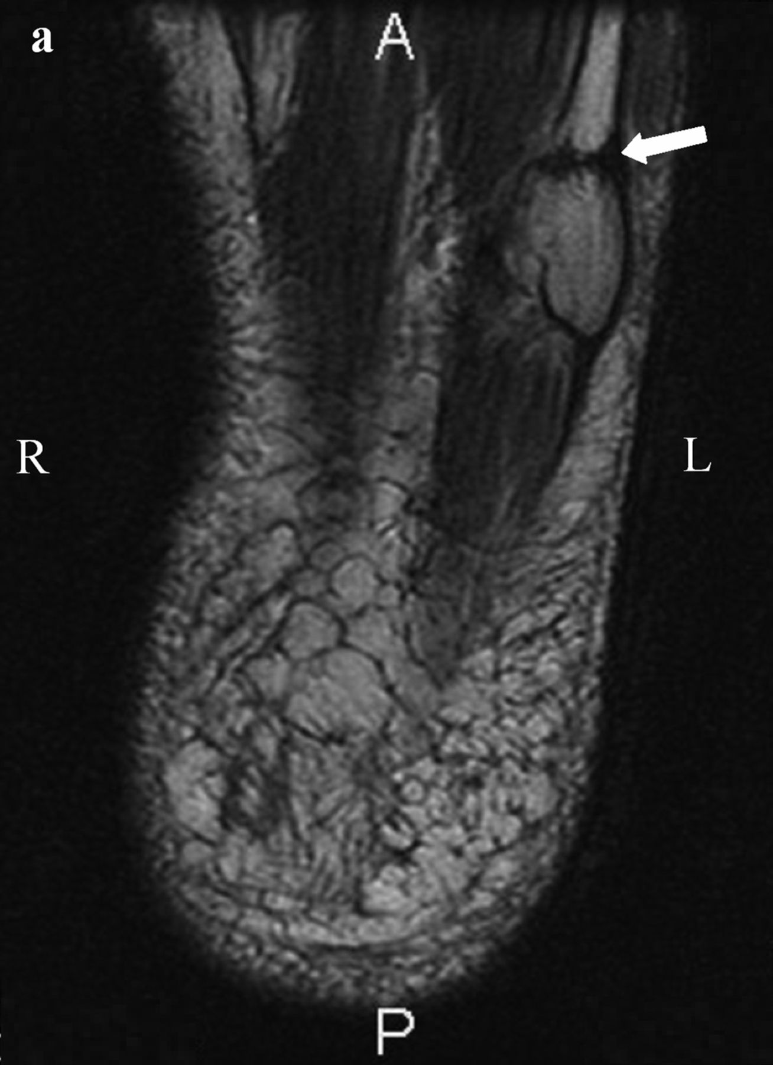
Notes:
A stress fracture of the 5th. Metarsal.

Slide 20
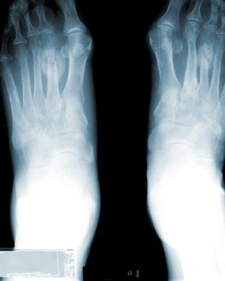
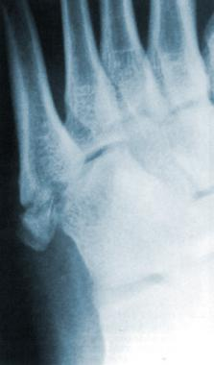
Metatarsal Stress Fractures
http://emedicine.medscape.com/article/85746-overview

Slide 21
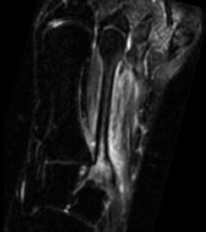
Metarsal Stress Fracture
On the left a 28-year old female with recent onset of pain over a region of the 2nd metatarsal bone.
At presentation, the radiograph was negative for fracture of the second metatarsal bone.
An MRI STIR (Short TI Inversion Recovery)sequence showed a high signal intensity of bone marrow and the surrounding soft tissue, indicating bone marrow edema as a result of a stress fracture.
http://www.radiologyassistant.nl/en/p4615feaee7e0a/stress-fractures.html

Slide 22
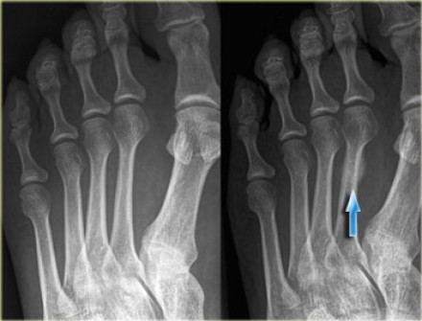
Radiographs have a sensitivity of 15-35% for detecting stress fractures on initial examinations, increasing to 30-70% at follow up due to more overt bone reaction.
Therefore, clinicians should not be comforted by negative radiographs and should initiate further more appropriate art imaging.
Radiographs are however mandatory in order to show overt fractures and to rule out other diseases, like infections or tumours.
On the left a 42-year old female who walks long distances and has been experiencing forefoot pain for a month.
On the initial radiograph no fracture is seen.
After 4 weeks, a follow up radiograph clearly marks callus formation at the site of the stress fracture.
.
http://www.radiologyassistant.nl/en/p4615feaee7e0a/stress-fractures.html

Slide 23
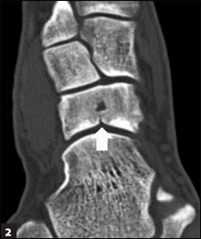
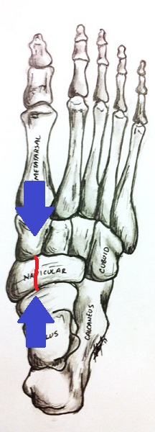
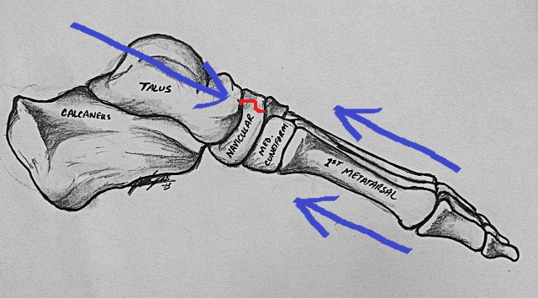
Navicular Stress Fracture
Notes:
CT

Slide 24
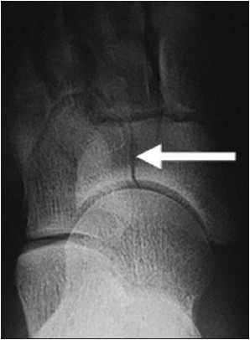
Navicular Stress Fracture
Notes:
X-ray

Slide 25
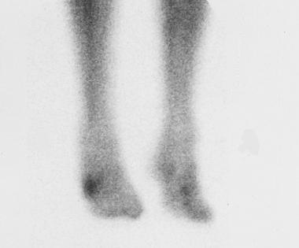
Right 5th. Metatarsal #
Notes:
Bone scan

Slide 26
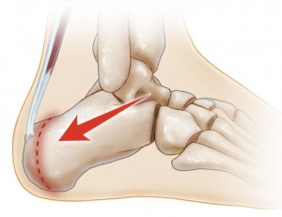
Sever’s Disease (Calcaneal Apophysitis)
The foot’s equivalent of Osgood-Schlatter’s disease and is caused by the same thing, over stressing of the apophysis by the Achilles’ tendon.
Notes:
Overuse of the Achilles tendon pulling on the apophysis.

Slide 27
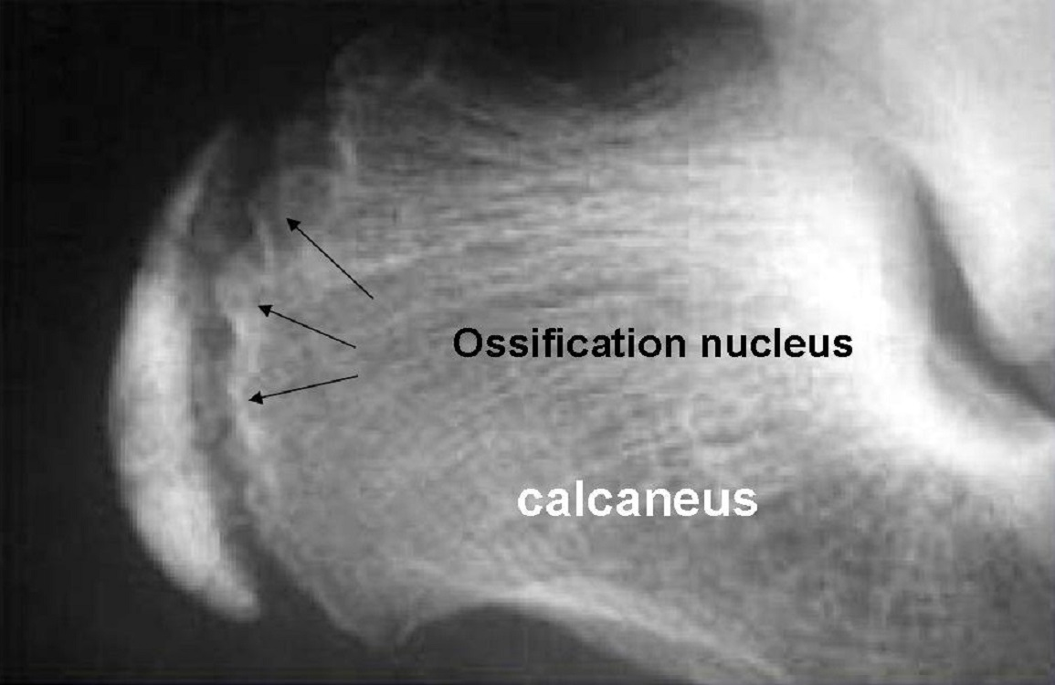
The most prominent symptom of Sever's disease is heel pain in an adolsecent, which is usually aggravated by physical activity such as walking, running or jumping. The pain is localised to the posterior and plantar side of the heel over the calcaneal apophysis. Sometimes, the pain may be so severe that it may cause limping and interfere with physical performance in sports. External appearance of the heel is almost always normal, and signs of local disease such as edema, erythema (redness) are absent. The main diagnostic tool is pain on medial- lateral compression of the calcaneus in the area of growth plate, so called squeeze test. Foot radiographs are usually normal. Therefore, the diagnosis of Sever's disease is primarily clinical.

Slide 28
Diagnotic Criteria
Do not rely on the presence of the heel bump, it may absent in the early stages
Highly active adolscent (jumping and running)
Posterior and plantar heel pain
Pain during and after activities
Lateral-medial compression (squeeze test) painful
Notes:
Atypical adolescent; active!

Slide 29
Treatment
Rest
Orthotics
Aging
NSAIDs

Slide 30
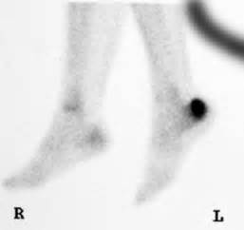
Calcaneal Stress Fracture on Bone Scan

Slide 31
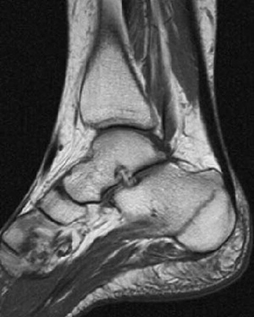
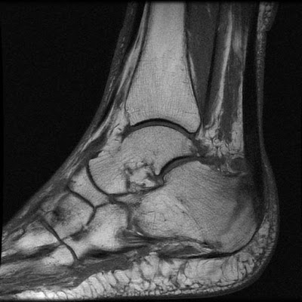
MRI Calcaneal Stress Fracture

Slide 32
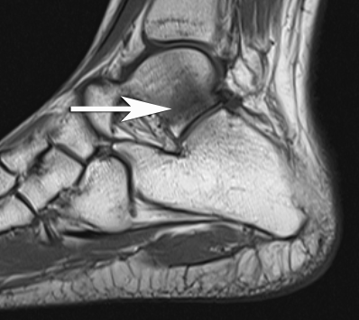
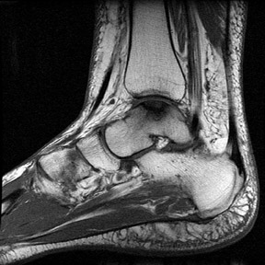
http://appliedradiology.com/articles/mri-of-the-foot?trendmd-shared=1

Slide 33
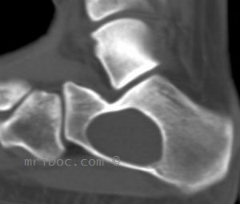
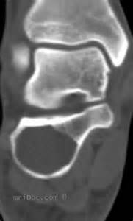
Calcaneal Cyst

Slide 34
Plantar Fasciopathy

Slide 35
Diagnostic Criterion - Fasciitis
Pain with each step
Aching after walking and at end of day
Extreme tenderness
+/- stress test
Notes:
This does not get better after a few steps but continues with each step and may worsen. Remember it is inflamed.

Slide 36
Diagnostic Criteria
Fasciosis
Pain up after prolonged periods of NWB
Pain lessens with a few steps
No aching after pain or at the end of the day
Deep palpation moderate tenderness
Stress test probably negative
Notes:
This is more of what you are familiar and is not inflamed but degenerate.

Slide 37
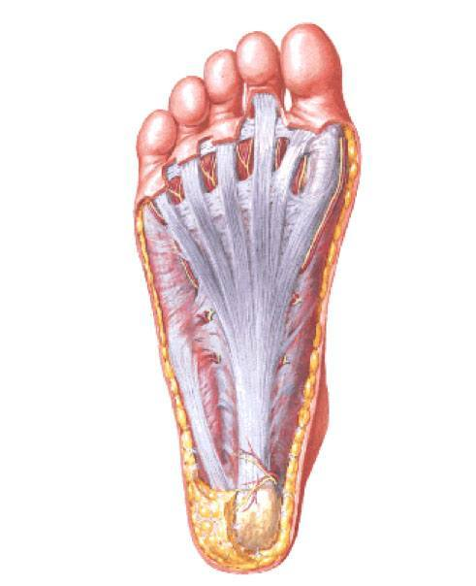
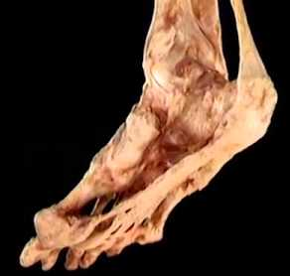
Notes:
Nice clean diagram and a messy dissection.

Slide 38
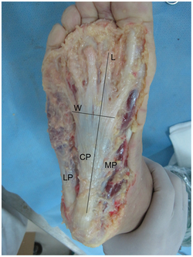
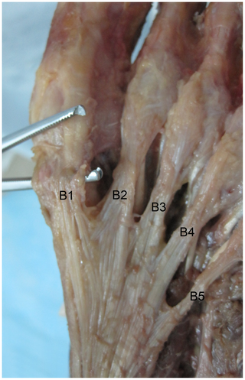
Plantar Fascia
Dissection
Notes:
More mess

Slide 39
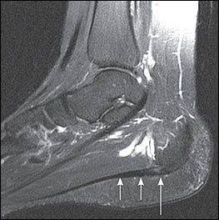
MRI Thickening of the plantar fascia

Slide 40
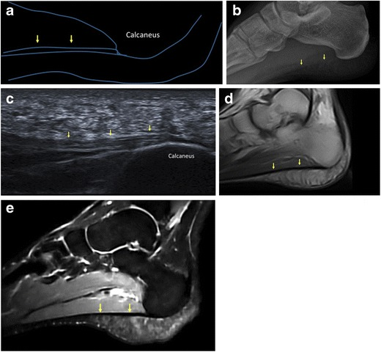
Normal plantar fascia. A schematic representation (a) and lateral plain radiograph (b) show the normal PF (arrows). On sagittal ultrasound scan, the normal PF (arrows) appears as a fibrillar ligamentous structure (c). On MRI, the normal PF (arrows) is seen as a thin band of low signal intensity on both T1-weighted (d) and fluid-sensitive (e) images
https://www.ncbi.nlm.nih.gov/pmc/articles/PMC5265197/
Notes:
Various imaging of plantar fasciopathy. The presence of a bone spur simply shows a traction osteophyte not the presence of plantafasciopathy.

Slide 41
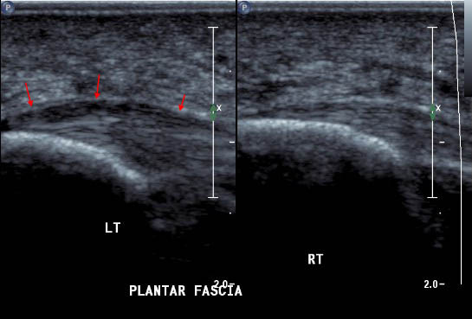
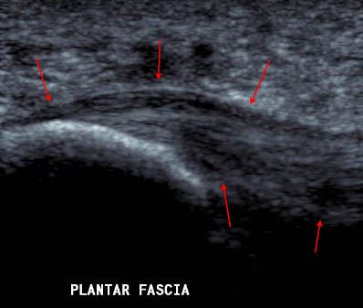
ULTRASONOGRAPHY PLANTAR FASCIA
BELOW
The red arrows indicate the margins of the thickened plantar fascia. Note the convex shape and hypoechoic change.
ABOVE
A thickened plantar fascia origin (red arrows) compared to a normal plantar fascia on the right.
http://www.ultrasoundpaedia.com/pathology-foot/

Slide 42
Fat Pad
There are at least three distinct fat pads:
Kager’s (under the Achille’s tendon)
Calcaneal (under the heel and along the lateral border of the foot)
Metatarsal (under the metatarsal heads and toes)
Notes:
The fat pad can be burst, atrophied and inflamed.

Slide 43
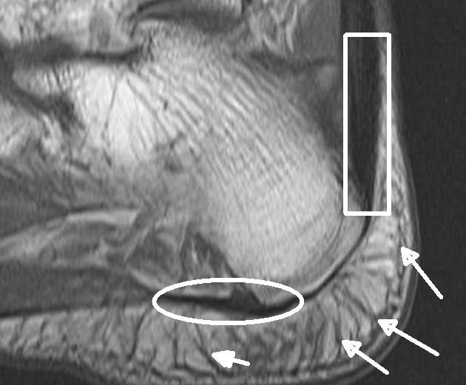
This is a MRI scan of the heel. Inside the white box is the Achilles tendon insertion. The round white oval shows the attachment site of the plantar fascia. The white arrows show the bands of tissue called fibrous septae that hold the fat pad in place. In health this prevents it being dislocated during movement. This configuration is common throughout the body and helps protect the enthesis.

Slide 44
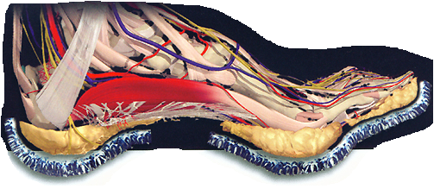
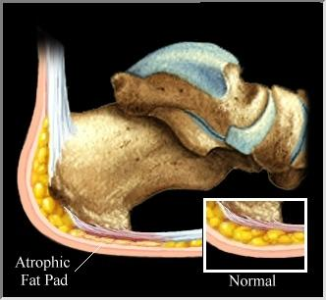
The following applies to all fat pads but those in the feet are more susceptible to injury due to weight bearing.
There are two distinct chambers, the micro and macrolayers both of which have septae or quasiligaments that run through the them to form small groupings of fat cells and act as baffles to prevent to much spreading and in the deeper layers to to anchor them to the underlying periosteum thereby preventing slipping. For a slide show on the properties of the fat pad of the heel go to: http://www.professionalevents.co.uk/_images/_products2downloads/82_219.pdf

Slide 45
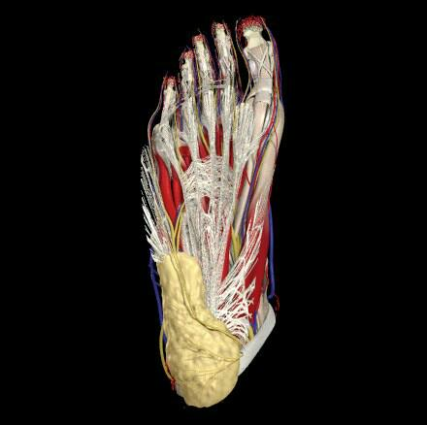

Slide 46
Diagnostic Criteria
Tenderness of pad itself
Able to palpate the underlying tender bone
Able to palpate its malposition
Squeezing the fat pad from it’s sides reduces the tenderness and the palpability of the underlying bone

Slide 47
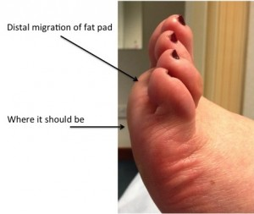
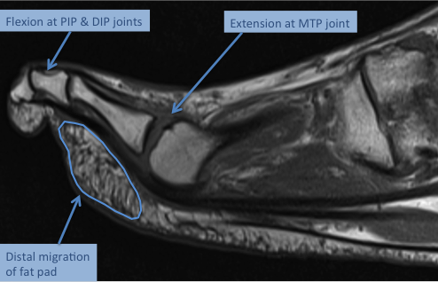
Slipped Fat Pad

Slide 48
Bursitis
There are at least eight bursae in the foot and ankle
  Subcutaneous
  Plantar calcaneal
  Retrocalcaneal
  Metatarsal (the interdigital bursae may be part of this)
  Lateral malleolar
  Medial malleolar
  Subcutaneous Achilles
  Kagel’s

Slide 49
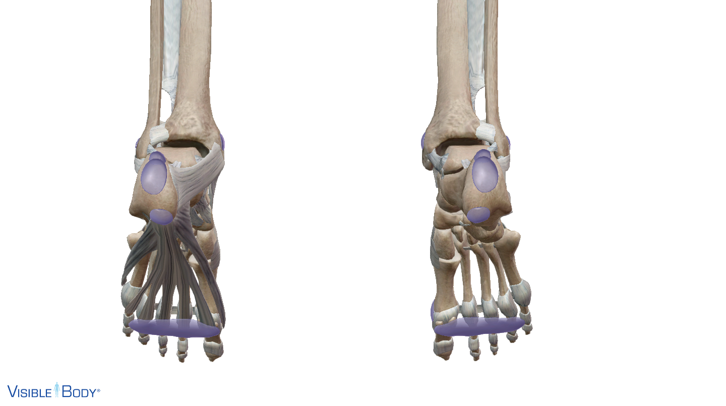
Metatarsal
Calcaneal
Subcutaneous Calcaneal
Retrocalcalcaneal
4
3
2
1
1

Slide 50
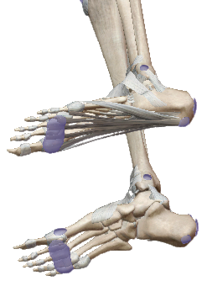
1
2

Slide 51
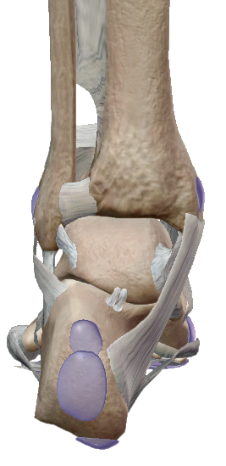

Slide 52
Diagnostic Criteria
Mainly a diagnosis of exclusion but there may be:
  Pain with barefoot walking > than wearing shoes
  Swelling
  Superficial tenderness and painful to squeezing
  Malposition of bursa when it slips

Slide 53
Causes
Direct impact
Systemic arthropathy
Infection (septic bursitis
Other altered biomechanics particularly an antalgic gate
Hammer toes (slipped and non-slipped bursitis)
Contact inflammation with plantar fasciitis or tendonitis as examples
Poorly fitted orthotics

Slide 54
Treatment
Deal with the cause if possible:
  Change footware
  Change orthotic
  Eliminate the pain and hence the antalgic gait
  Deal with the pathomechnanics
Ice
IFC
High dose ultrasound
Low intensity Shockwave therapy

Slide 55
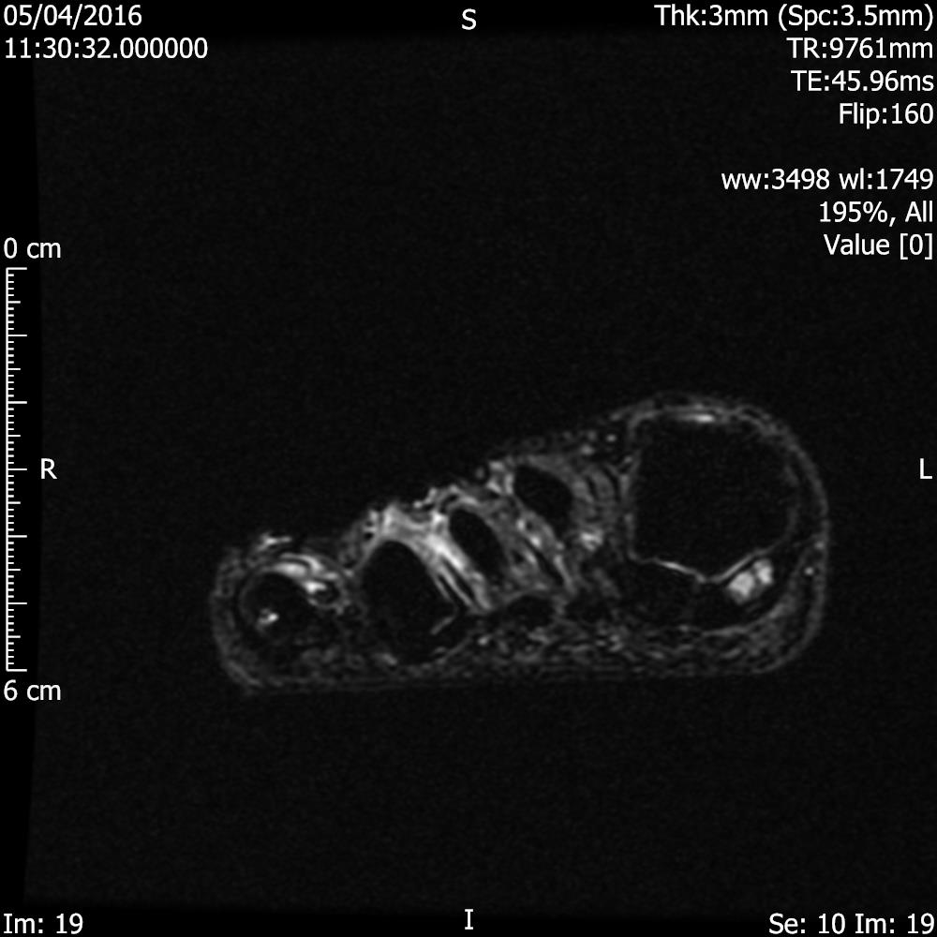









Fig. 1: Intermetatarsal bursitis of 3rd space: STIR axial image of forefoot shows hyper intense fluid signal in 3rd intermatatarsal space with mild medial sesamoiditis: References: Radiology,NHS Trust, university hospital Leicester-Leicester/UK

Slide 56
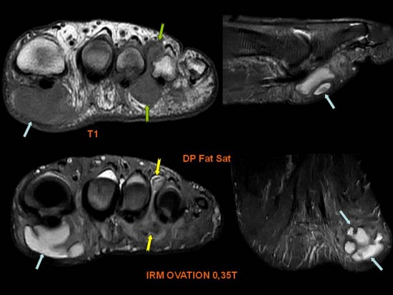
Soft tissue mass between the 3rd and 4th metatarsal heads, hypointense on T1 (->); slightly hyperintense on DP FS
(-> ). Association with a fluid collection (->) hyperintense on DP FS, under the first metatarsal head.
The mass is a Morton’s neuroma

Slide 57
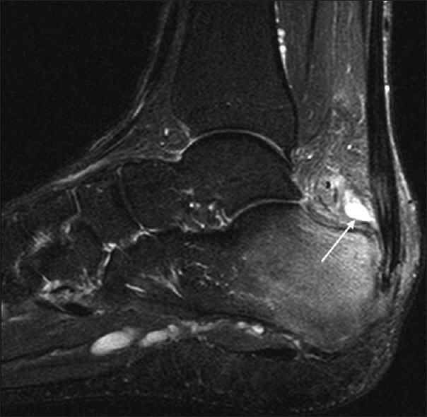
Retrocalcaneal Bursitis MRI

Slide 58
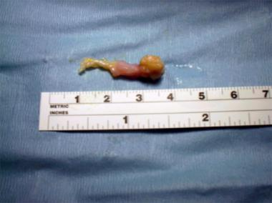
Morton’s Neuroma

Slide 59
Diagnostic Criteria
Episodic of increasing frequency
Neuropathic pain and dysesthesias
Cramping
Decreased sensation in the two adjacent toes

Slide 60
The green arrows indicate the neuroma

Slide 61
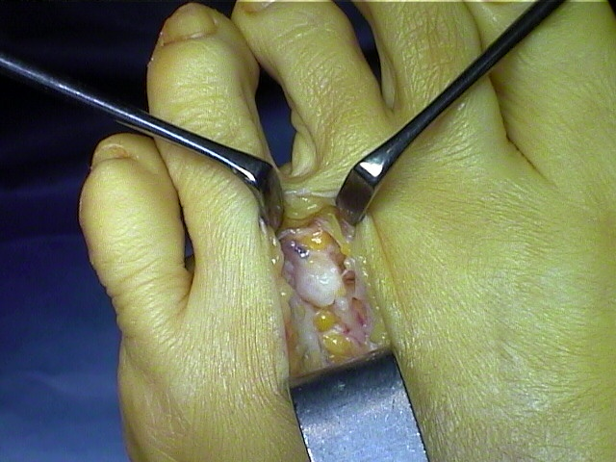

Slide 62
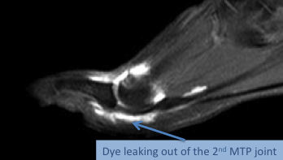
An ultrasound may reveal a hypoechoic defect in the plantar plate, usually at the distal attachment. An arthrogram may demonstrate synovial hypertrophy and extravasation of dye into the flexor tendon sheath. MRI may also demonstrate a tear of the plantar plate with increased signal intensity within the plate, along with a loss of continuity.

Slide 63
Metatarsalgia
Given that the term means metatarsal pain, it is not a diagnostic but a restatement of the patient’s symptoms. The forefoot pathologies above that cause pain at the metatarsal heads cause metatarsalgia but the following are also causes:
Plantar plate tears
Avascular necrosis (children)
Bunions
Sesamoiditis
Arthritis
Neuropathy (commonest is diabetic)

Slide 64
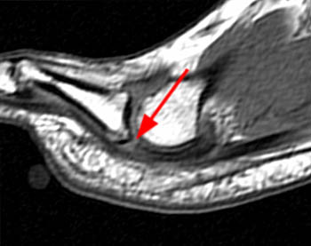
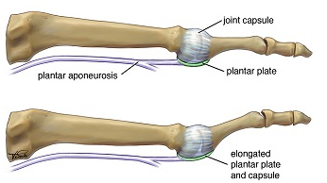
Plantar plate tear
Most commonly experienced by middle aged women whose feet have a tendency to over-pronate or roll in, a plantar plate tear is often a cause of persistent pain and swelling in the ball of the foot. It is also commonly associated with a bunion and a hammer toe.
https://www.myfootdr.com.au/conditions-treated/plantar-plate-tear/

Slide 65
Cause
The second metatarsophalangeal joint is most likely to be affected as it is the longest metatarsal and has unopposed lumbricals and no plantar interossei insertions. Plantar plate tears usually result from repetitive overload from abnormal forefoot loading patterns resulting from hallux valgus, excessive pronation, short first metatarsal or long second metatarsal. The tear usually arises from the base of the proximal phalanx.1
http://www.aapsm.org.au/

Slide 66
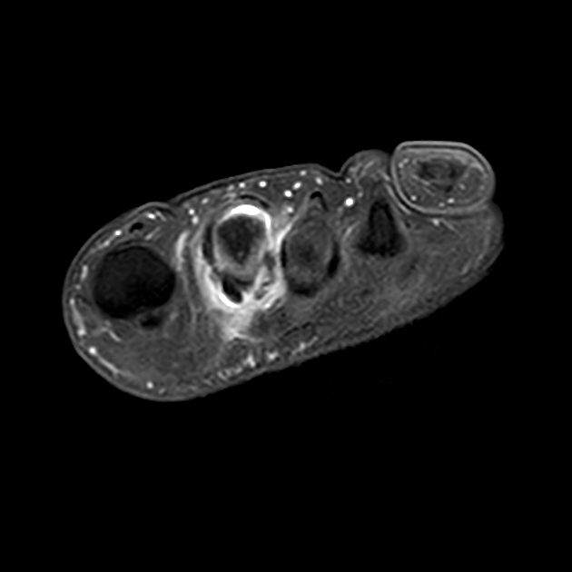
Tears of the plantar plate may be the most common cause of pain under the second metatarsophalangeal joint, though it can occur at any of the metatarsophalangeal joints. It is also referred to as predislocation syndrome, crossover toe deformity and floating toe syndrome. A fibrocartilaginous thickening of the metatarsophalangeal joint, the plantar plate serves to:
stabilize the metatarsophalangeal joint
assist in the windlass mechanism due its attachment to the plantar fascia
resist hyperextension of the metatarsophalangeal joint
absorb compressive loads
http://www.aapsm.org.au/
Clearly there is inconsistency between practitioners; the sports podiatrist vs. the general practitioner. They have different experiences that lead to differing opinions on epidemiology and cause. Probably both are correct depending on which population is seen. JM

Slide 67
Diagnostic Criteria
…... complains of localized pain under the metatarsophalangeal joint. Swelling may be present, extending to the dorsal aspect of the joint. Pain is aggravated by dorsiflexion of the affected joint. Neuroma-like symptoms may be experienced by patients due to irritation of the plantar digital nerve from the localized oedema.
Examination reveals pain at the base of the proximal phalanx which may be aggravated by dorsiflexion of the joint. In relaxed stance a dorsiflexion deformity of the toe may be noted. This is often accompanied by a crossover deformity. The modified Lachman’s test can also be utilized. The metatarsal head is stabilized and the proximal phalanx is dorsally translocated (see Fig 3). A 2mm or 50% joint displacement is a positive sign of plantar plate laxity.
http://www.aapsm.org.au/

Slide 68
Treatment
Treatment initially consists of icing, NSAIDs, relative rest, plantarflexion strapping of the digit (see Fig 4) and accommodative padding to reduce loads under the affected metatarsophalangeal joint. Orthoses and a stiff-soled shoe or rocker-bottom shoe are also required. Orthosis modifications may include a plantar metatarsal pad (the bulk of the pad should sit proximal to the metatarsal heads), anterior shell edge longer to the second metatarsal (Fig 5), and control rearfoot and midfoot forces which may lead to overload at the 2nd MPJ. Soft top covering options should also be considered. An extra-articular corticosteroid injection may also be useful. Primary repair of the plantar plate with or without a flexor tendon transfer may be required in patients that don’t respond to conservative measures.
http://www.aapsm.org.au/

Slide 69
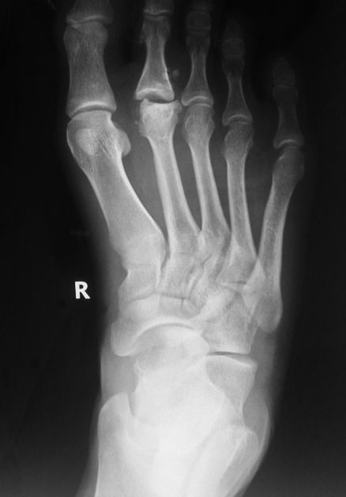
Avascular necrosis
Freiberg disease, also known as Freiberg infraction, is osteochondrosis of metatarsal heads. It typically affects the 2nd metatarsal head (the 3rd and 4th may also be affected). It can be bilateral in up to 10% of cases.
It is commoner in women aged 10-18 (male to female ratio of 1:3) (Other authorities suggest children from 10-15 years without a gender preference).
The cause of Freiberg infraction is controversial and is probably multifactorial.
A traumatic insult in the form of either acute or repetitive injury and vascular compromise, perhaps due to an elongated 2nd metatarsal, are the most popular theories, and as it is more commonly seen in women, particularly during adolescence, high-heeled shoes have been postulated as a possible causative factor.
Histologically, Freiberg infraction is characterised by the collapse of the subchondral bone, osteonecrosis, and cartilaginous fissures ¹.
←------------
https://radiopaedia.org/articles/freiberg-disease

Slide 70
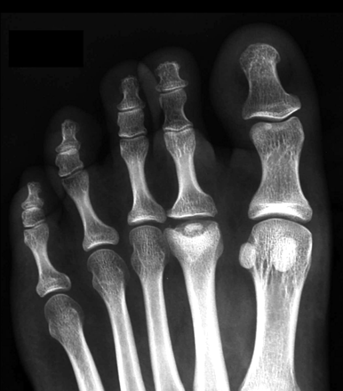
Diagnostic Criteria
Clinically they present with pain that is increased by weight-bearing, plus swelling and tenderness. So not a lot there to differentiate it from other causes of metatarsalgia except the age and sex of the patient and there is a three to one chance that this guide will be wrong.
Imaging is necessary to differentiate the condition definitively. JM
Plain radiograph
These can be split into early and late features:
Early
flattening and cystic lesions of the affected metatarsal head
widening of the metatarsophalangeal (MTP) joint
Late
osteochondral fragments
sclerosis and flattening of the bone
increased cortical thickening
https://radiopaedia.org/articles/freiberg-disease

Slide 71
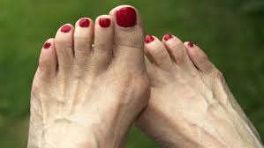

Hallux Valgus and Bunions
Comprises of:
Medial deviation of the first metatarsal
Lateral deviation and/or rotation of the hallux
Prominence, with or without medial soft-tissue enlargement of the first metatarsal head
http://emedicine.medscape.com/article/1235796-overview

Slide 72

Hallux Rigidus
Hallux rigidus is a syndrome with symptoms related to degeneration of the first MTP joint. The symptoms result from cartilage wear, altered joint mechanics, and osteophyte formation, particularly on the dorsal aspect of the first MT head. The pain in hallux rigidus usually derives from impingement of dorsal osteophytes, from shoe-related pressure on prominent osteophytes, or both. Irregularity of the articular cartilage surface(s) can result in pain at the extrmes of motion with activity.

Slide 73

Gout
Gout can cause pain in joints other than the big toe and it can also cause enthisitis including Achilles tendonitis and plantar fasciitis. The appearance in the photo is pretty acute and may also be caused by infection, so if this turns up in your clinic you should get is seen immediately by a physician who should eliminate the possibility of infection before worrying about gout.

Slide 74

A little less acute but it will be extremely tender and painful on movement and pressure.
There is no good reason for us to try to treat this when medication works well especially in the acute phase.

Slide 75
Swodeam
Institute

