Slide 1

Provider Disclaimer
  In compliance with continuing education requirements, all presenters must disclose any financial or other associations with the manufacturers of commercial products, suppliers of commercial services or commercial supporters as well as any use of unlabeled product(s) under investigational use.
  Athletico Physical Therapy, event committee and the presenters for this event do not have financial or other associations with the manufacturers of commercial products, suppliers of commercial services or commercial supporters.
  This presentation does not involve the unlabeled use of a product or product under investigational use.
  There was no commercial support for this activity.

Slide 2
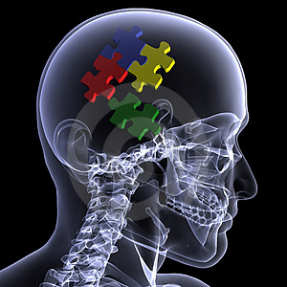
IMPACT
SCRIPT FOCUSED HYPOTHETIC DEDUCTION

Slide 3

At a minimum, all therapists
MUST
be able to make an uncomplicated pathoanatomical diagnosis regardless of their level of experience
Notes:
Without knowing which structures are affected by which pathologies you cannot determine the optimal treatment. Treatment based classification systems are not useful when dealing with the condition demonstrating a non-average presentation or when two or more conditions co-exist. Even if we allow the statistics to determine things only about 63% of conditions will fall within one standard deviation of the average leaving you lost with about one third of your patients. You also have to consider that you are totally relying on the ability of the maker of the classification to be correct one hundred percent of the time to arrive at the lower one third.

Slide 4
Pathoanatomical Diagnosis
Central to the discussion today must include:
The structure
The pathology
So Low Back Pain is not such a diagnosis
But a syndrome is allowed if the pathology or the structure is unknown and the collection of S/Sx characteristic

Slide 5
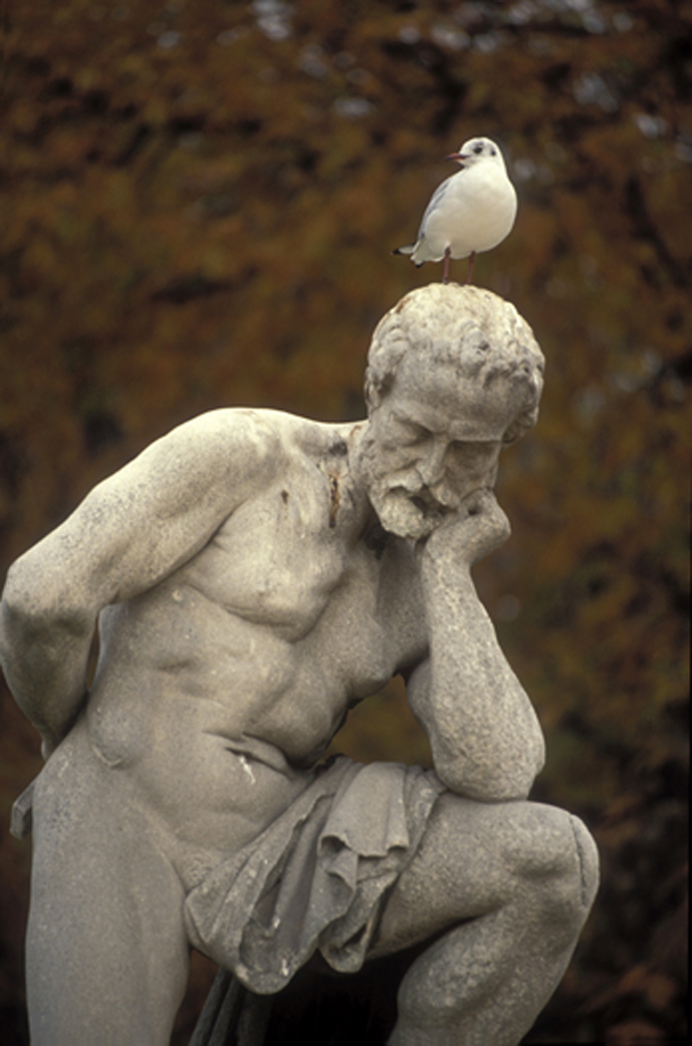
Script Focused Hypothetic Deductive Reasoning
A New Method from Old Tools
Notes:
Script focused deduction combines a modification of the illness script with hypothetic deductive reasoning. The modified illness script focuses the hypothetic deductive examination on the hypothesis being tested and prevents extraneous questions that confound the process.

Slide 6
What’s New
Principles of thin slicing
Modification of the illness script
Modification of hypothetic-deduction
Built-in bias correction and error reduction
Notes:
Script focused hypothetic deduction mimics the pattern recognition of the expert by modifying the illness script and combining it with hypothetic deduction to allow even brand new therapists to work through a system of repeatedly testing hypotheses focusing only on the illness script of the hypothesis under test. Finally specific bias correction measures are taken after the diagnosis is arrived at.

Slide 7

Clinical Reasoning Definition
Clinical Reasoning is a sub-set of Critical Reasoning which may be defined as the logical and rational processing of previously held formal knowledge, current information about the particular case, and knowledge from experience together with error reduction in the solving of a given problem.
Notes:
Clinical reasoning is a subset of critical reasoning that is necessary in all spheres of rational problem solving in every part of life.

Slide 8
Notes:
Making a diagnosis entails three main inputs, formal knowledge you learned in school, from books and others, experiential knowledge that you have garnered over the years and information received directly from the patient’s history and response to your tests. You generate your hypothesis as soon as you have sufficient information from the patient to do and the hypothesis is tested as more information comes in and is mixed with your innate knowledge. Eventually this generates a diagnosis or you saying I have no idea what the hell this is and sending for a second opinion. The diagnosis is used to make a prognosis and a treatment plan. Final testing of the diagnosis is when treatment is applied, if the patient responds as you expect your diagnosis is proved, at least for all practical purposes and if not then you have either messed up the treatment or the diagnosis.

Slide 9
Differential Diagnosis
The selection of one diagnosis among two or more possibilities based on best available general and specific evidence including criterion, construct and other forms of validity, experience and data generated by and about the patient. It may also be defined as diagnosis by exclusion from a list of possibilities using the same criteria as above.
Notes:
The problem with differential diagnosis is clearly evidenced by the TV series House. Listing a bunch of diagnosis that fulfills all of the information is cumbersome and to it add that we cannot employ objective tests such as imaging and lab studies to test each potential diagnosis. However, DDx is a useful tool for certain types of bias correction such as anchoring and we will use it as such.

Slide 10
it is important that we do not lose site of the fact that the only way we can innovate new techniques, models and philosophies is to understand what is happening with our patients and how our treatments help. Classification systems do not allow this and so should be eliminated from our approach
In addition the regression to a syndrome approach in which clusters of signs and symptoms rather than specific pathologies are used to determine treatment makes for dumbed down therapists
Notes:
Given that you are taking a clinical reasoning course I have every expectation that you would rather problem solve rather than follow somebody else’s direction, particularly as you have no idea of how good the authority is. This way any mistakes are you own but all the successes belong to you.

Slide 11
Non-pathoanatomical Diagnosis
There is currently a trend in physical therapy to move away from pathoanatomical diagnosis (and incidently differential diagnosis) and towards treatment based classification systems
There is very little evidence but much opinion about the weakness of the pathoanatomical diagnosis but it is built on solid construct and it is the system used in allopathic medicine
Notes:
There has always been in innate and inane prejudice against pathoanatomical diagnosis buy the traditional physiotherapist of 50 years ago which has to a large extent survived in non-clinicians today. The large part of the opposition to PADx was that it is the physicians job to make the diagnosis and our job to work with it. But as even the newest members of our profession know it is extremely rare to get a sensible musculoskeletal diagnosis from your referrer (things such as muscle tear and low back are the standard), additionally most are now seeing patients on a primary care basis which means you are on your own for the diagnosis.

Slide 12
Clinical Reasoning Requirements
Systemic Knowledge
  Anatomy
  Pathology
  Physiology
  Biomechanics
  Research and non-research data
    Prevalence and incidence
    Sensitivity and specificity values (likelihood ratios)
Notes:
In order to reason critically and clinically you must have information and have critically processed that information so that the information becomes background knowledge. To complete the process of clinical reasoning with any hope of success you must have and have done the following things. Have good systemic knowledge of basic sciences and possess a minimum of clinical skills.

Slide 13
2. Patient Information
  From the patient – signs and symptoms
  About the patient – objective test results
Notes:
Be able to entice the patient to verbally give you the information you need (and entice is often the word) and be able to carry out the appropriate tests necessary.

Slide 14
Cognitive reasoning in the form of integration and analysis of all necessary information. It must be:
  Logical
  Rational
  Reasonable
Bias/error reduction
Notes:
You must then be able to integrate and analyse this information, being able to discard irrelevant data. You must be logical, rational and reasonable or you’ll be seeing the proverbial zebra.

Slide 15
Clinical Reasoning Methods
Above all Else, Knowledge and Logic

Slide 16
Methods and Tools
Axioms
Pattern Recognition
Algorithms
Hypothetic-deduction
Essential Illness Scripts
Notes:
The word axiom may need some clarification before we go to much further. An axiom is a statement that is considered self-evident and true. Often unproven but they have stood the test of time and either not failed or not failed significantly. As you may realize this is not exactly scientific but it is usually a good tool. As much as possible do not use them unless you need to.

Slide 17
Axioms
  Occam’s razor
  Sutton’s law (go where the money is)
  Treat the patient, not the numbers
Notes:
Occam’s (Ockham) razor has been simplified to “don’t make things more complex than they need to be”. An extension should be “don’t make them simpler than they are. The most obvious example is to make a single condition the target providing it answers the totality of the presentation. If it doesn’t then multiple pathologies are likely. Similarly, multiple common diagnoses are more likely than a single rare diagnosis and this to follows the rule of Occam in that mutliple diagnoses are simpler than one rare condition. Sutton’s law states that the first tests to be used must be those that are most likely to prove positive. And treat the patient not the numbers means that the presentation is more important then the frequency and prevalence of the condition and you should not disregard rare conditions simply because they are rare.

Slide 18

Pattern Recognition: Thin Slicing
Using a minimum of information to reach a correct decision or diagnosis. The diagnosis is often made within seconds of the patient being seen with the clinician only needing to ask a couple of confirmatory questions and undertake one or two tests to reduce the risk of error
Notes:
This is the domain of the expert who has seen the condition many times in most of its disguises. It comes only with reflective experience and cannot be learned in any other way. But as we will see, it can be mimicked.

Slide 19
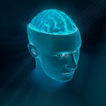
Pattern Recognition
Thin slicing has been demonstrated many times to be an effective method of problem solving for many decades and it is known by many other names most commonly “a gut feeling” or “subconscious”
Notes:
This comes from the social science domains of psychology and it is ability to see patterns of behavior from short interactions. You soon learn to determine the patient’s personality, motivations, involvement etc in a very short period. But it is also a form of pattern recognition and I may use the term synonymously with it.

Slide 20
Pattern Recognition
Though counter-intuitive there is good evidence going back many years that decisions can be made about very complex problems with a minimum amount of information often better than when there is an abundance of information.
On the other hand a simple decision may need as much information as can be obtained.
Klein, G. The Power of Intuition, in Sources of Power. MIT Press, Cambridge. 1998
Oskamp, S. Overconfidence in Case Study Judgments. J Cons Psychol 39:3 1965
Reilly, B. et al. Triage of patients with chest pain in the emergency department. A J Medicine 112 2002
Notes:
An example given in Gladwell’s book “Blink” is buying a car. It is easy and quick narrowing the choice down to two or three from dozens but determining which of the two or three requires a good deal of studying each of them and hours of anguishing about the choice.

Slide 21
Pattern Recognition
Over-confidence in Case Study Judgements. Oskamp, S. J Consult Psychol 29:3 1965
Notes:
A word about experts and distinguishing them from pretenders. It has been demonstrated that experts and incompetents both evidence high levels of confidence but incompetents have higher levels and do not doubt themselves. Experts, on the other hand, will have less confidence in their conclusion than will over-confident incompetents and in fact their confidence is at lower levels than it should be. Beware of people who have no doubt about their abilities and conclusions.

Slide 22
Strengths and Biases and Weakness of Pattern Recognition
It is fast and generally very accurate
The main bias here is diagnostic and information anchoring; that is if heavily invested in the diagnosis the therapist may not change it when necessary.
De-biasing takes the form of actively trying to disprove the diagnosis so ask and do other than confirmatory questions and tests
Pattern Recognition
Notes:
The strength of pattern recognition is that it is fast and almost always accurate. The obvious weaknesses are that inexperieced therapists cannot do it and when it goes wrong it goes very very wrong. Anchoring occurs at all levels of clinician and in fact is probably more common with the inexperienced but it does happen with experts using pattern recognition sometimes. With the inexperienced therapist they have so much information coming at them that if they meet an unfamiliar presentation (and most are at the beginning) then they grab and hold tightly on to the first datum that makes any sense or that they recognize and nothing can take them off of it. It is also likely that the same mechanism occurs in experts so that when faced with the unfamiliar they continue to use pattern recognition and buoy themselves up with the familiar.

Slide 23

Developing trust in your ability to thin slice may be problematic, that is trust in a minimum of information rather than a maximum
Probably the biggest problem with this method of clinical reasoning is that it does not seem teachable, rather the clinician has to allow it to develop over time and not be afraid to trust it
Notes:
It takes quality time to be capable of pattern recognition, it is not just a matter of putting in time but being critical of your performance and results and reflecting on cases, particularly difficult ones or those you failed with. It cannot be taught you must develop it and develop your trust in it.

Slide 24

Hypothetic-deduction: the Ultimate Heuristic
This is the most widely used method of clinical reasoning by the non-expert
It is the generation of a hypothesis from minimal information which is then tested
It is used from the first glimpse of the patient to the final test
https://en.wikipedia.org/wiki/Hypothetico-deductive_model
Notes:
This from Wikipedia. The hypothetico-deductive model or method is a proposed description of scientific method. According to it, scientific inquiry proceeds by formulating a hypothesis in a form that can be falsifiable, using a test on observable data where the outcome is not yet known. https://en.wikipedia.org/wiki/Hypothetico-deductive_model

Slide 25
Hypothetic Deduction
The first hypothesis (H1) is usually based on knowledge of the anatomy underlying the pain, the observation of the patient, and the statistical probability of the condition being present
Notes:
Generally the first thing the patient tells you is where the pain is and so H1 is based on that. If the patient talks about the pain quality then H1 may not be possible until more information comes in and usually the follow up question to it is where is the pain and you are away. Trying to get the therapist to make H1 out loud is like pulling teeth; “I need more information before I can do that” is the usual response but it’s not true. The therapist automatically formulates a hypothesis, he/she is just too intimidated to say it out loud. If you can’t formulate a hypothesis then meaningful questions are not possible and random questions does not work. Properly done hypothetic deduction is an evolving algorithm.

Slide 26
Hypothetic Deduction
H1 is tested with a question focused on the hypothesis
The hypothesis fails when a key question or group of questions weakens it sufficiently but at the same time generates H2
Notes:
Ideally questioning is focused on the hypothesis and extraneous questions are not be entertained as they are distractions. Generally speaking though this doesn’t happen because we are trained not to do this. We have all been told not to make a decision or come to a conclusion until you have all the information possible. This simply doesn’t work and only leads to confusion or worse Anchoring to the bit of information that is familiar.

Slide 27
Hypothetic Deduction
By the end of the subjective examination the clinician may have changed the hypothesis a number of time but should have at least 70% confidence that the hypothesis will turn out to be the correct diagnosis
The objective examination is therefore primarily undertaken to convert the hypothesis into the diagnosis by “proving” it and make it more precise
Notes:
It is worth noting that the only reasonably secure “proof” of the diagnosis is that the condition responds to the chosen treatment as expected and scientifically speaking even that’s not definite but the patient doesn’t care about that and you are not doing formal research.

Slide 28
Strengths and Weaknesses
Hypothetic Deduction
It is scientific in the very real sense of the word and constantly has an end point in view, proving (or disproving Hn)
The clinician should be kept focused by the hypothesis
The real weakness is the inability of most therapists to stay focused on the hypothesis
Notes:
Hypothetic deduction is practical science in that you formulate a hypothesis based on observation (the first symptom) and you try to prove it (conversely disprove it) by testing it with more tests (test in this sense means questions and objective tests). Anchoring becomes an issue here if the therapist takes in too much information, which is almost always the case and later we will see how script focused deduction tries to reduce this tendency.

Slide 29

Hypothetic Deduction
The therapist is often reluctant to take the first step by forming H1 until all information has been collected
The probability of diagnostic and information anchoring, base rate neglect or regression to the familiar bias are distinct. Therefore active steps must be taken to reduce bias.
Notes:
Because we are told from an early age that more information is better we are timid when it comes to forming H1 and this is a definite bar to accurate reasoning. You cannot, as already stated, ask sensible and pertinent questions if you don’t have some idea of what you are asking about. Hypothetic deduction runs the full gamut of biases and steps must be taken to reduce or eliminate them once the exam is completed.

Slide 30
Illness Scripts
The picture that the clinician has in mind of a particular condition.
The more experienced the clinician the richer the Illness Script
Diagnosis is made by matching the patient’s presentation with the Illness Script
Not so much a method as an explanation of thought processing
Notes:
If you consider tennis elbow a picture immediately springs into your mind of how the patient will present. The illness script is also the presentation of the condition that the patient gives but this is less useful to us than the first for current purposes. If you are very experienced with tennis elbows you will have a broader, deeper and richer illness script than the person who has only seen one or two or even none, just what they have read, but you will have a picture of it in your mind. This is the Illness script.

Slide 31
Script Focused
Hypothetic-Deduction (SF)
Notes:
As a disclaimer this form of clinical reasoning was developed by Jim Meadows and is certainly not mainstream and like all other types of clinical reasoning there is no experimental evidence for it. It is a combination of a modification of essential illness script (EIS) and hypothetic deduction.

Slide 32


Is it Possible to Use Thin Slicing
SFHD
Without the Experience Necessary
for Pattern Recognition?

Slide 33
SFHD
It seems to me that it should be possible using the current knowledge, theories and methods involving thin slicing, Illness scripts, algorithms and hypothetic-deductive reasoning to design a combination that will result in the novice being able to mimic the expert, at least in non-complex conditions.

Slide 34
Essential Illness Scripts
SFHD
The EIS is the minimum number of characteristics from the Illness Script that will uniquely identify the average presentation of a condition
Notes:
The EIS is an average presentation of the condition. For example: tennis elbow is lateral elbow pain, pain on gripping, tenderness along the tendon, pain with isometric wrist extension and radial deviation.

Slide 35
Essential Illness Script
EIS
This is the unique cluster of signs and symptoms that identifies the average presentation of the condition
Usually it consists of 3-5 questions and 2 or 3 tests
Usually if two of the subjective responses or one or two objective tests do not support the H then it needs to be replaced
Notes:
The more you add to the EIS the more sensitivity the exam gives and the less the more specficity, which is what you are after.

Slide 36
Example of EIS:
Lumbar Disc Herniation
EIS
Unilateral severe low back and leg pain
Flexion and extension impairments
Severe pain on walking
Obligate functional loss
Severely +ve SLR
Severely limited trunk ROM in flexion and extension
Disproof
PA over lumbar vertebra -ve
Notes:
There is are few other conditions that have a presentation like this other than a very atypical segmental dysfunction, which is going to be good deal more rare than a disc herniation. The other condition that could appear this way is a fracture but there would be a history of trauma and a sudden onset of severe pain.

Slide 37
Developing the EIS
EIS
To develop the EIS :
look to the appropriate literature
use your experience and the experience of others
research any conflict between the sources thoroughly using best available evidence and your own best judgment
Do not simply accept authority
Notes:
The course will give a number of EIS’ but it is up to you to make sure that you agree with them. Follow the steps above.

Slide 38
EIS
Use as few features as possible to form a unique cluster
Do not become invested in H1 and be prepared to change it as many times as necessary
Understand that not all variations fit into a nice neat EIS as this is just the average presentation and cannot include outliers
Notes:
As with everything remember that weakness exist. The EIS is an average and does not contain the atypical variants. Do not overload the EIS specificity is more important than sensitivity and don’t forget that patient’s symptoms are 100% sensitive for his condition.

Slide 39
EIS
The Essential Illness Script should be drawn up or at least thoroughly checked by the therapist
Regardless of who develops the EIS it is prone to error due to inexperience, bias or misinformation
Information and diagnostic anchoring to H1 is still very possible but can be avoided by asking a question that definitely does not fit the EIS
Notes:
Do not rely on me or any other expert for your illness script. Until you are experienced enough to write your own check any provided EIS with your own experience, clinical pathology books and other people. Be skeptical.

Slide 40
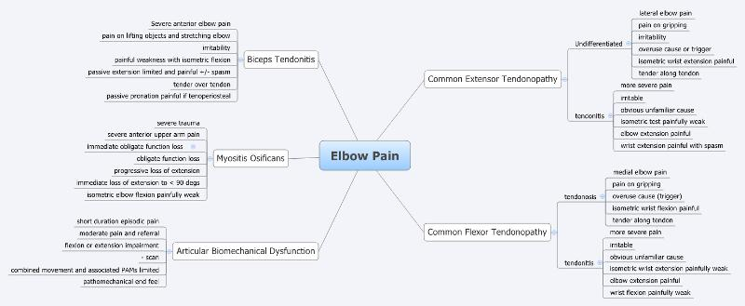
SFHD
Notes:
Here are five EIS forelbow pain.

Slide 41
Script Focused
Hypothetic-deduction
Typically hypothetic-deductive reasoning is done as part of the general subjective and objective examinations where the relevant information is picked from the total. This is why it can be overwhelming
SFHD minimizes incoming information by asking only questions and doing only tests on the Essential Illness script for H1
So typically only the three or four questions from the EIS are asked
Notes:
SFHD uses the EIS to focus on the hypothesis so that there is no distraction from extraneous questions. It is crucial that Conservatism bias does not occur and the therapist is very open to changing the hypothesis when the assessment information generates a better fit.

Slide 42
SFHD
If H1 is supported from the subjective exam then only the tests making up the illness script are initially carried out
If H1 is refuted then the most likely hypothesis generated from this information becomes H2 and its illness script is used
This process is repeated until the final hypothesis is successfully tested and becomes the diagnosis
If no diagnosis can be made a full examination is carried out but you’re probably screwed at this point as far as SFHD is concerned
Notes:
Often only one hypothesis is required but the more times you test a different hypothesis the more likely the final diagnosis will be correct. If you ask questions that are extra to the EIS then there is no point in making an EIS and you are using or rather misusing hypothetic deduction.

Slide 43
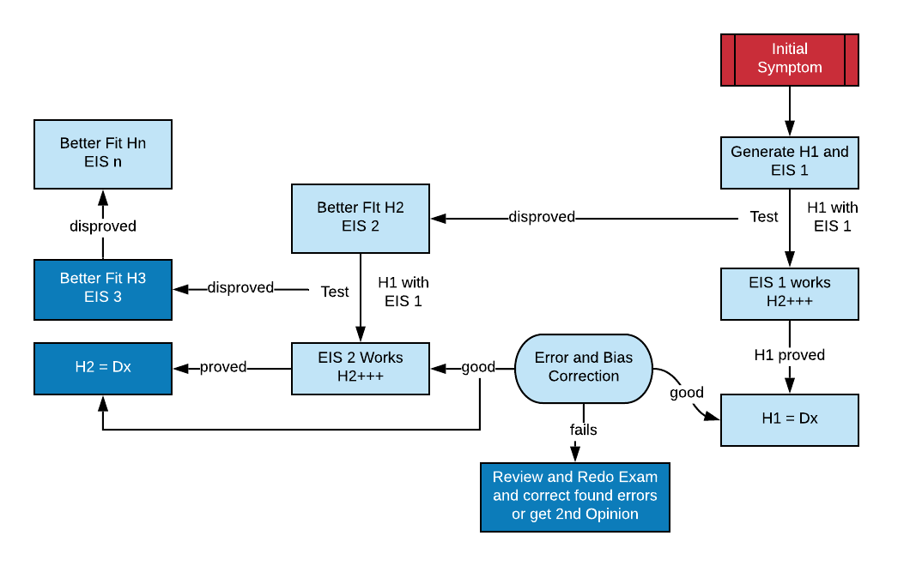
SFHD Process
Notes:
The initial symptom must, if possible, generate H1, do not wait until you think you have enough to be sure, the testing of the hypothesis will bring about sureness or doubt. Once H1 is present formulate the EIS and only test H1 from it. If once you have exhausted the EIS to your satisfaction then test H1 with bias correction, particularly DDx and if this is good you have the working diagnosis. If EIS 1 finds a better fitting hypothesis shift immediately to H2 and test it with EIS 2. This process continues until you have either proved Hn or failed to make a diagnosis with this method. Failure may mean errors in the EIS or bias or it may mean that the diagnosis is not amenable to this method. Such things as two or more conditions or atypical presentations causing the symptoms

Slide 44
The initial symptom must, if possible, generate H1, do not wait until you think you have enough to be sure, the testing of the hypothesis will bring about sureness or doubt. Once H1 is present formulate the EIS and only test H1 from it. If once you have exhausted the EIS to your satisfaction then test H1 with bias correction, particularly DDx and if this is good you have the working diagnosis. If EIS 1 finds a better fitting hypothesis shift immediately to H2 and test it with EIS 2. This process continues until you have either proved Hn or failed to make a diagnosis with this method. Failure may mean errors in the EIS or bias or it may mean that the diagnosis is not amenable to this method. Such things as two or more conditions or atypical presentations causing the symptoms

Slide 45
SFHD
EIS + Hypothetic-deduction = A Thin Slice
Notes:
Using this method mimics pattern recognition but you have to make the initial hypothesis immediately and you must be prepared to change the hypothesis as required by the questions generating a better fitting hypothesis.

Slide 46
Bias and Error Reduction
SFHD
Distraction error is automatically eliminated by asking all questions and doing all tests from the EIS only.
Diagnostic anchoring can be reduced or eliminated by asking a question or doing a test, which if positive disproves the hypothesis
Congruence bias is reduced by testing other possible diagnoses using DDx
Conservatism can only be countered by an act of will on your part.
Notes:
Error and bias exist with this method of reasoning and needs to be dealt with. There are concrete steps you can take for all of these biases except conservatism. This is probably as much a personality thing as anything else but consider that changing hypotheses is not a failure, not doing so is.

Slide 47
SFHD
To avoid premature satisfaction a more complete history is taken, which may also be used to search for etiologies, and the usual differential examination is carried out but after the diagnosis has been made
If the extension of the examination refutes the diagnosis then it should also prove the replacement diagnosis but care must be taken to avoid anchoring bias so some deliberately non-supporting questions and tests are needed
Notes:
Clearly premature satisfaction is a major issue with SFHD in that the assessments are deliberately curtailed. To overcome this issue you can do a complete examination but only after the diagnosis is made and not before.

Slide 48
SFHD
Notes:
From the EIS no more four questions and two tests focused on the EIS are carried out and often no iteration is necessary as this will generate a provisional diagnosis. This provisional diagnosis is subjected to bias correction with DDx and a full examination and if this doesn’t change things then the provisional becomes the final working diagnosis.

Slide 49
SFHD
Notes:
On the occasions where H1 fails, H2 is generated from the questions and tests already used and further examination that is based on the EIS for H2 carried out. If this works fine, if not then H3 to Hn are tested.

Slide 50
Eg. Lateral Elbow Pain
SFHD
The patient reports isolated pain on the lateral side of the elbow
The therapist considers the tissues underlying the pain and the likelihood of each condition that can give such pain
Statistically the most likely condition is common extensor tendonopathy and this becomes H1
The Essential Illness Script for tennis elbow is accessed and the questions drawn from this; for example does using the hand or elbow cause the greatest pain
Notes:
This is an example of using SFHD on lateral elbow pain.

Slide 51
SFHD
H1 Proven
If the answer is gripping activities then H1 is strengthened and the next question from the EIS is asked the answer to which will either strengthen or weaken H1.
If after asking all of the questions on the EIS, H1 is still strongly believed then the specific objective tests can be done, this includes isometric wrist extension and palpation along the tendon
If these two tests are positive then the EIS becomes the diagnosis
Notes:
This is where H1 is found to be the diagnosis.

Slide 52
SFHD
H1 is Disproven
If H1 is weakned by say pain on elbow movement rather than hand function then H2 may be articular dysfunction
The EssentiaI Illness script for articular dysfunction is accessed and questions from it asked
Notes:
H1 is not the diagnosis

Slide 53
SFHD
Questions can now be asked and tests done to determine tendonosis vs. tendonitis, etiology and predispositions, the more complicated aspects of tennis elbow
Once all of these are known a reasonable and individualized treatment plan can be implemented based on the diagnosis rather than on an often naïve, simplistic and imprecise classification system
Notes:
A problem that commonly arises is that the therapist will want to ask questions about etiology, predispositions, return activities and other things extraneous to the diagnosis. These questions distract from the task at hand, making the diagnosis, and in the case of etiology make no sense. How can you ask about what’s causing the tennis elbow if you do not know at the time that the patient has a tennis elbow. As about them once the diagnosis is made. FOCUS.

Slide 54
SFHD
If H2 is supported those objective tests from its EIS, such as quadrant tests or the full biomechanical exam of the elbow
If H1, tendonopathy, is upheld by the subjective and objective tests then lack of tenderness over the tendon would be the disproving test
Questions can be asked and tests done to determine tendonosis vs. tendonitis, etiology and predispositions including:
Notes:
After the diagnosis is made then you can test to stage the tendonopathy, itis or osis, the biomechanics if appropriate, etc. There is no point in looking at the biomechanics for example is you do not know there is a biomechanical dysfunction present.

Slide 55
SFHD
The neck and the rest of the upper limb can now be scanned and screened to see if there are any predisposing or etiological factors present
In short more time can be spent on the more complex aspects of the problem (level of inflammation, etiology and contributing remote pathologies etc.) when less time has to be spent on the diagnosis

Slide 56
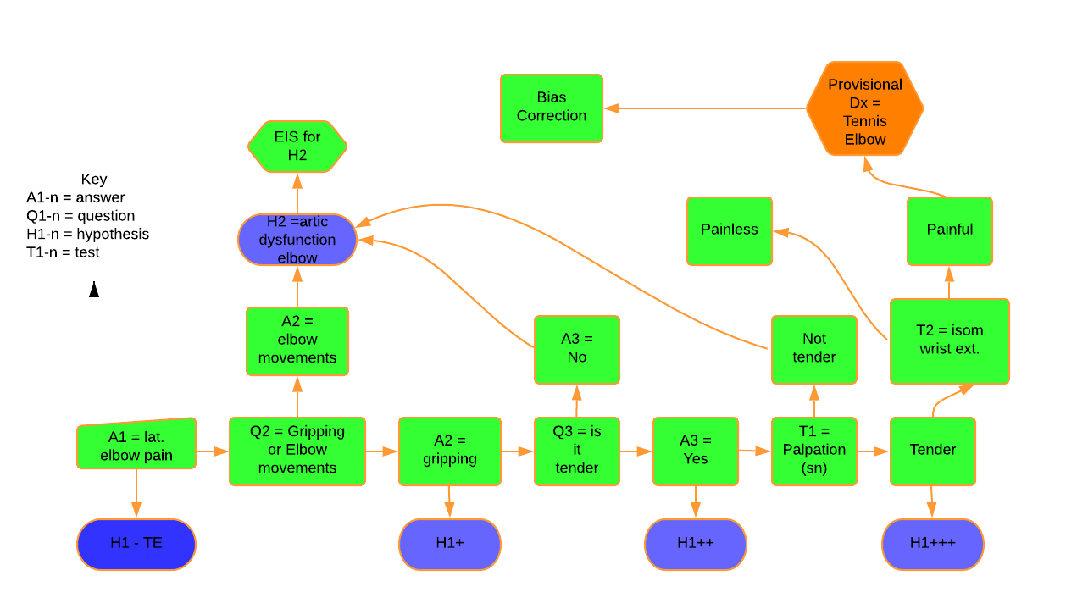
SFHD
Notes:
Starting with the answer to the question (Q1) what’s your problem the patient’s answer (A1) is pain over the lateral elbow. H1 is naturally tennis elbow so questions from the EIS Q2, and 3 are answered appropriately along the bottom row all strengthening H1. These lead to the first test T1 which leads to the second, and if appropriately positive leads to the provisional diagnosis of tennis elbow and then bias correction. When Q2 or 3 get inappropriate responses then H2, in this case articular dysfunction is generated and the process continues using the EIS for articular dysfunction. As can be seen the more hypotheses that are generated the more focused information is generated and the more likely the final diagnosis is to be correct.

Slide 57
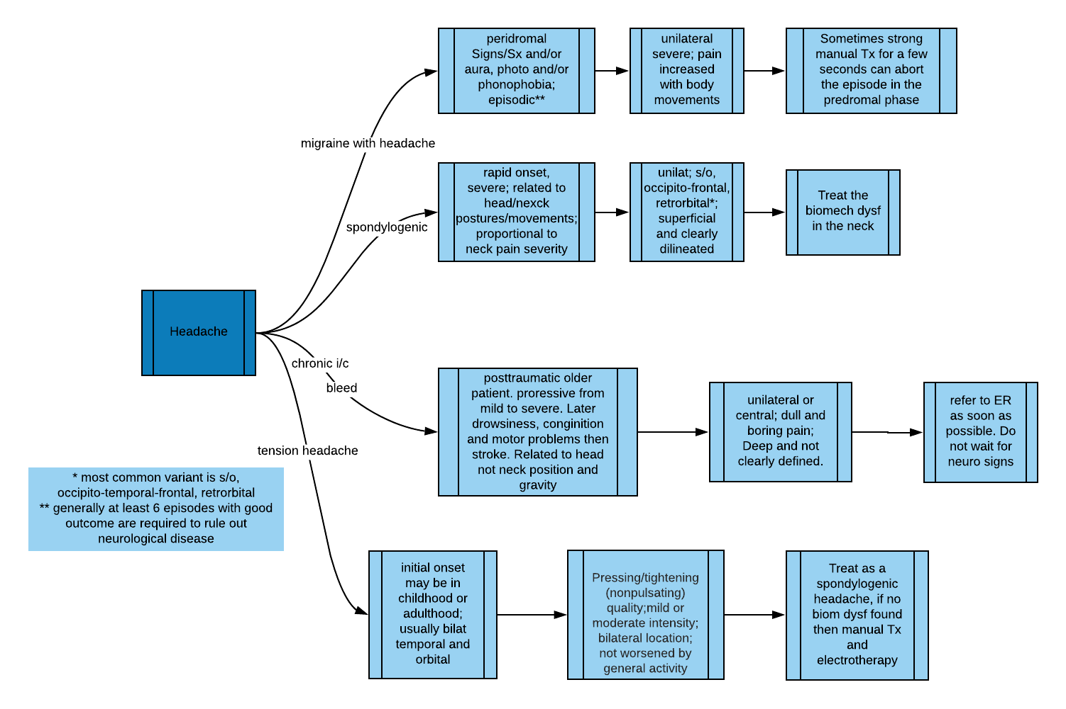
SFHD of Selected Headaches
Notes:
Follow the lines to each of the four types of headache SFHD.

Slide 58
Strengths and Weakness
SFHD
It is simple and easy to understand
It reduces the noise and improves the signal coming from the patient and so minimizes the potential for the clinician to become confused
There is a tendency to not change the H when required as this is seen as failure, but ex deficio, eruditio (but from a failure, well taught), and this is not failure anyway
Notes:
Everything is more authoritative if you add a Latin tag.

Slide 59
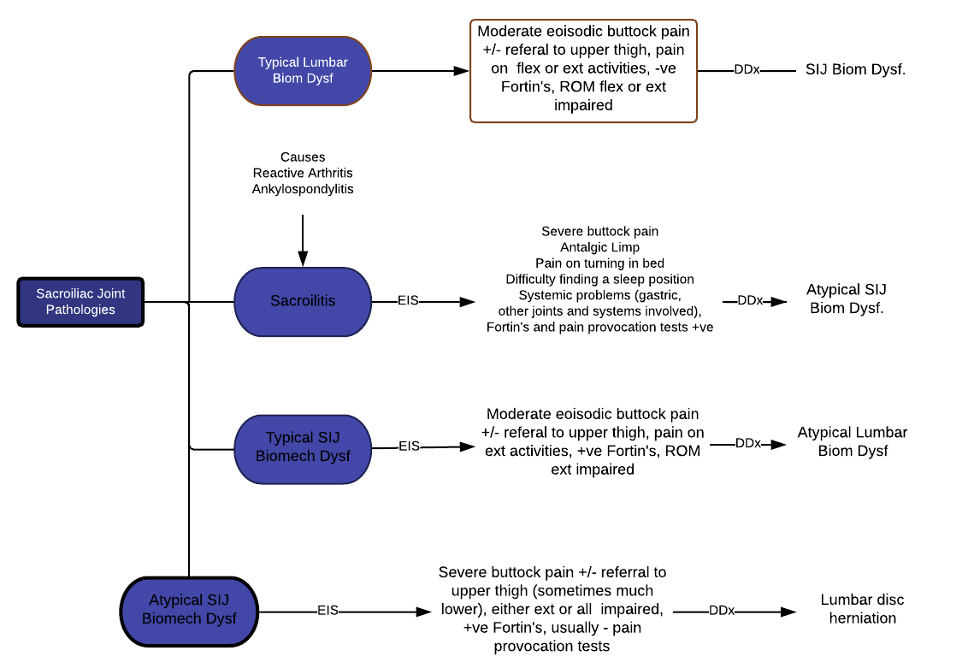
Buttock Pain

Slide 60
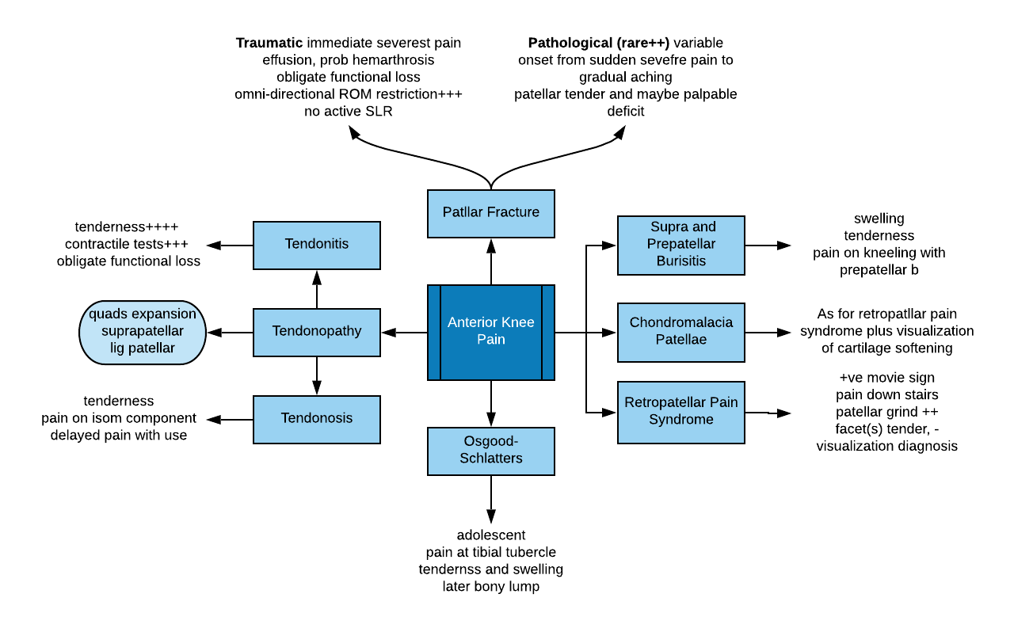
Knee Pain

Slide 61
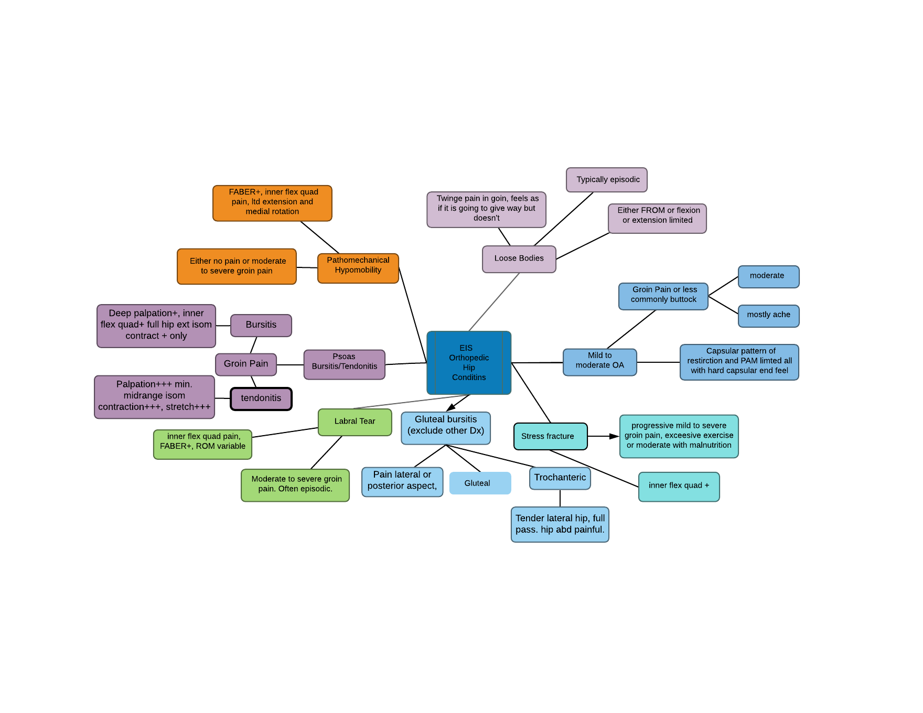
Hip Pain

Slide 63
Strengths and Weakness
SFHD
It does not work well with atypical variants or where two different pathologies are generating symptoms
It is not as efficient nor as accurate as pattern recognition in the hands of an expert
Notes:
Atypical variants and multiple pathologies take more experience and skill than does the more simple conditions. The expectation is that as your experience progresses your ability to assess and your knowledge of more complex conditions will improve and increase.

Slide 64
SFHD
Summary
The uncomplicated diagnosis should be easily available to non-experts and not a struggle
It mimics what experts do with pattern recognition, that is ask a few supporting questions and do a few tests, without the experience of expertise being required
But by completing all aspects of the examination after the diagnosis has been made it reduces bias and error
Notes:
Technique is easy, it’s just a motor skill that can be mastered with practice but clinical reasoning is more difficult because you do have to overcome your bias and it is more complex than snapping joints. If you concentrate as much on refining your clinical reasoning abilities as you will learning and practicing techniques you will do well. This entails being skeptical of your results and reflecting on your practice especially your failures. Experience isn’t about how many years you practice it is about learning from you practice and you do this by reflecting about it.

Slide 65
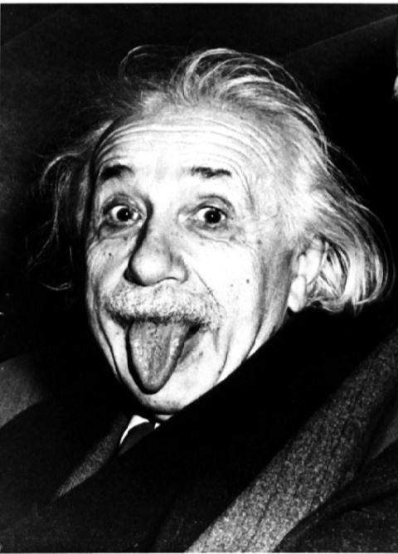
Everything should be as simple as possible but no simpler

