Slide 1
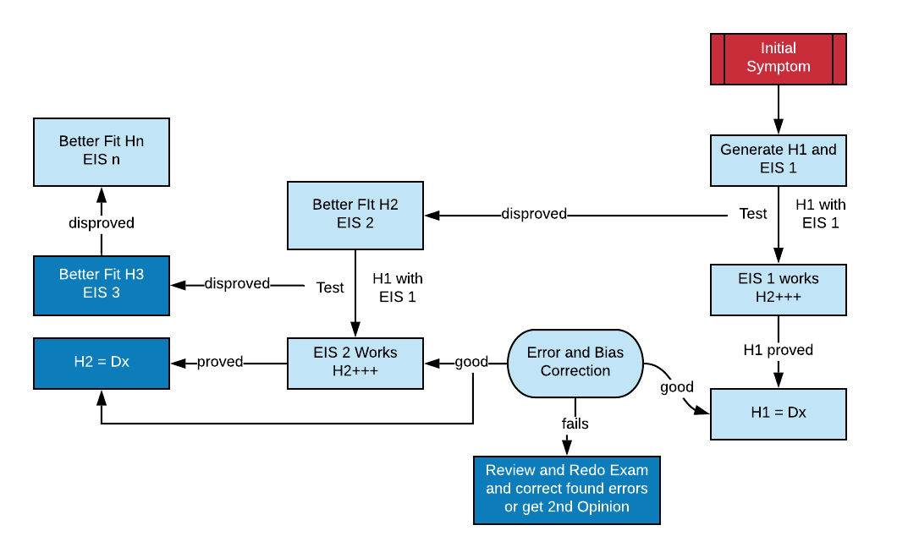
Notes:
General outline of SFHD. Starting with the initial symptom, usually the location of the pain, H1 is generated and the EIS for H1 recalled and used to test H1. If EIS1 fails then H2 is made using the information from EIS1 to make a better fit and this is turn is tested with EIS2. This continues until either a provisional diagnosis is made or this form of reasoning is abandoned for another or a second opinion. The provisional Dx is then subjected to error and bias correction and if this does not prove to be an issue the working diagnosis is made and treatment can be planned.

Slide 2
Notes:
SFHD for lateral elbow pain. Tennis elbow or more precisely common extensor tendonopathy is the obvious H1. The EIS1 is most++ pain on gripping rather than elbow or neck movement, tenderness along the tendon and pain on contractile testing. If H1 is supported with EIS1 thenH1 becomes the provisional diagnosis. Bias and error correction are applied to the diagnosis and if there are no issues then PDx becomes the working Dx.

Slide 3
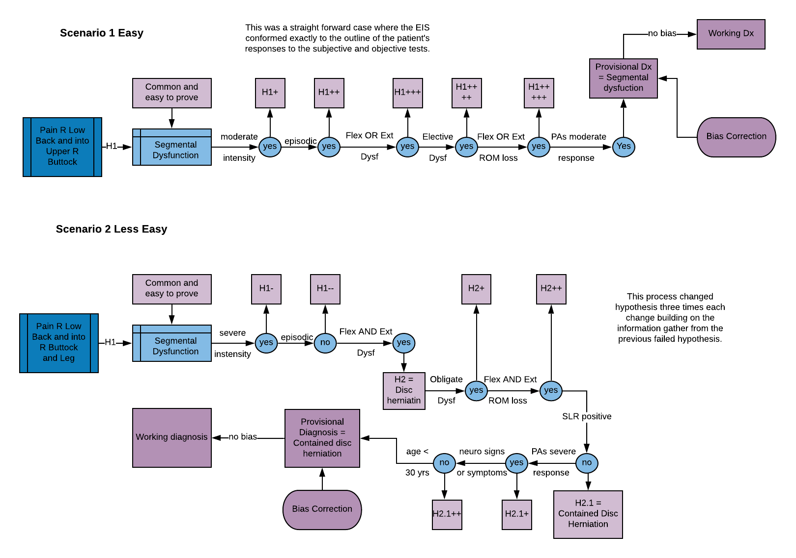
Notes:
Two cases of low back pain with the same presenting symptoms showing how H1 strengthens in case 1 and weakens in case 2.

Slide 4
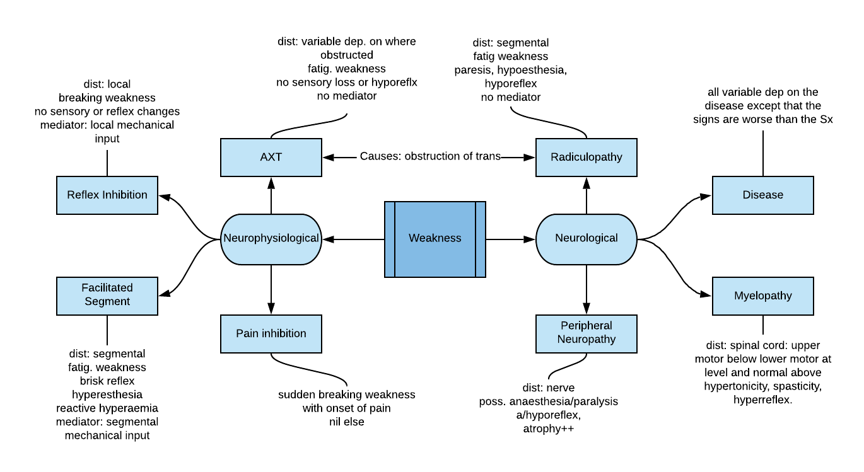
Notes:
EIS for various types of weakness. The main differences are in the distribution, how the weakness shows itself, relationship to other S/Sx, the tone of the muscle and what if anything reduces the weakness.

Slide 5
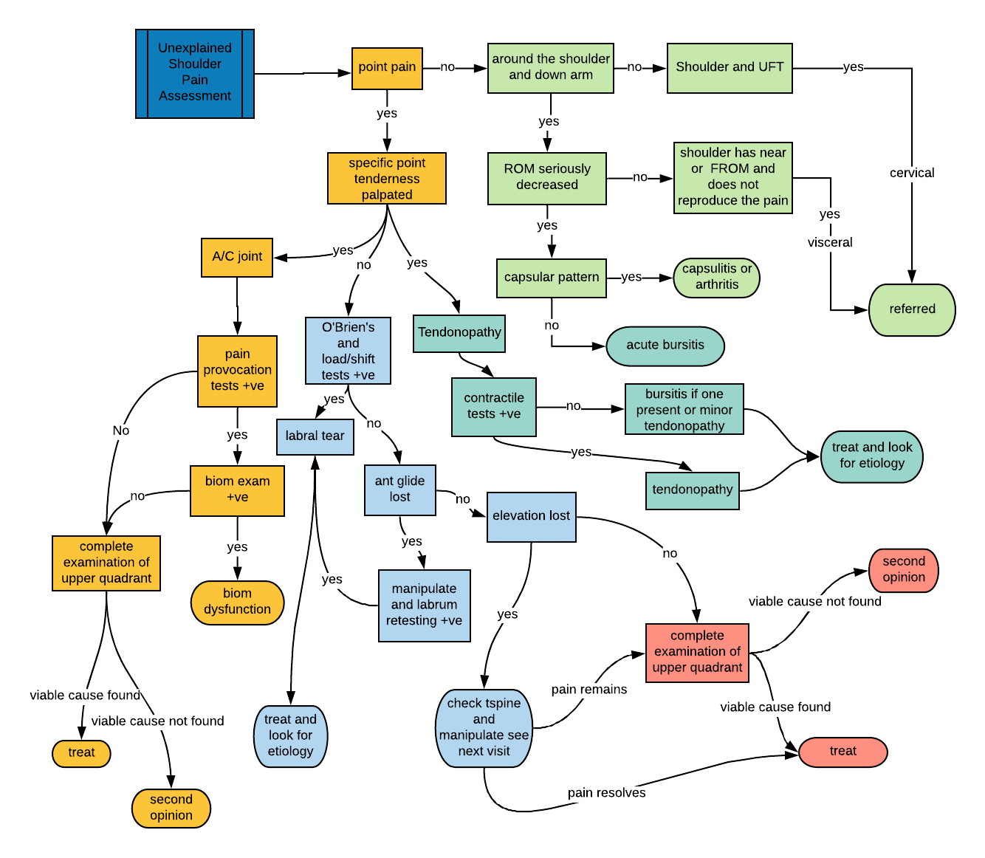
Unexplained Shoulder Pain
Notes:
Process of differentiating various shoulder pain based on a developing algorithm.

Slide 6
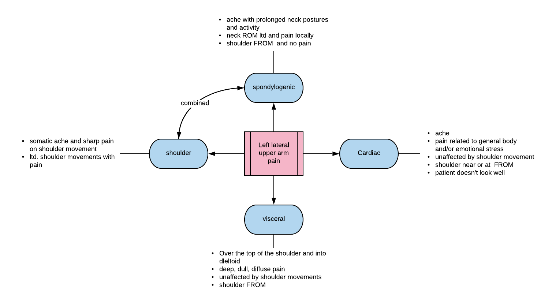
Notes:
Characteristics of selected causes of shoulder and upper arm pain.

Slide 7
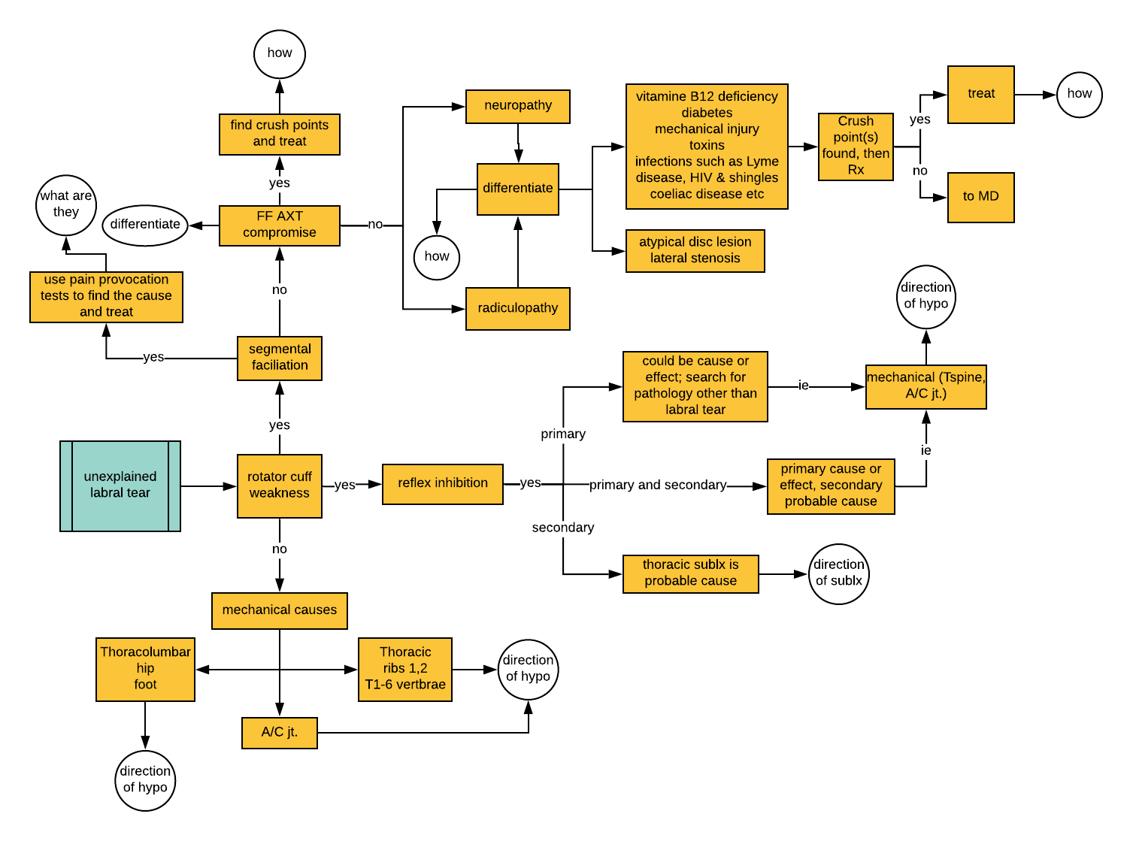
Search for Etiology: Quiz Fill in the White Circles
Notes:
This is a search for the etiology of a non traumatic labral tear. The uncolored circle are questions for you to deal with.

Slide 8
