Slide 1
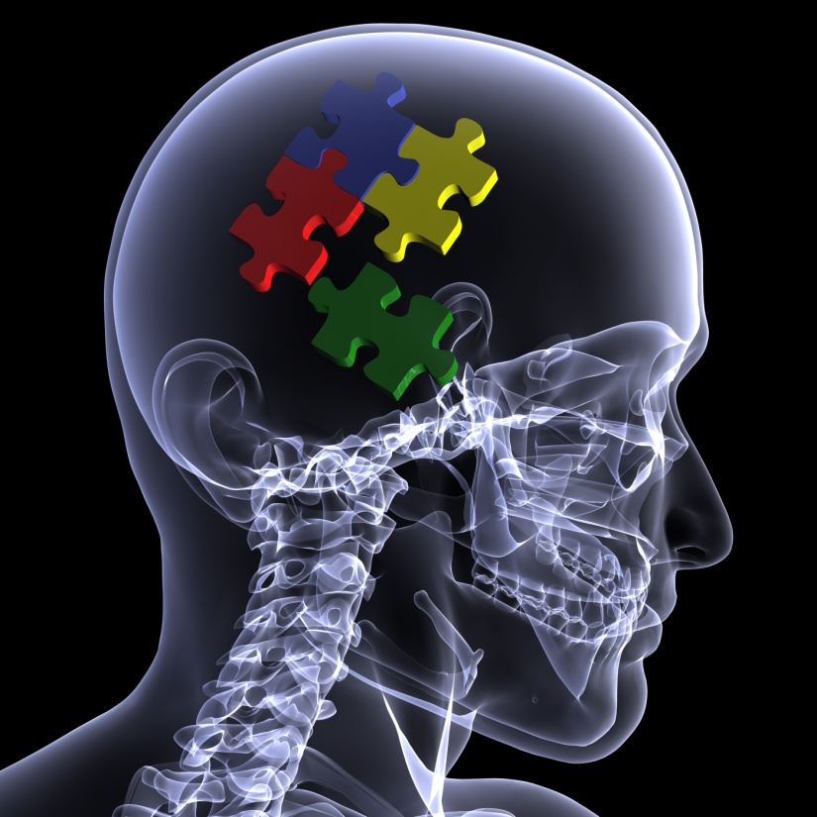
^{SWODEAM INSTITUTE}
Jim Meadows

Slide 2

Vertebrobasilar Pathologies

Slide 3
Anatomy Review
Identify the Marked Structures:
Partial Solution at the End of the Presentation

Slide 4
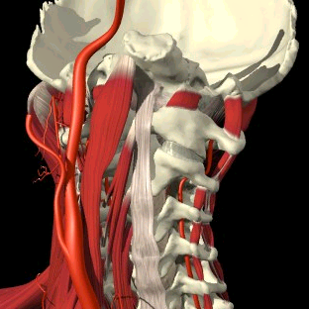

Slide 5
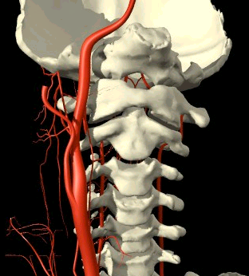

Slide 6
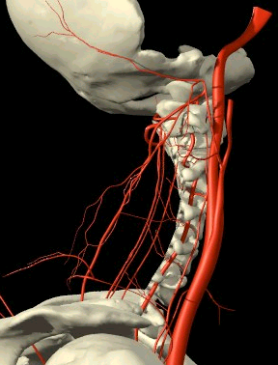

Slide 7
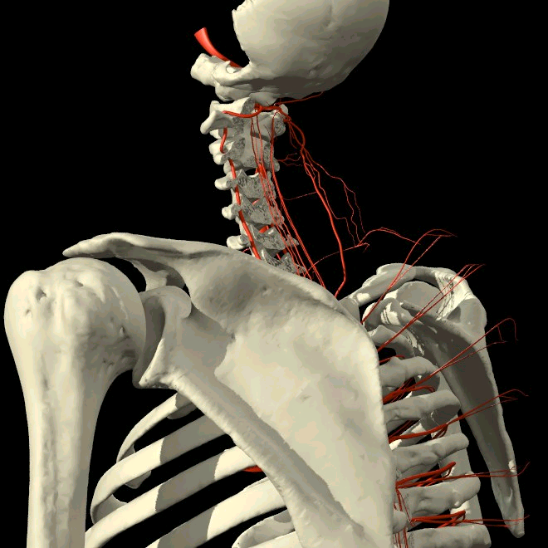

Slide 8
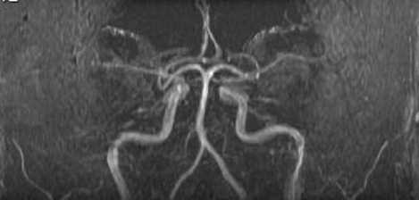

Slide 9
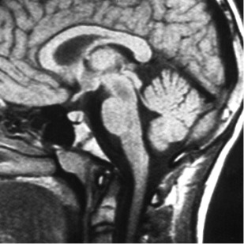

Slide 10
Non-traumatic Pathologies
Athersclerosis
Atheroma
Ostephytic and neoplastic compression
Disc compression
Congenital anomaly (absence, hypoplasia, atresia)
Bow Hunter’s Syndrome (rotational obstruction)
Subclavian steal syndrome

Slide 11
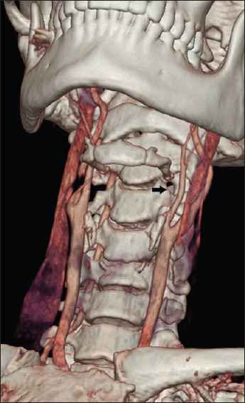
Traumatic VB Injury
Approximately 33-40% of cervical fracture/disclocation patients have a vertebral artery injury
Only about 20% are symptomatic
Symptoms were present when the contralateral supply was deficient (hypoplasia, absence or atresia)

Slide 12
Traumatic Pathologies
Intramural Tears) Media and/or intima tearing
Pseudoanurysm
Dissection/Transection
Arteriovenous fistulae
Thromboembolus
Bruising/ Atheroma
Vasospasm
Collar hematoma

Slide 13
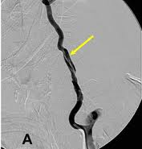
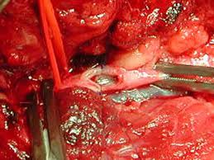
Dissection (intramural tear)
Most common injury Usually caused by stretching the artery as in a flexion injury
to the artery.
Most usually the intima is torn from the media, occasionally the media from the adventitia
Bleeding with hematoma formation occurs producing stenosis with dilation proximal to the block
Usually caused by stretching the artery as in a flexion injury

Slide 14
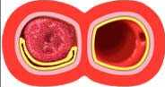
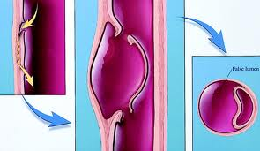
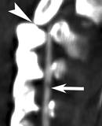
Dissection (intramural tear)
The blood may then run outside of the intima and oxygen cannot be absorbed
The stenosis causes reduced flow distal to the block
Emoblus formation is the worse consequence
A pseudoaneurysm may form
Intimal Flap

Slide 15
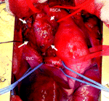
Psuedoaneurysm
When both inner coats tear the adventitia can balloon out
It can stabilize and disappear or rupture
Another form of pseudoaneurysm is what on imaging appears to be an aneurysm but is in fact a coil of an artery behind another

Slide 16
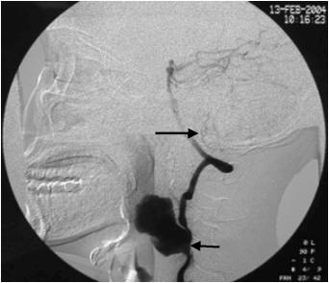
Pseudoaneurysm
A a bleed that is contained by soft tissue is also termed pseudoaneurysm
The pseudoaneurysm may stabilize and heal or may rupture
Intracranially it might cause pressure against an neurological structure

Slide 17
Transection
A tear may occur through the artery rather than along it bleeding will then escape the artery and where it occurs and how much occurs will determine the signs and symptoms

Slide 18
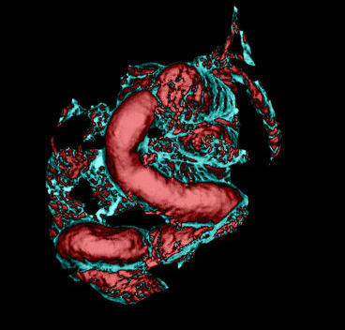
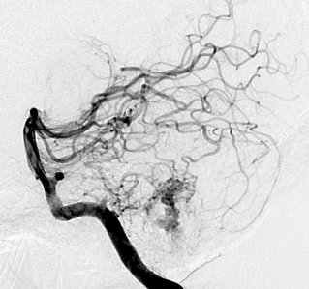
Ateriovenous Fistula
A direct connection between an artery and a vein
They may be spontaneous or traumatic
Effect are due to it being a space occupying lesion and whether it ruptures or not

Slide 19
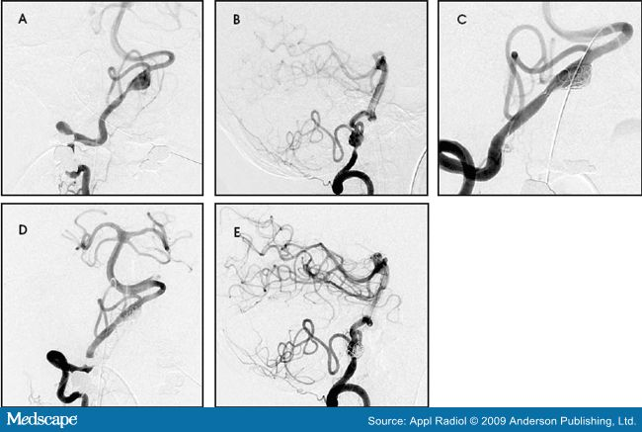
Thromboembolus
The thrombus will form over the injury and may release an embolus either spontaneously or as a result of further stress
The effect will depend on which artery is blocked, the extent of the blockage and any collateral circulation available

Slide 20
Collar Hematoma
The venous plexus and the vertebral artery are torn and the resulting fistula causes engorgement of the veins which constrict the artery

Slide 21
Fracture/Dislocation
Burst fractures, transverse process fractures and facet dislocation, especially unilateral are all frequently (20%) associated with vertebral artery injury
Most of these injuries are asymptomatic
Symptoms occur commonly when there is congenital deficit in the contralateral artery

Slide 22
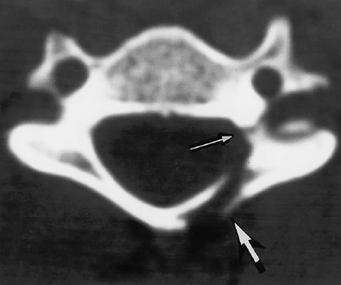
Facet # Extending into the Transverse Canal
86% would have vertebral artery pathology
21% would have signs/symptoms

Slide 23
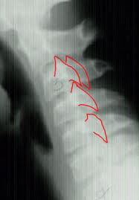
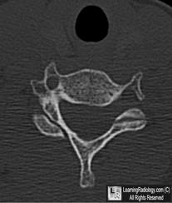
Facet Dislocation

Slide 24
Vasospasm
Most likely to be caused either in isolation or accompanying minor reversible injuries by compression (extension) rather than distraction (flexion) injuries

Slide 25
I Carotid
E Carotid
Com Carotid
Long Colli
Long Capitus
V2
V3
Rect Cap Lat
Rect Cap Ant
Ant Long Lig
C1/2 capsule
A/C joint
Ant Spinal a
Occipital a

Slide 26
I Carotid
E Carotid
Long Colli
Long Capitus
V2
V3
Rect Cap Lat
Rect Cap Ant
Ant Long Lig
C1/2 capsule
A/C joint
Ant Spinal a
Occipital a

Slide 27
I Carotid
E Carotid
Long Colli
Long Capitus
V2
V3
Rect Cap Lat
Rect Cap Ant
Ant Long Lig
C1/2 capsule
A/C joint
Ant Spinal A
Occiipital

Slide 28
I Carotid
E Carotid
Long Colli
Long Capitus
V2
V3
Rect Cap Lat
Rect Cap Ant
Ant Long Lig
C1/2 capsule
A/C joint
Basilar a
Post cerebral

Slide 29
I Carotid
E Carotid
Long Colli
Long Capitus
V2
V3
Rect Cap Lat
Rect Cap Ant
Ant Long Lig
C1/2 capsule
A/C joint
Basilar a
Post cerebral

Slide 30
Foramen magnum
Dens
Midbrain
Cerebellum
Broca’s area
Pons
Medulla
Spinal cord
C2/3 disc
Ligamentum nuchae
Visual cortex

Slide 31
